Slide 1
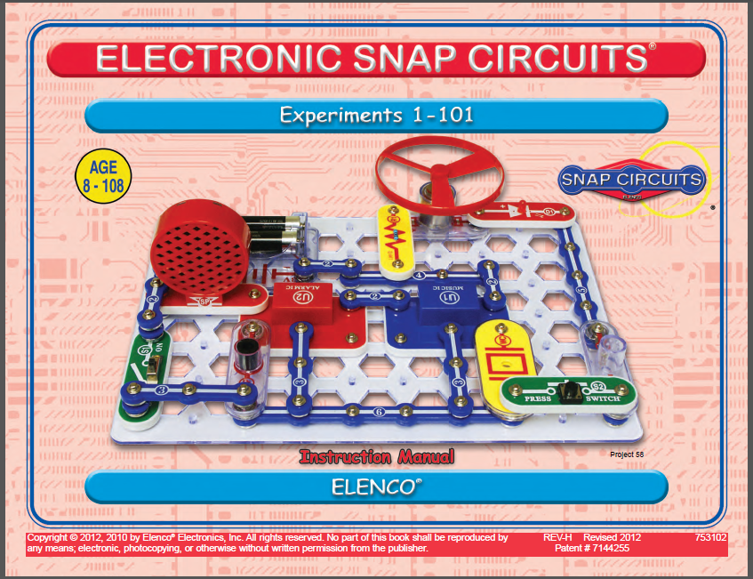
電子電路工程師培訓
- 3小時 精選課程適用
國立清華大學教務處跨領域科教中心兼教學推廣中心
戴明鳳教授 /助理許乃今 2016.07.27 修
檔案連結網址 https://drive.google.com/open?id=0B4bNyMQ3x7awaDF4UDMtSWJLaEU

Slide 2
電學動手篇：生活中實用之聲、光、力學式控制電路實驗DIY與其探究
運用美商開發的鈕扣式電路(snap circuit)元件套件組探究基本且有趣的基本電子電路。
此套件內所有的零件經過精心設計，不需要任何焊接或額外工具輔助，只要像扣鈕扣一樣將各種零件扣組在一起，即可完成電路組裝。
可組接達100多組以上於生活中實用、有趣、簡單易學且具親和力的電子電路，使能深入淺出地理解生活中實用的基本電子及電路知識。
經由講員精彩的演講和彩色的電路圖示，就可以自己組裝完成各式實用且有趣的應用電路，並熟悉電子電路的工作原理和效用，如各種不同控制方式的音樂播放、防盜和滿水警報器、門鈴等多種生活中實用的電路裝置。甚至還可以跟朋友一起設計並進行一些有趣的電子遊戲。
善用此研習與電子積木套件組，可讓原對電子電路完全沒有概念的K12師生或甚至成年人都可以透過自己動手做組裝的過程，學習各種基本電子零件和簡單電路的特性與功能。
⇨您也可以成為電子電路的科學與技術達人喔！

Slide 3
SC-100 英文實驗教材
http://www.elenco.com/admin_data/pdffiles/SC-100_REV-H11.pdf

Slide 4
零件收存配置圖 SC-100 Snap Circuits® Block Layout

Slide 5
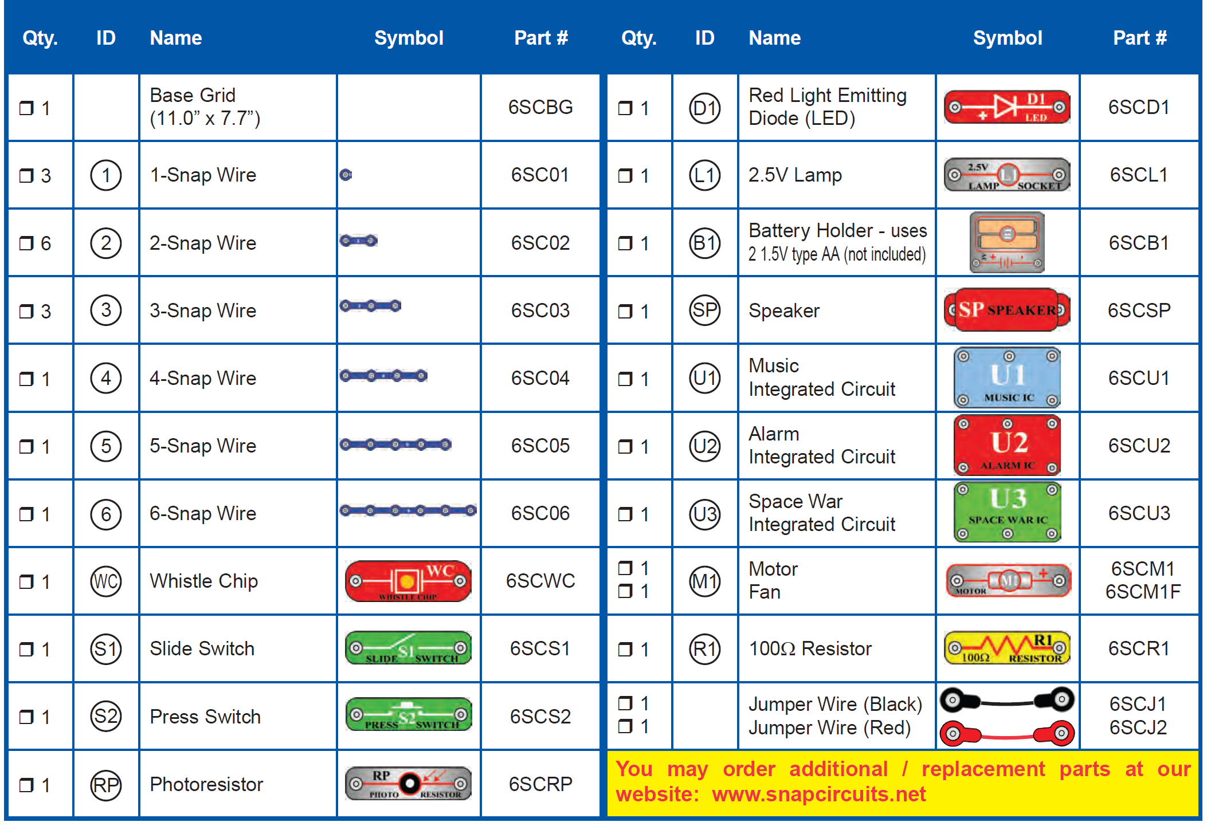
SC-100 電子元件清單：元件符號＆零件編號

Slide 6
SC-100 電子元件清單：元件符號＆零件編號
4種不同機制、不同用途與功能的切換開關

Slide 7
SC-100 電子元件清單：元件符號＆零件編號
Speaker + 3種不同組合、不同用途與功能的聲音產生IC模組

Slide 8
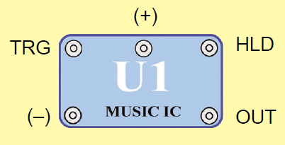
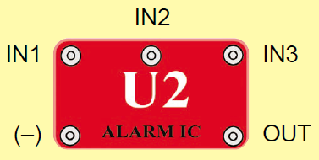
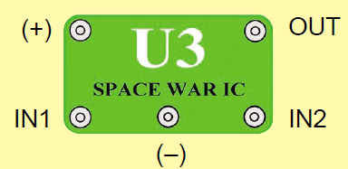
聲音產生積體電路套件U1, U2, U3各接點用途
(+) : 連接電池之正極
(–) : 連接電池之負極
OUT : 輸出端
HLD : 持續式控制輸入端
TRG : 觸發式控制輸入端
IN1, IN2, IN3 : 控制輸入端
(–) : 連接電池之負極
OUT : 輸出端
(+) : 連接電池之正極
(–) : 連接電池之負極
OUT : 輸出端
IN1, IN2 : 控制輸入端
U2
IN2 ：警車
IN2 & IN1 ：消防車
IN2 & [ IN1 + (-) ] ：救護車
------------------------------------------------------
IN3 ：槍聲(電玩飛行戰鬥機,低音)
IN3 & IN2 ：槍聲(電玩飛行戰鬥機,高音)
IN3 & IN1 ：槍聲(電玩機關槍,中音)

Slide 9
U1: Music IC Module
This module contains sound-generation ICs and supporting components.
It can play several musical tunes that are recorded in it.
(+)
(–)
TRG
OUT
HLD
(+) - power from batteries
(–) - power return to batteries
OUT - output connection
HLD - hold control input
TRG - trigger control input
Actual schematic
Having two different control inputs.
The OUT connection pulls current into the module (not out of it), usually from a speaker. This current is adjusted to make the music.
Snap Circuits projects 15 and 16 show how to connect this part and what it can do.
Music for ~20 sec on power-up, then hold HLD to (+) power or touch TRG to (+) power to resume music.

Slide 10
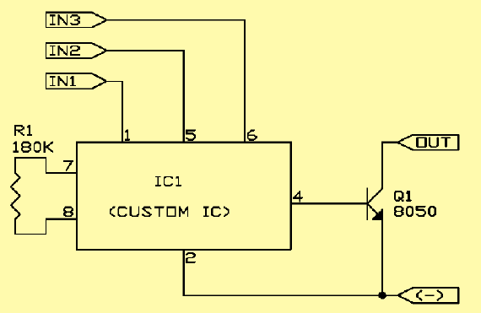
U2: Alarm IC Module-make several siren sounds
IN1
IN2
IN3
OUT
IN1, IN2, IN3 - control inputs
(–) - power return to batteries
OUT - output connection
(–)
This module has three control inputs, and can make 5 siren sounds.
Connect control inputs to (+) power to make 5 alarm sounds.
The OUT connection pulls current into the module (not out of it), usually from a speaker. This current is adjusted to make the siren sounds.
Snap Circuits project 17 shows a simple way to connect this part, and projects 113-117 show the connections needed to make the five possible sounds.

Slide 11
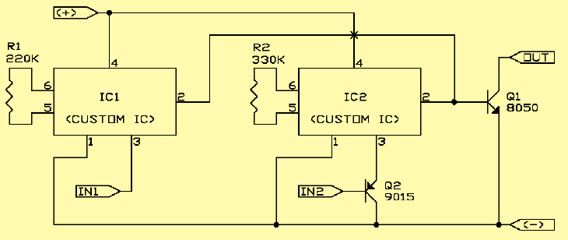
U3: Space War Sound IC Module-
The module contains sound-generation ICs and supporting components. It can make several siren sounds.
(+) - power from batteries
(–) - power return to batteries
OUT - output connection
IN1, IN2 - control inputs
Actual schematic
This module has two control inputs that can be stepped through 8 sounds.
The OUT connection pulls current into the module (not out of it), usually from a speaker. This current is adjusted to make the space war sounds.
Snap Circuits project 19 shows how to connect this part and what it can do.
Connect each control input to (–) power to sequence through 8 sounds

Slide 12
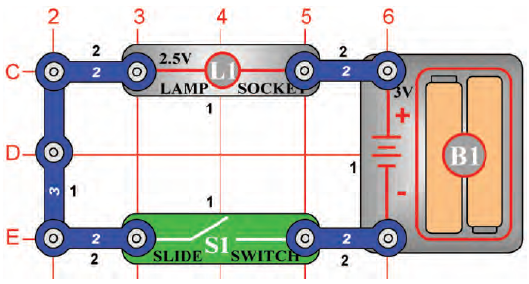
操作
說明
A. 白色數字 1, 2, 3
- 表snap wire 上的鈕釦數
  2 為有 2 鈕釦點的藍色連接導線
  3 為有3個鈕釦點的連接導線
B. 黑色數字1, 2, 3：代表層別.
  1 為平面結構第一層
  2 為平面結構第二層
  (建議先將第一層結構的元件安裝於板子上後，再進行第二層結構的建置。)

Slide 13
Electric Light & Switch- Electricity is turned ON or OFF with a switch. 利用滑動開關控制電燈的開啟與關閉。
建議將L1與S1改建置於第二層,方便後續實驗.
→2
不可使用S2按鍵開關喔!!!
→2
Closed circuit (閉路)：當滑動開關S1關閉時(即為切換到ON)，則電路導通，電燈L1亮起。
Open circuit (開路)：當滑動開關閥S1打開時(即切換到OFF)，則電路不導通，電燈L1熄滅.

Slide 14
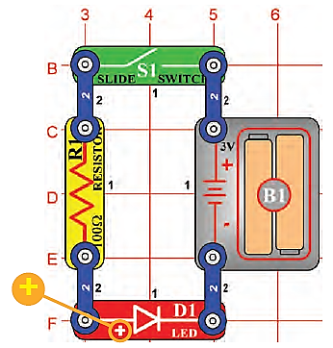
(7) Light Emitting Diode
To show how a resistor and LED are wired to emit light.
如何串接電阻與LED，使LED發光。
建議將D1與S1改建置於第二層，方便後續實驗。
將S1切換到ON，電流先流經電阻再經過LED，電阻可限制電流，保護LED。
避免將LED直接跨接電池。
沒有電阻保護時，大電流將可能燒毀LED內的半導體發光元件。
LED被廣泛應用在需要給使用者訊息或指示的各種電子儀器上。
想想你每天會使用到什麼東西是有LED在裡面的？
→2
→2

Slide 15
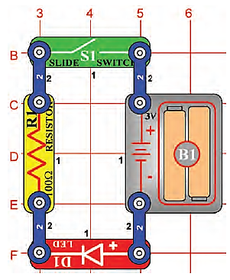
(8) One Direction for LED
To show how electricity can only pass in one direction through an LED.
電流只能單一方向流經LED元件
延續實驗(7)，請將D1反向連接。
因LED具有電流單一方向流經的特性，故此電路的LED不會亮起。
在此電路，LED反向放置並不會受損，因為電壓不夠大到破壞此電子元件。

Slide 16
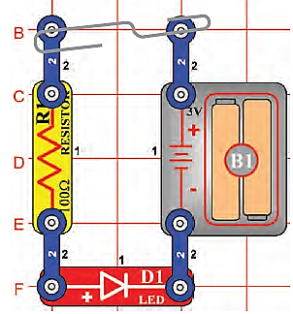
(9) Conduction Detector
To make a circuit that detects the conduction of electricity in different materials.
建立一電路，可檢測不同物品的導電性。
延續實驗(7)，移除S1，改利用金屬迴紋針連接，LED依舊可發亮。
再移除金屬迴紋針，改用手指連接兩端，LED將不會發亮。因為人體電阻太大，導致電流不夠使LED發亮。
假如電壓提高，電流足夠流過人體手指與LED，則LED將會發亮。
此電路可檢測待測物是否為良好的導電體。(例如塑膠材料等)

Slide 17
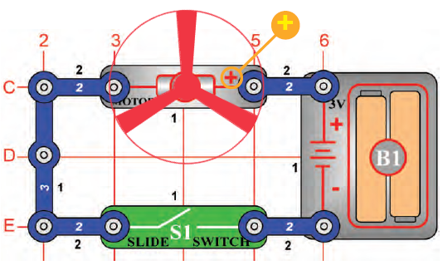
(2) DC Motor & Switch
to show how electricity is used to run a Direct Current(DC) Motor.
如何運轉直流馬達
電能轉成動能
建議將M1與S1改建置於第二層，方便後續實驗。
→2
→2
當開關閥S1關閉時(切換到ON)，電路導通，直流馬達M1啟動，並推動風扇旋轉。
直流馬達被使用在電池裝置時，主要應用在具旋轉動機的裝備，例如電動牙刷或是玩具車。
電子馬達比起汽油柴油引擎來的簡易控制。

Slide 18
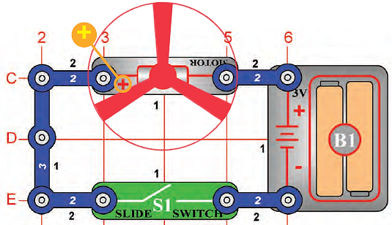
(11) Flying Saucer
延續實驗(2)，但將馬達反向安裝，馬達的(+)極連接電池的(-)極。
S1切換到ON，馬達將慢慢增加轉速。
當馬達達到最高轉速後，關閉電源S1:OFF，風扇將會像飛碟一樣升起浮在空中。
注意不要於直視風扇上頭，避免風扇飛起傷及臉部。
馬達風扇轉動將風往下吹，馬達停止運轉時，因為風扇葉片未被鎖住於馬達軸上，因此風扇葉片將會被空氣風壓反向推起而飛離馬達軸。
但假如馬達運轉過慢，則此飛碟現象將不會出現。可換新電池，或是等馬達轉速達到最大值時，再實驗。
To make a circuit that launches the fan blade to simulate a flying saucer.
像飛碟一樣飛起的風扇

Slide 19
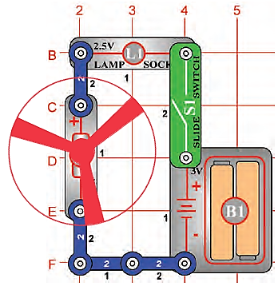
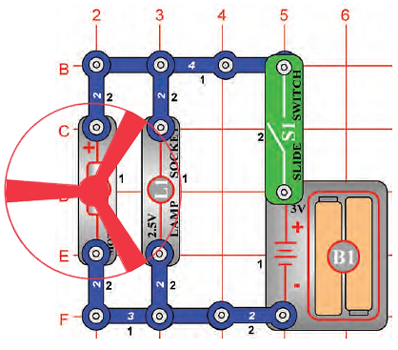
(5) Lamp & Fan
in Series
(6) Lamp & Fan
in Parallel
串聯電燈與風扇
移除風扇葉片後，
留意電燈將熄滅。
並聯電燈與風扇
電燈不會影響流經馬達的電流

Slide 20
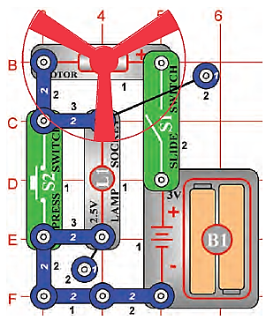
(13) Two-Speed Fan
To show how switches can increase or decrease the speed of an electric fan.
設計如何改變風扇速度
開啟電源S1:ON，電流流經S1、M1、L1再回到電池。此時風扇與電燈都會作動。
當按壓S2時(S2電阻遠小於L1)，電流將改流經S2，此時L1呈現短路不會亮燈，且馬達風扇轉速變快。
商業型風扇不會使用增加電阻方式來調變風量，因為電阻會產生熱。會使用變壓器或其他電子裝置來改變風扇跨壓使風量可調。

Slide 21
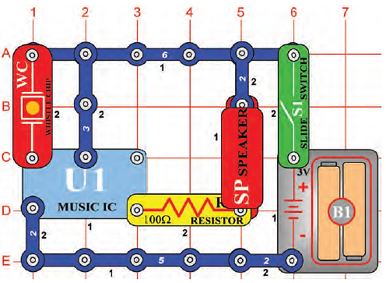


(4) Adjusting Sound Level
利用電阻降低喇叭音量
(+) : 連接電池之正極
(–) : 連接電池之負極
OUT : 輸出端
HLD : 持續式控制輸入端
TRG : 觸發式控制輸入端
利用電阻降低流經喇叭的電流，可降低喇叭的輸出音量。
當S1切換到ON，喇叭SP將有短暫的聲響，隨之停止。

Slide 22

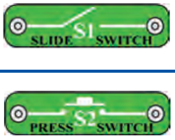


(4a) 不同功能的開關
與控制音樂IC的搭配性
這些開關分別適合放在哪些位置
TRG？ 或 HLD？
？
？
(+) : 連接電池之正極
(–) : 連接電池之負極
OUT : 輸出端
HLD : 持續式控制輸入端
TRG : 觸發式控制輸入端
當聲音停止後，輕敲口哨晶片WC，或在
口哨晶片旁拍手，喇叭SP將再次發出短暫的聲響並隨之停止。

Slide 23
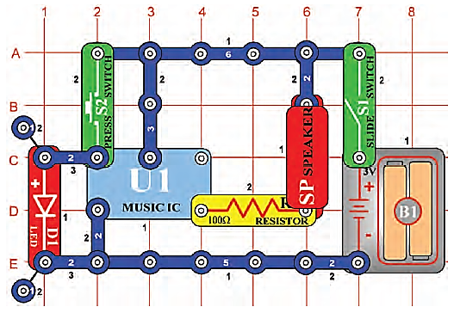
(15) Musical Doorbell
S1切換到ON，警報聲響一周期後停止。
再按壓S2一下，可使警報聲再次聲響一周期後停止.。
即使一直按住S2也一樣聲響一周期後停止。
S2按鍵就像門鈴按鈕一樣。
音樂IC也會被使用在安撫嬰幼兒上，例如玩具或椅子上。甚至將音樂改成文字輸出，還可以讓小孩學習。
To show how an integrated circuit can be used as a musical doorbell.
音樂IC應用於門鈴

Slide 24
U1: Music IC Module
This module contains sound-generation ICs and supporting components.
It can play several musical tunes that are recorded in it.
(+)
(–)
TRG
OUT
HLD
(+) - power from batteries
(–) - power return to batteries
OUT - output connection
HLD - hold control input
TRG - trigger control input
Actual schematic
Having two different control inputs.
The OUT connection pulls current into the module (not out of it), usually from a speaker. This current is adjusted to make the music.
Snap Circuits projects 15 and 16 show how to connect this part and what it can do.
Music for ~20 sec on power-up, then hold HLD to (+) power or touch TRG to (+) power to resume music.

Slide 25
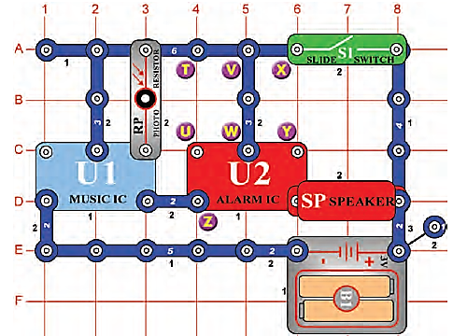
(27) More Sound Effects
To build a police siren and other sounds.
警報器建立
S1切換到ON，警報聲響一周期後停止。
按下S2可使警報聲再次作動，且持續按住才有聲響。
U1的音樂聲，將伴隨著U2的警報聲一同發出。

Slide 26
(28) More Sounds
維持VW連線，再額外連接 X & Y。
將有槍聲與音樂聲混和。
(29) More Sounds (II)
維持VW連線，再額外連接 T & U。
將有消防車與音樂聲混和。
(30) More Sounds (III)
維持VW連線，再額外連接 U & Z。
將有救護車與音樂聲混和。
(31) More Sounds (IV)
僅連接 T & U。(VW連線也移除)
將有生日快樂歌與雜音混和。
IN1, IN2, IN3 :
控制輸入端
(–) : 連接電池之負極
OUT : 輸出端
IN2 ：警車
IN2 & IN1 ：消防車
IN2 & [IN1+ (-)] ：救護車
-----------------------------------------------------------
IN3 ：槍聲(戰鬥機,低音)
IN3 & IN2：槍聲(戰鬥機,高音)
IN3 & IN1：槍聲(機關槍,中音)

Slide 27
U2: Alarm IC Module-make several siren sounds
IN1
IN2
IN3
OUT
IN1, IN2, IN3 - control inputs
(–) - power return to batteries
OUT - output connection
(–)
This module has three control inputs, and can make 5 siren sounds.
Connect control inputs to (+) power to make 5 alarm sounds.
The OUT connection pulls current into the module (not out of it), usually from a speaker. This current is adjusted to make the siren sounds.
Snap Circuits project 17 shows a simple way to connect this part, and projects 113-117 show the connections needed to make the five possible sounds.

Slide 28
U3: Space War Sound IC Module-
The module contains sound-generation ICs and supporting components. It can make several siren sounds.
(+) - power from batteries
(–) - power return to batteries
OUT - output connection
IN1, IN2 - control inputs
Actual schematic
This module has two control inputs that can be stepped through 8 sounds.
The OUT connection pulls current into the module (not out of it), usually from a speaker. This current is adjusted to make the space war sounds.
Snap Circuits project 19 shows how to connect this part and what it can do.
Connect each control input to (–) power to sequence through 8 sounds

Slide 29
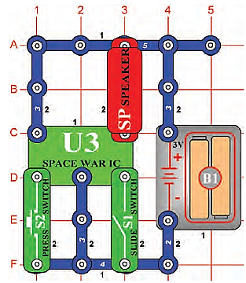
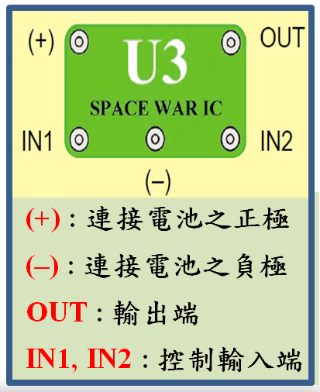
(19) Space War
To introduce you to the space war integrated circuit and the sounds it can make. 介紹U3太空戰IC
(+) : 連接電池之正極
(–) : 連接電池之負極
OUT : 輸出端
IN1, IN2 : 控制輸入端
同時or個別翻轉S1開關與按壓S2開關。
反覆操作，可混和出像太空戰激戰的聲響。
電影工作室，技術人員將槍火聲音精準地配置於影片中。
你也可以試試看物品掉落地上，瞬間撞擊的配音…不容易吧~

Slide 30
(20) Light Switch
(+) : 連接電池正極
(–) : 連接電池負極
OUT : 輸出端
IN1, IN2 : 控制輸入端
To show how light can control a circuit using a photoresistor.
使用光敏電阻元件控制電路
延續(19)，將RP取代S1。
電路立即發出聲響。試著關閉聲音。
會發現只有一種方式可以達到，就是遮蔽RP或是關掉房間電燈使成暗室。
RP照光可以開啟電路聲響，因此可稱之RP為光控開關。
光敏電阻元件內有一種照到光會降低本身電阻值的元件物。
應用於街燈自動開關。 傍晚天暗時，街燈將亮起。早晨天亮時，街燈將熄滅。

Slide 31

(21) Paper Space War
To give a more dramatic demonstration of using the photoresistor.
使用光敏電阻元件,產生更多戲劇性的示範.
同(20)電路, 拿張白紙繪製不同大小黑色塊狀.
將其放至於RP上方慢慢移動.
紙張上黑白變化,控制RP受光與否,可聽到聲音因而改變.

Slide 32
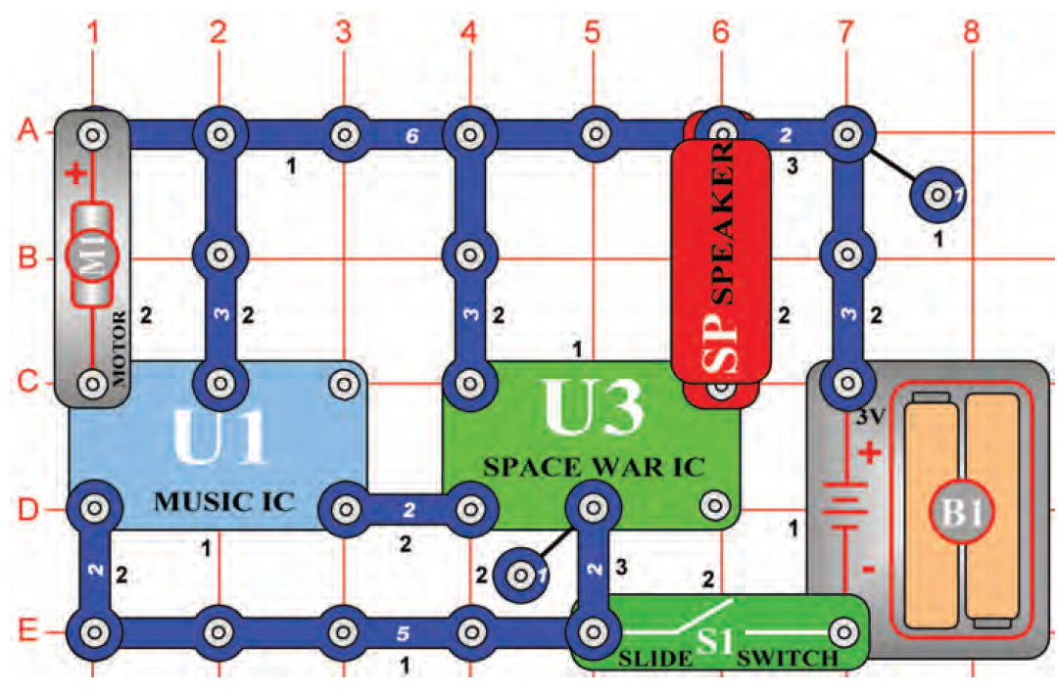
(34) Motor Space Sounds
To build a circuit that uses a motor to activate space war sounds.
利用馬達觸發太空戰聲響
S1切換到ON，聲響一周期後停止。
聲響停止後，試著轉動M1，聲音將會再次作響。
你知道為什麼轉動馬達會讓聲響再次作動嗎？
事實上，DC馬達也是直流產生器，當你轉動馬達時，會產生電壓觸發U1聲音IC。
(35) Motor Space Light
To build a circuit that uses a motor to activate a light diode.
利用馬達觸發LED燈亮
聲音過大會吵到別人時，可利用D1取代SP。

Slide 33
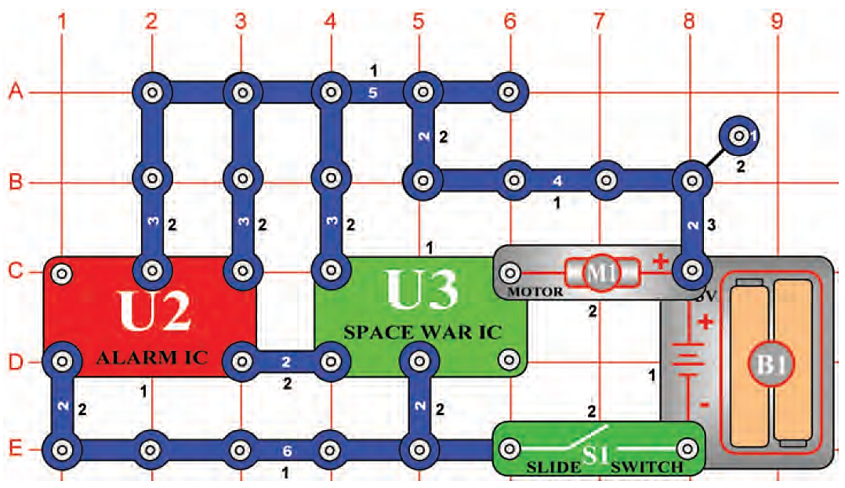
(60) Space War Flicker Motor
To run the motor using the space war IC.
利用U3 IC來驅動馬達
開啟電源S1:ON， M1會轉動。(若不會轉動，可以用手輕輕推動M1，使其開始轉動。)
來至U3的聲音，可驅動馬達運轉。
因為馬達是磁鐵與線圈組成，與喇叭相似。所以依稀可從馬達聽到太空戰聲響。

Slide 34
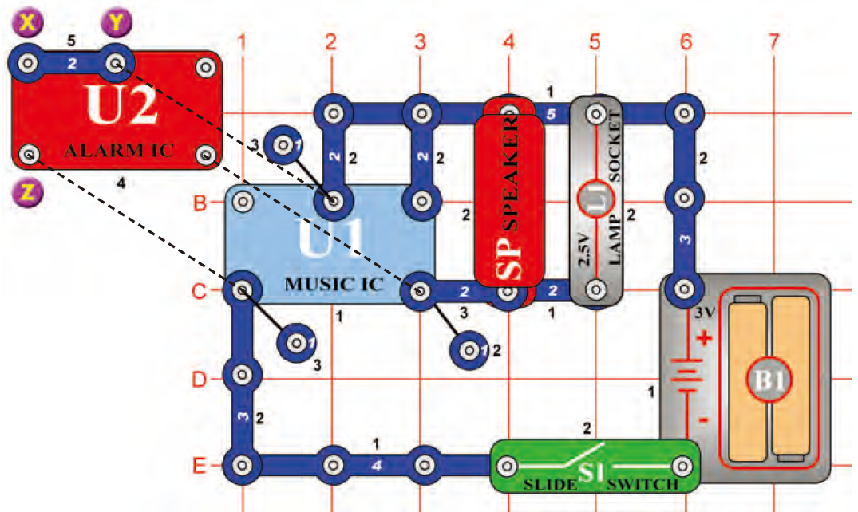
(92) Wacky Sounds
To combine different sounds. 不同聲響的結合
將2鈕扣連接線連接X點&Y點。
開啟電源S1:ON，將同時聽到消防車聲與生日快樂歌，同時L1的亮度會隨聲音而變化。
U2-IC
IN2：警車
IN2 & IN1：消防車
IN2 & [IN1+(-)]：救護車

Slide 35
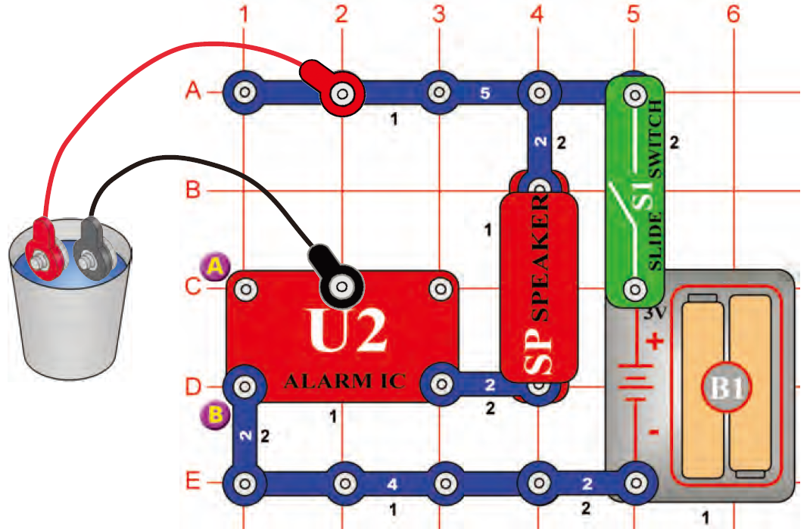
(98)簡易的水偵測警報器 Simple Water Alarm
當跳線置放於水杯外，開啟電源S1：ON後，所有元件不會有作動。
當將跳線放置於裝有水的水杯內時，則SP會發出警報聲。
可以改用長的導線置放於地下室的地板上，當暴風雨來襲，導致地下室積水，此時該電路就會發出警報聲響，警告地下室淹水了~

Slide 36

(99) Simple Salt Water Alarm
To detect salt water.
偵測鹽水
在水中加鹽巴，警報聲會更大聲與快速。
手握住跳線,試試看你的身體是否可以導電使SP發出聲響。
(100) Ambulance Water Alarm
To show a variation of the circuit in Project #98.
實驗(98)電路變形
延續實驗(98)。新增一條連接線於A和B點。
水偵測警報器作動方式相同，只是聲響換成了救護車聲。
(101) Ambulance Contact Alarm
To show a variation of the circuit in Project #98.
實驗(98)電路變形
直接將跳線連接在一起，聲響音調與利用水導通時的音調不同。
利用水介質導電的救護車聲響，節奏比較慢與聲音比較小。
IN2: 警車
IN2 & IN1: 消防車
IN2 & [IN1+(-)]: 救護車

Slide 37
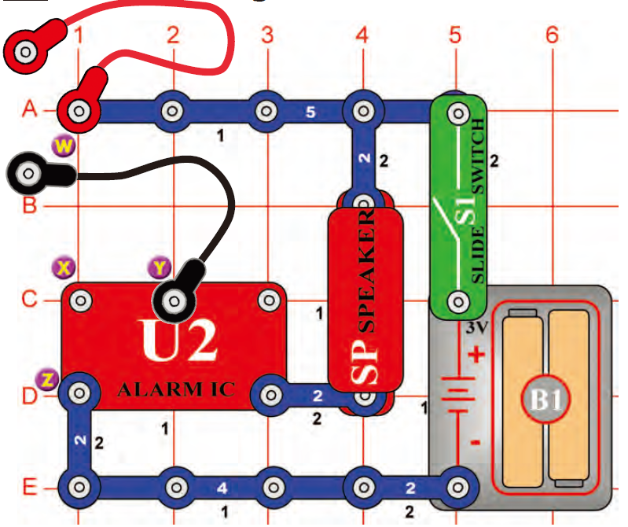
(81) Pencil Alarm
跳線先不相連。
拿一枝鉛筆。2號鉛筆(等同HB)更好。
將一張白紙放於平坦桌面上，利用鉛筆在白紙上塗上厚厚的黑色塊(可將鉛筆斜拿重重的畫，越厚越好)。
開啟電源S1:ON，將跳線放於剛剛繪製的黑色塊上。因鉛筆石墨會導電，可以使電路導通,發出警車聲。
假如還是沒有聲響，可以將跳線移近一點，或是在黑色塊上面滴水，增加導電性。
To draw an alarm activator.
繪製一個警報觸媒劑
IN2: 警車
IN2 & IN1: 消防車
IN2 & [IN1+(-)]: 救護車

Slide 38
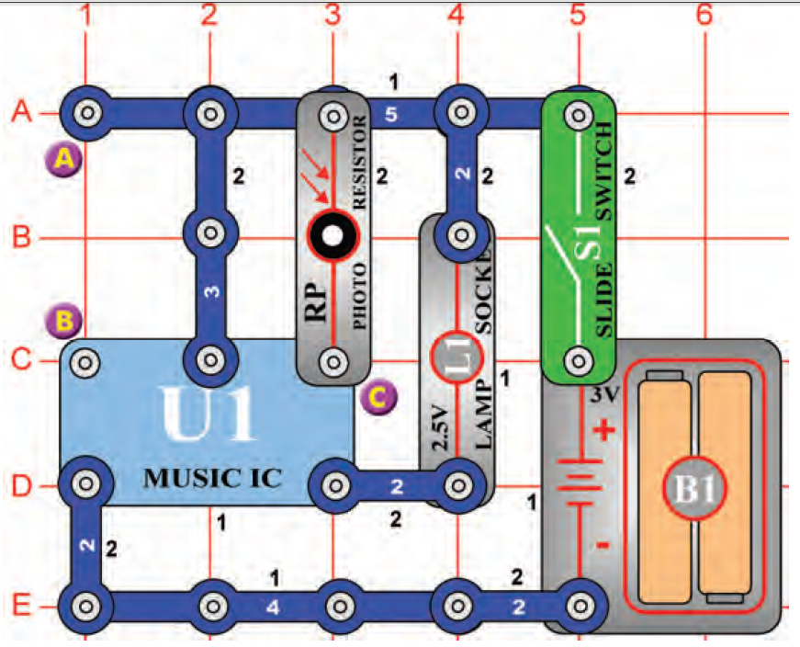
(71) Light-Controlled Lamp
蓋住整個電路，再開啟電源S1:ON。注意L1會亮起數秒後熄滅。
將整個電路板靠近燈源後，L1會再次亮起。
再次蓋住RP並置放於燈源下，L1不會亮起。
RP的電阻值會隨光強度增加而減弱。
低電阻作用就像一條導線連接C點與電池的正極。
可應用於車庫。
To turn a lamp on and off using light.
利用光源來啟動燈泡開關

Slide 39
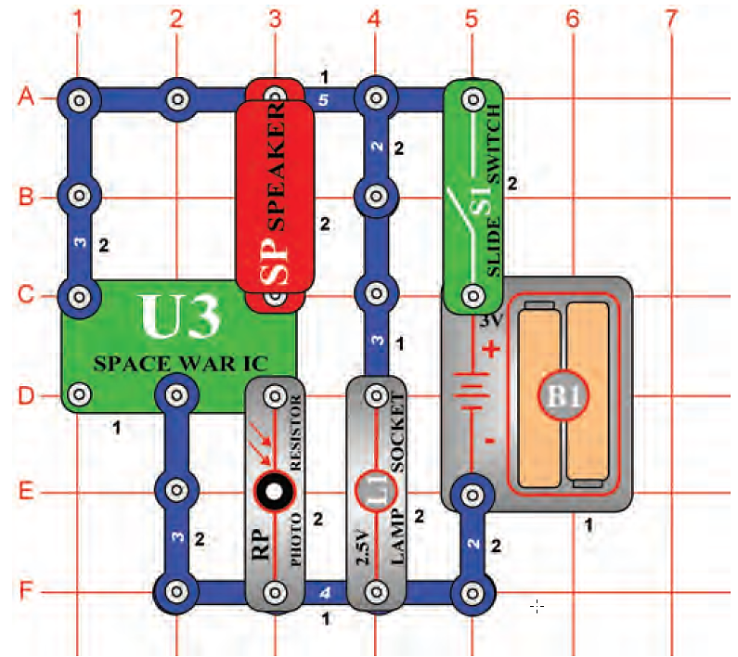
(51) Reflection Detector
To detect if a mirror is present.
反射物偵測器(reflection detector)
先遮蔽RP(室內電燈關閉, 或是將電路放在桌子地下)，並開啟電源S1:ON。 ⇨ L1會亮燈但SP不會發出聲音。
拿取一小鏡子，放在L1與RP上面。此時就可以聽到聲響。
也可使用一張白紙取代鏡子，白色表面也能反射光線喔。
但是黑色的物品呢???

Slide 40
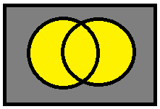
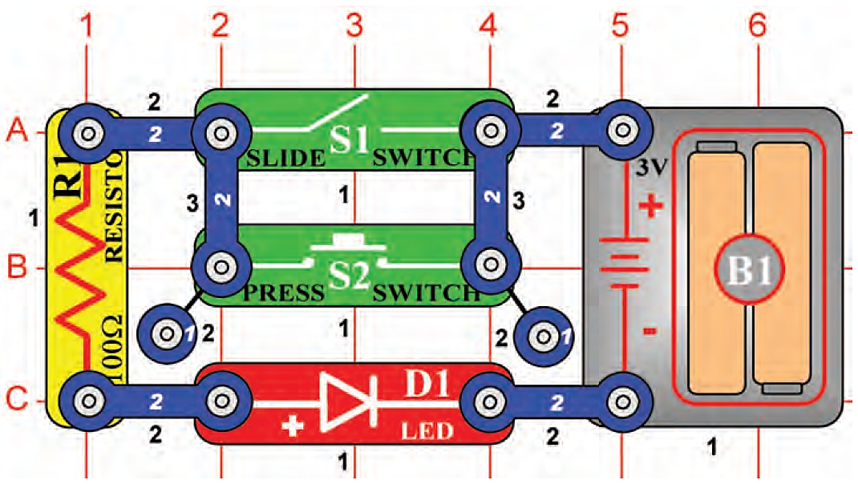
(47) This OR That
To introduce you to the OR concept of electronic wiring.
電子接線的 OR 概念
開啟S1:ON，或是按壓S2，LED皆會亮起。
這實驗只會全亮或全暗，沒有部份亮起，看起來相當無趣。但這實驗卻能代表非常重要的電子學概論。
像這樣兩個開關可應用於家中電燈，或是當跨越鐵路的兩個感測器，應用於當開始噹噹響與放下閘門時。
開關也可多於兩個，電路功能是一樣的。

Slide 41
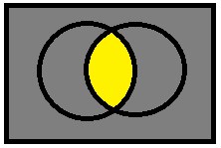
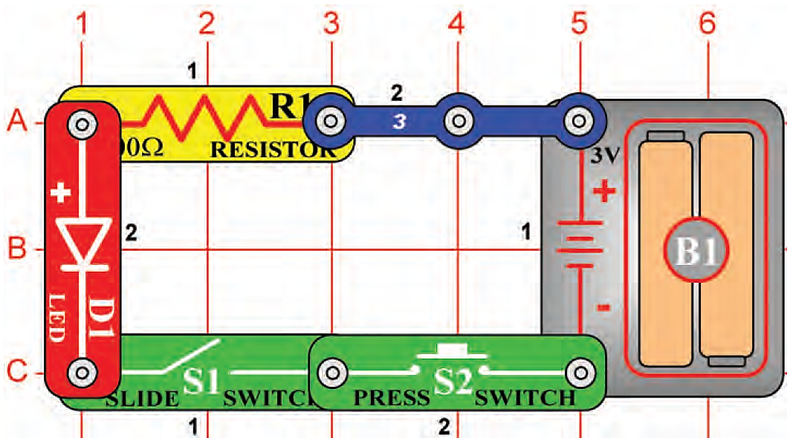
(48) This AND That
To introduce you to digital circuits.
數位電路, AND 概念.
同時開啟S1:ON與按壓S2，LED燈才會亮起。
這兩個開關裝置就像家中電燈一樣，有房間開關(S2)與電源箱裡的主開關(S1)。
AND與OR電路的組合，被應用於電腦加乘數目。這電路被製成小的電晶體於大規模的積體電路。

Slide 42

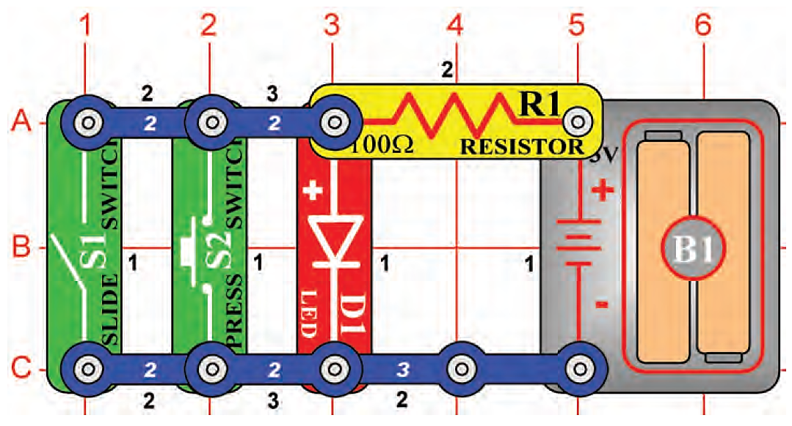
(49) Neither This NOR That
To demonstrate the concept of a NOR circuit.
NOR電路概念
OR
NOR
試試開關S1與按壓S2，什麼狀況LED會亮起或熄滅？
與實驗(47)OR電路狀況完全相反。
只要S1:ON或是按壓到S2，LED就會熄滅。
NOR是NOT this OR that的縮寫。

Slide 43

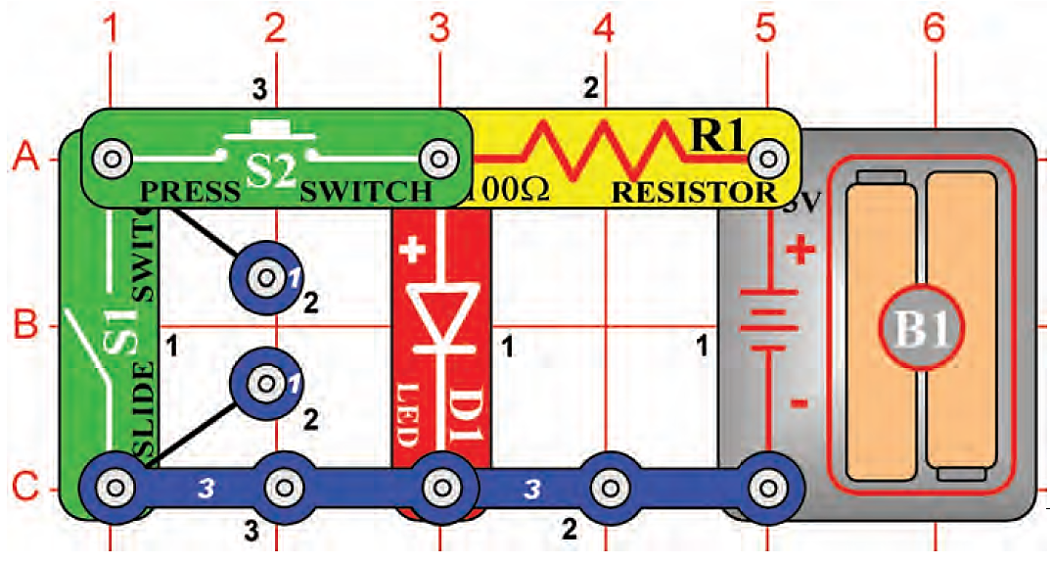
(50) NOT This AND That
To demonstrate the concept of a NAND circuit.
NAND電路概念
AND
NAND
試試開關S1與按壓S2， 什麼狀況LED會亮起或熄滅？
與實驗(48)AND電路狀況完全相反。
只有同時S1:ON與按壓S2，LED燈才會熄滅。
NAND是NOT this AND that的縮寫。
電路開關可更多或更少。若只有一個輸入開關，則可形成NOT電路。

Slide 44
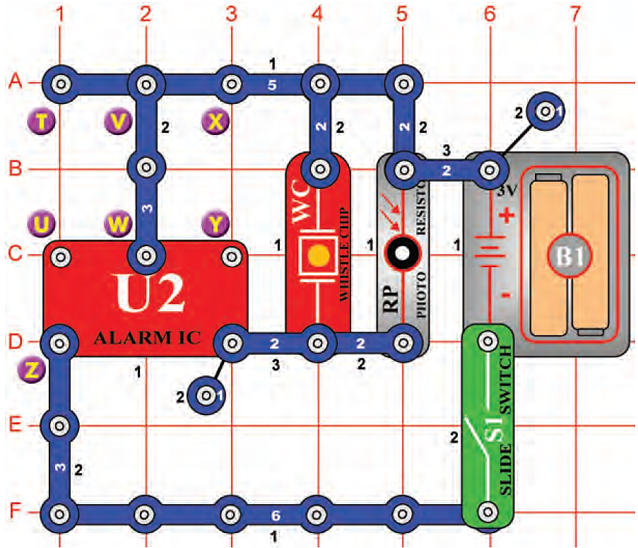
(61) Light-Controlled Sounds
開啟電源S1:ON，WC發出警車聲響。
此時聲音大小可以利用RP照光強度來控制。
比較看看哪種狀況聲響較大？
為什麼？
To give a more dramatic demonstration of using the photosensitive resistance.
使用光敏電阻來產生更具戲劇性的聲音表現
 | 連接狀態 | 電阻大小 | 聲音大小
1 | 拿掉RP | [R=∞Ω] | 最小聲
2 | 遮住RP | [R~∞Ω] | 小聲
3 | RP照強光 | [R~1KΩ] | 大聲
4 | 改接電阻 | [R~100Ω] | 最大聲
5 | 改接導線 | [R~0Ω] | 更小聲 ??

Slide 45
~ THE END ~

Slide 46
Introduction of Electronics Snap Circuits Jr. (SC 100)
Snap Circuits® makes learning electronics easy and fun!
Just follow the colorful pictures in our manual and build exciting projects such as a flying saucer; alarms; doorbells and much more!
You can even play electronic games with your friends.
All parts are mounted on plastic modules and snap together with ease.
Enjoy hours of educational fun while learning about electronics.
No tools required.
Includes Projects 1-101 manual.

Slide 47
Content
Chapter 1: Basic Components & Circuits - Introduces electricity with the components and circuit types listed here. By building circuits using Snap Circuits ®, students begin to understand the electrical world.
Chapter 2: Motors & Electricity - Students learn how electricity and magnetism are used in motors and generators, about the electricity that runs their homes, and about lightning.
Chapter 3: Resistance- Students learn how resistors are used to limit and control the flow of electricity. They also learn the basic rules for understanding circuits, and receive an introduction to digital electronics.
Chapter 4: Electronic Sound and Integrated Circuits-- Students learn how electricity makes sound. They also learn about the integrated circuit modules included in Snap Circuits and what is inside them. They have the opportunity to use Ics in many types of circuits.

Slide 48
Chapter 1: Basic Components & Circuits
Object: Introduces electricity with the components and circuit types listed here. By building circuits using Snap Circuits Jr, students begin to understand the electrical world.
1-1 Electricity
1-2 Wires
1-3 Batteries
1-4 Switches
1-5 Lamps
1-6 Base Grid - project 1 is discussed
1-7 Series and Parallel circuits - two mini-circuits are discussed
1-8 Short Circuits
1-9 Solder
1-10 Schematics
Summary & quiz

Slide 49
Chapter 2: Motors & Electricity
To learn how electricity and magnetism are used in motors and generators, about the electricity that runs their homes, and about lightning.
2-1 Motors - project 2
2-2 Motor circuits - projects 5, 6, 80, 11, 12, 13
2-3 Fuses - project 14
2-4 Your electric company - projects 55 and 56
2-5 Static Electricity
2-6 Types of lamps
2-7 Types of switches
2-8 Electricians
Summary & quiz

Slide 50
Chapter 3: Resistance
To learn how resistors are used to limit and control the flow of electricity. They also learn the basic rules for understanding circuits, and receive an introduction to digital electronics.
3-1 Resistors
3-2 LEDs - projects 7 & 8
3-3 The Photoresistor - one mini-circuit is discussed
3-4 Resistors in series and parallel - three mini-circuits are discussed
3-5 Resistance - project 9 is discussed
3-6 Resistance of water - projects 98 and 99
3-7 Introduction to logic - projects 47, 48, 49, 50
3-8 Digital electronics
Summary & quiz

Slide 51
Chapter 4: Electronic Sound and Integrated Circuits
To learn how electricity makes sound.
To learn about the integrated circuit modules included in Snap Circuits and what is inside them.
To have the opportunity to use Ics in many types of circuits.
4-1 Electronic Sound - three mini-circuits are discussed
4-2 Whistle Chip - one mini-circuit is discussed
4-3 The ICs in snap circuits
4-4 Description of all projects using ICs
No projects are discussed in detail here but projects 38, 51, 58, 61, 81, and 83 are recommended.
Summary & quiz
Summary of Components

Slide 52
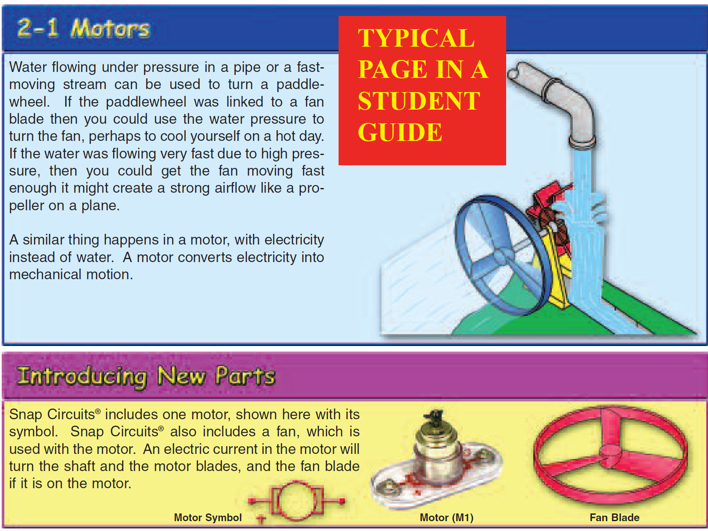

Slide 53
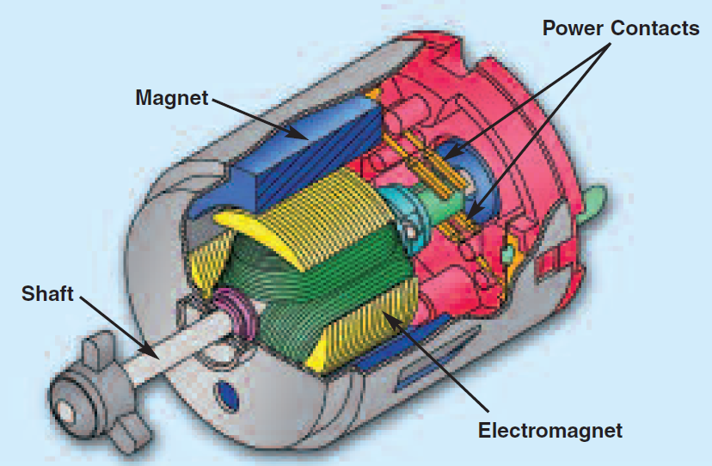
How does electricity turn the shaft in the motor?
The answer is magnetism.
Electricity is closely related to magnetism, and an electric current flowing in a wire has a magnetic field similar to that of a very, very tiny magnet.
Inside the motor is a coil of wire with many loops, if a large electric current flows through the loops the magnetic effects become concentrated enough to move a small magnet.
The motor also has a small magnet, on a shaft.
When electricity moves the magnet, the shaft spins.
If the fan is on the motor shaft then its blades will create airflow.

Slide 54
Integrated Circuits
Although Snap Circuits includes several parts that are called integrated circuits, they are actually modules containing a number of parts.
The modules contain specialized sound-generation and amplifier ICs and other supporting components (resistors, capacitors, and transistors) that are always needed with them.
This was done to simplify the connections you need to make to use them.

Slide 55
Sound IC 聲音晶片
Some types of electronic components can be super-miniaturized, allowing many thousands of parts to fit into an area smaller that your fingernail.
These “integrated circuits” (ICs) are used in everything from simple electronic toys to the most advanced computers.
The music, alarm, and space war ICs (U1, U2, and U3) in Snap Circuits® are actually modules containing specialized sound-generation ICs and other supporting components (resistors, capacitors, and transistors) that are always needed with them.
This was done to simplify the connections you need to make to use them.

Slide 56
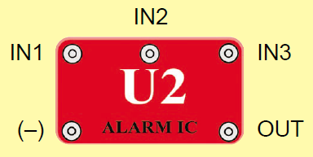
Sound IC 聲音晶片
(+) - power from batteries
(–) - power return to batteries
OUT - output connection
U1- Music IC:
HLD - hold control input
TRG - trigger control input
Music for a few seconds on power-up,
then hold HLD to (+)
power or touch TRG to (+) power to resume music.
U2-- Alarm IC:
IN1, IN2, IN3 - control inputs
Connect control inputs to (+) power to make five alarm.
sounds, see project 22 for configurations.
U3-- Space War IC:
IN1, IN2 - control inputs
Connect each control input to (–) power to sequence through 8 sounds.
接正電位電源

Slide 57
ICs
(+) - power from batteries
(–) - power return to batteries
OUT - output connection
HLD - hold control input
TRG - trigger control input
IN1, IN2, IN3 - control inputs
(–) - power return to batteries
OUT - output connection
(+) - power from batteries
(–) - power return to batteries
OUT - output connection
IN1, IN2 - control inputs

