Slide 1
光電工程研習
國立清華大學物理系及跨領域科教中心
戴明鳳教授 /助理許乃今 2016.08.16 修
檔案連結網址 https://drive.google.com/open?id=0B4bNyMQ3x7awMjJabmdUMEFTd1E

Slide 2
光電應用動手篇： 生活中實用之聲、光、力學式控制電路實驗DIY與其探究
運用鈕扣式光電(snap circuit)元件套件組探究基本且有趣的光電子電路。
套件內所有零件精心設計，不需任何焊接或額外工具輔助，只要像扣鈕扣一樣將各種零件扣組在一起，即可完成電路組裝。
可組接高達180多組以上於生活中實用、有趣、簡單易學且具親和力的電子電路，使能深入淺出地理解生活中實用的光電知識。
善用此研習與此套件，可讓原對光電電路完全沒有概念者師生或甚至成年人都可透過自己動手做組裝的過程，學習各種基本電子零件和簡單電路的特性與功能。
經由仔細的解說和彩色的電路圖示，就可以自己組裝完成各式實用且有趣的應用電路，並熟悉光電電路的工作原理和效用，多種生活中實用的光電裝置。甚至還可以跟朋友一起設計有趣的電子遊戲。
⇨您也可以成為光電子電路的科學與技術達人喔！

Slide 3
SC-175 英文實驗教材
http://www.elenco.com

Slide 4
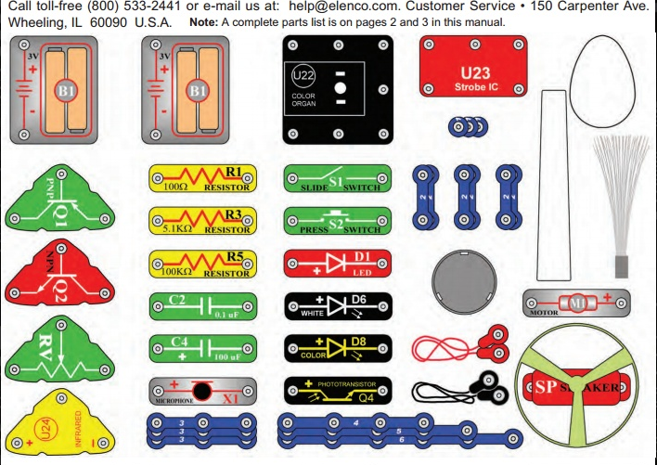
零件收存配置圖 SC-175 Snap Circuits® Block Layout

Slide 5
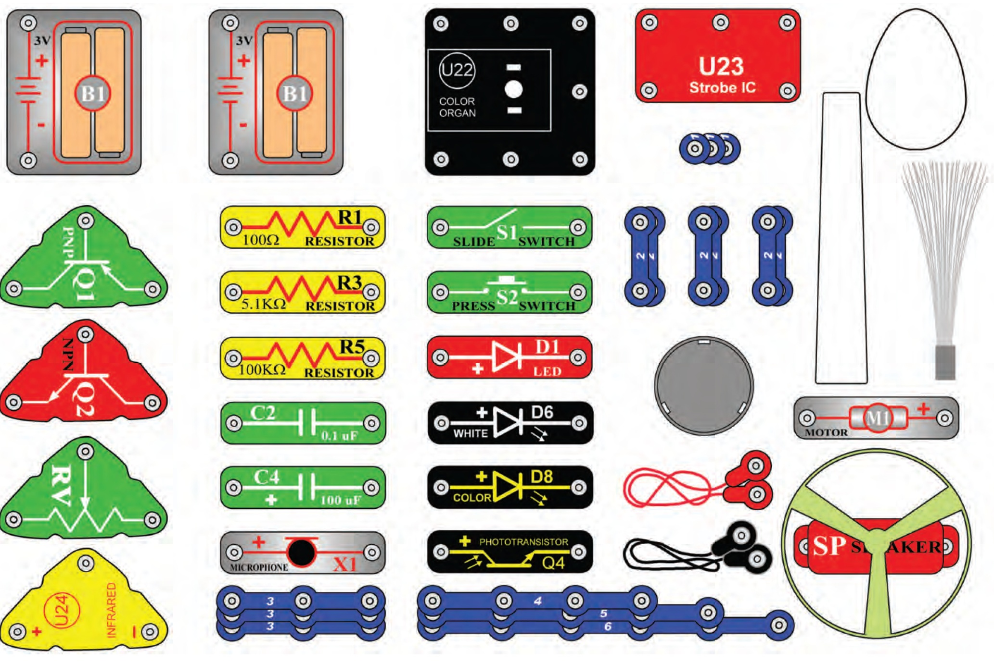
SCL-175 光電套件零件清單 (LIGHT Block Layout)

Slide 6
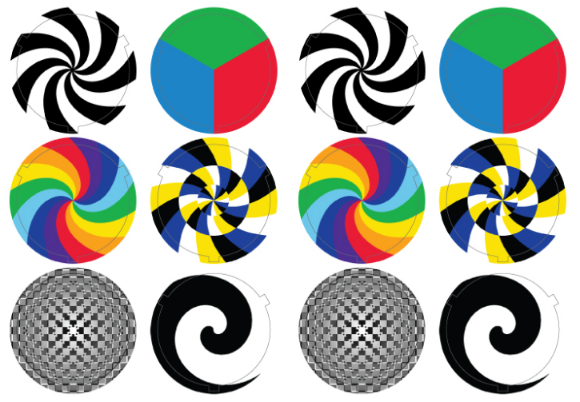
彩色圓形配件圖 SC-175 Snap Circuits® Color Discs

Slide 7
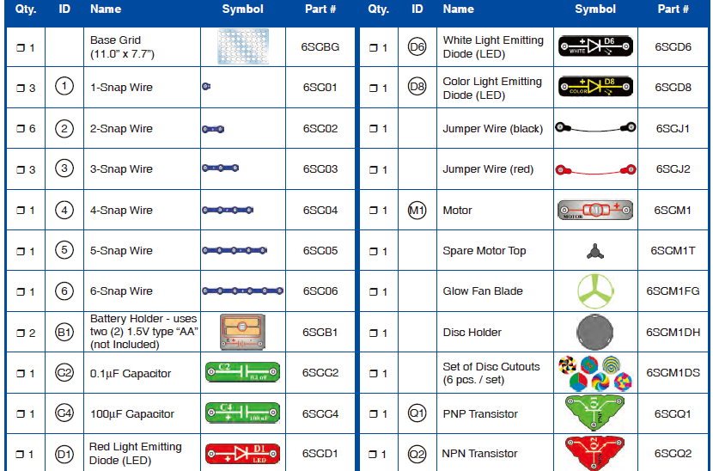
SC-175 電子元件表：元件符號＆零件編號

Slide 8
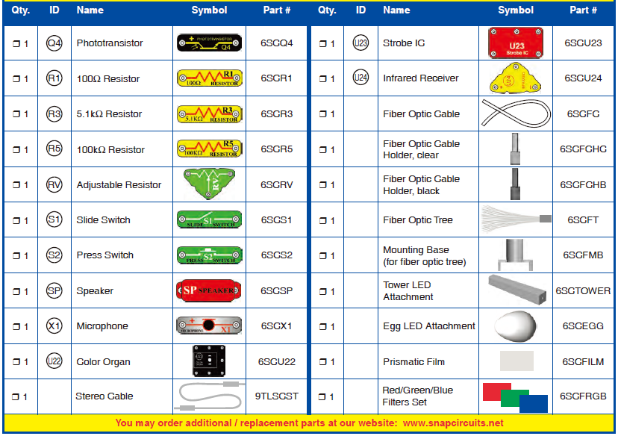
SC-175 元件清單：元件符號＆零件編號

Slide 9
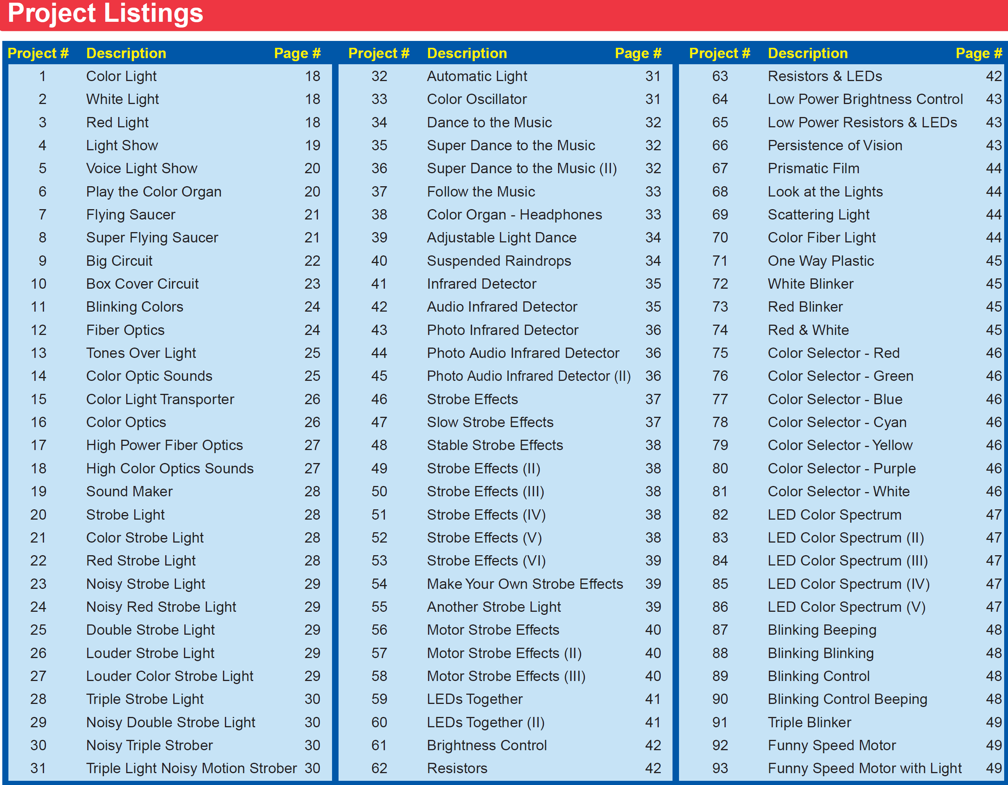

Slide 10
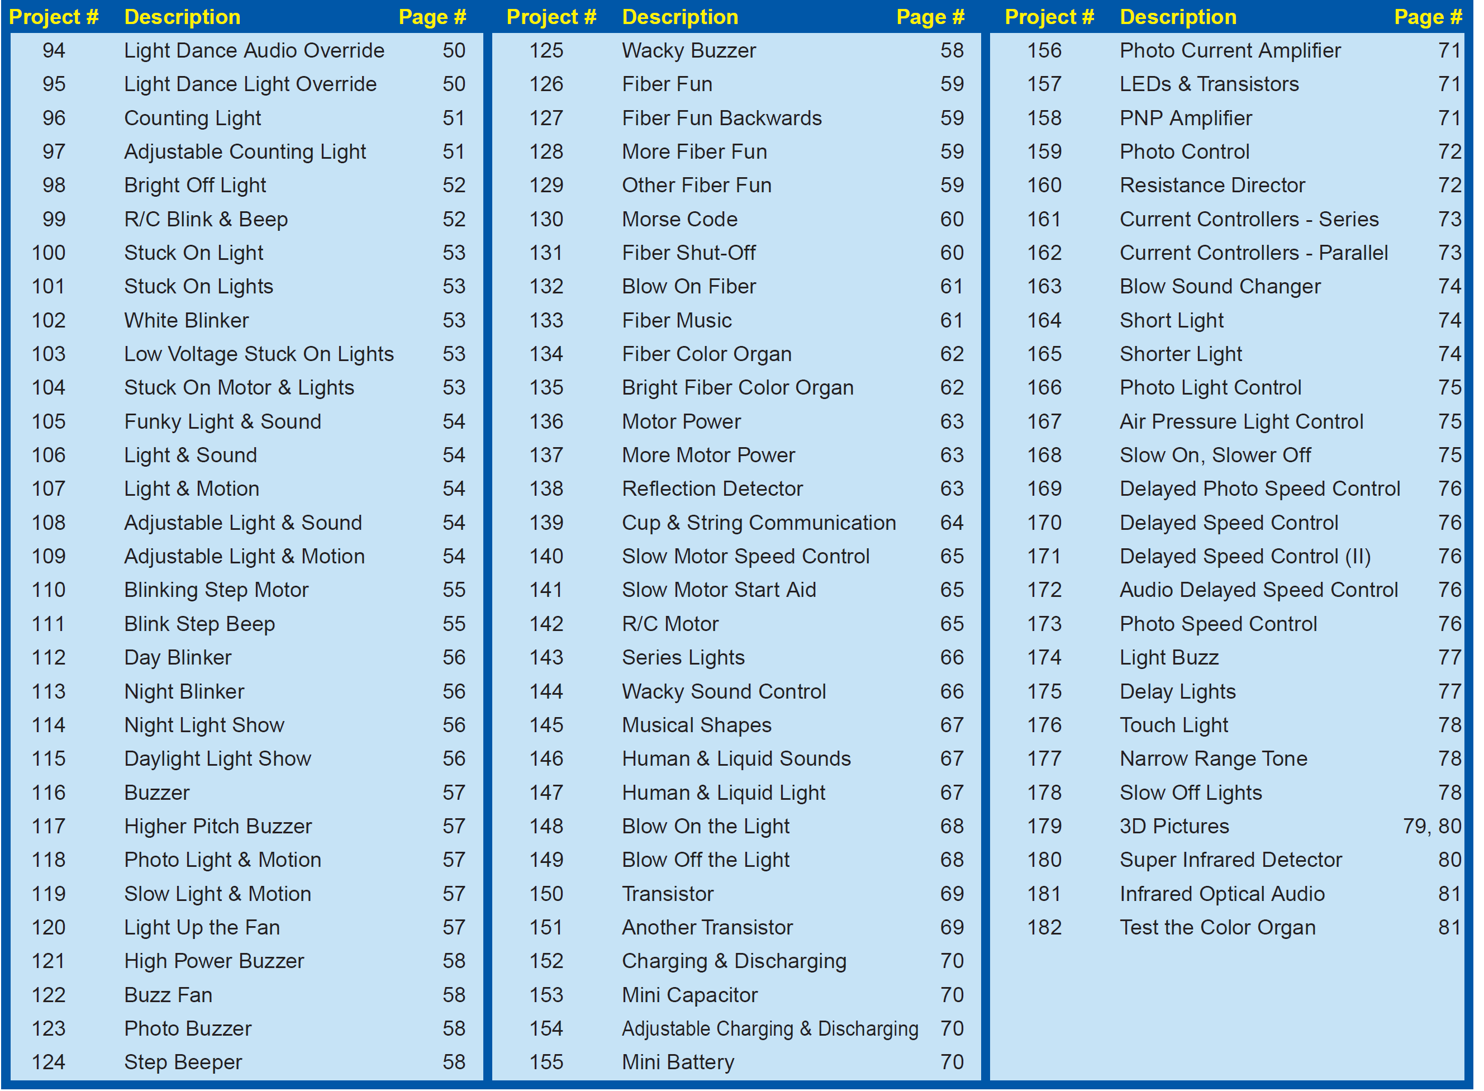

Slide 11
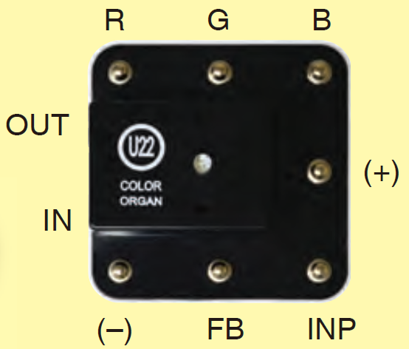
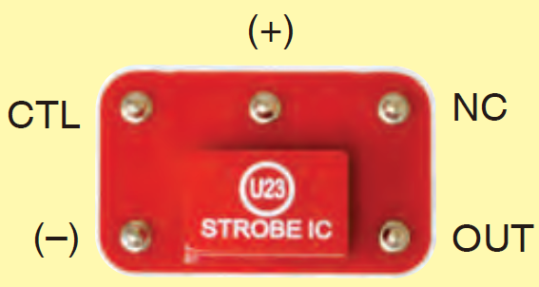
積體電路套件 U22、U23各接點用途
Connections:
R - red color control
G - green color control
B - blue color control
(+) - power from batteries
INP - circuit input
FB - feedback connection
(–) - power return to batteries
IN - audio input jack
OUT - audio output jack
Connections:
(+) - power from batteries
(–) - power return to batteries
OUT - output connection
CTL - strobe speed control
NC - not used

Slide 12
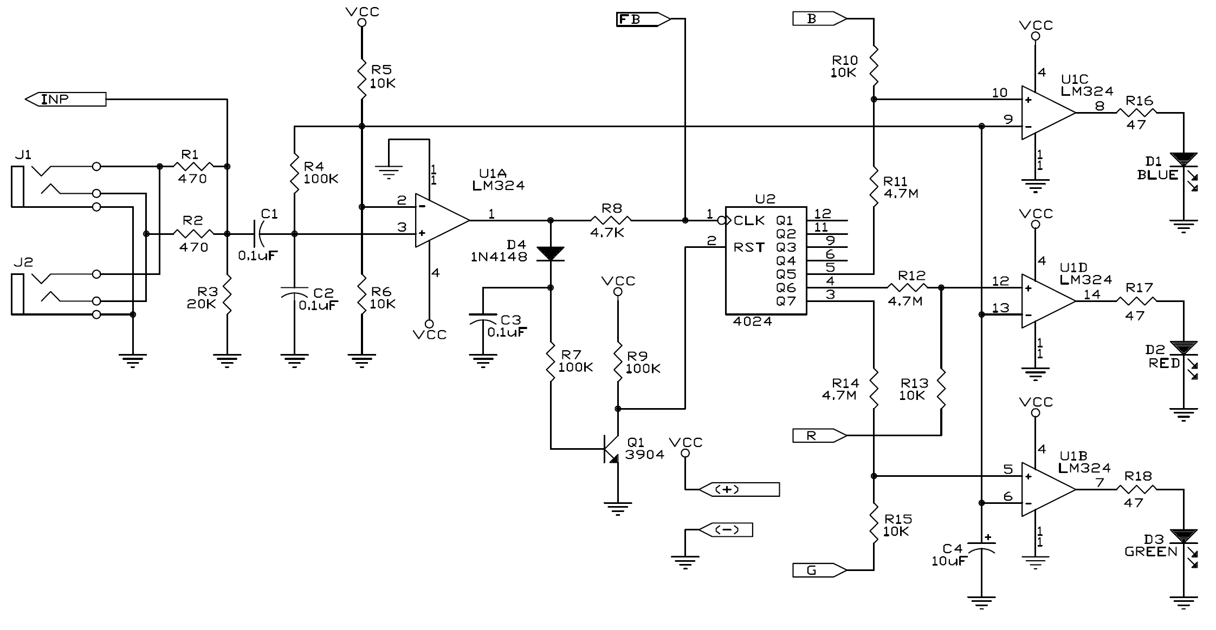
色光控制器(Color Organ) U22
此控制模組實際的電路如圖所示，外盒中心含一顆全彩LED和IC積體電路。
可直接控制 R, G, B或經由輸入外來的音頻信號控制 LED的光源顏色。
各接點功用 Connections:
R - red color control
G - green color control
B - blue color control
(+) - power from batteries
INP - circuit input
FB - feedback connection
(–) - power return to batteries
IN - audio input jack
OUT - audio output jack
U22 模組內部電路圖
僅SCL-175套件內含有此組件
Notes:
色光控制器(Color Organ) U22
The color organ module (only in SCL-175) contains resistors, capacitors, transistors, a tri-color LED, and integrated circuits.
The LED in it can change colors by direct control, or in synch with an audio input signal. Its actual schematic is complex and looks like this:

Slide 13
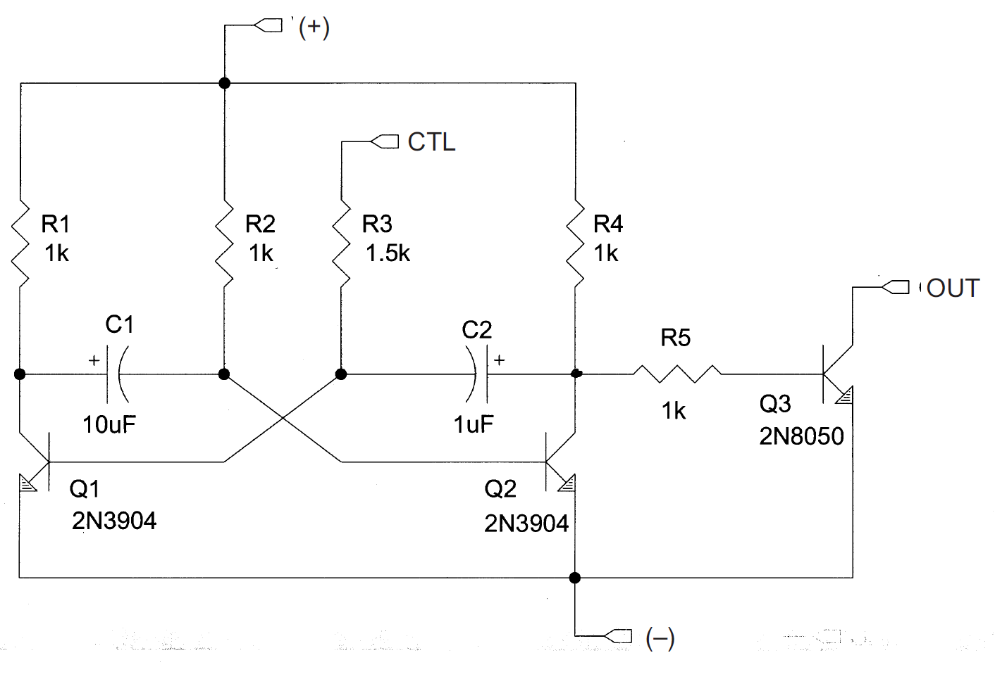
閃頻IC (Strobe IC)
僅Snap circuit SLC-175 套件內含有此組件，主要用以製造LED光源閃爍所需的閃頻電路。
Connections:
(+) - power from batteries
(–) - power return to batteries
OUT - output connection
CTL - strobe speed control
NC - not used
Notes:
閃頻IC (Strobe IC):
The strobe IC module (only in SCL-175) contains
resistors, capacitors, and transistors that
are needed to make a strobe light circuit. Its
schematic looks like this:

Slide 14
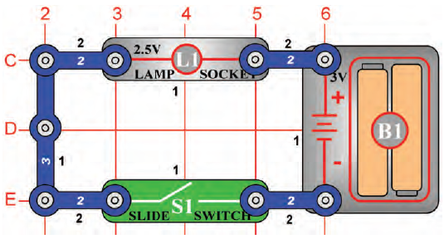
操作 說明
A. 白色數字 1, 2, 3
- 表snap wire 上的鈕釦數
2 為有 2 鈕釦點的藍色連接導線
3 為有3個鈕釦點的連接導線
B. 黑色數字1, 2, 3：代表層別.
1 為平面結構第一層
2 為平面結構第二層
(建議先將第一層結構的元件安裝於板子上後，再進行第二層結構的建置。)

Slide 15
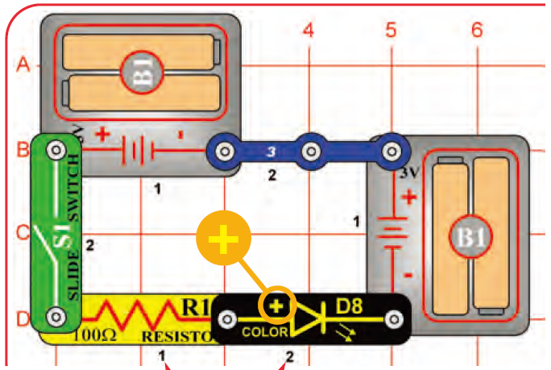
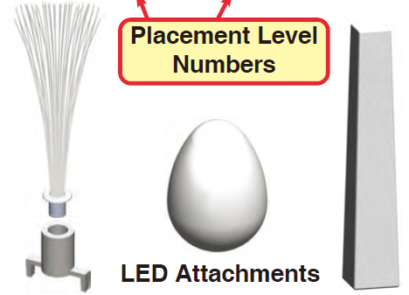
彩色光源 (Color Light) LED D8
LED: Light Emitting Diodes
此LED D8內含可分別單獨發出紅、藍、綠光的三個微型LED晶元，透過微電路控制三色LED的發光強度，以混出不同色光和亮度。
三個LED的燈罩/具配件
光纖束、蛋型、塔型燈具
可將三個LED的燈罩配件安放在LED D8 上，使高強度的LED 光束分散開來，使之不會刺眼。
光纖束燈具(fiber optic tree attachment)必須先安置在一個安裝底座(mounting base)上.

Slide 16
(2) 比較白光和紅光 LEDs
以白光LED (D6)和紅光LED (D1)取代Ｄ8，觀察光的顏色和亮度變化。安架上燈具，以利觀察。
LED：將電能轉換成光能，依製造所用的材料決定其發光的顏色。
白光LED：可產生高強度的白光，現已大量用做居家照明裝置和手電筒中的燈源。其照明效率遠高於傳統的燈泡。
紅光LED：通常售價較低，但發光亮度遠比其他色光的LED弱許多；故通常用以做為電子儀器的指示計(indicator)。

Slide 17
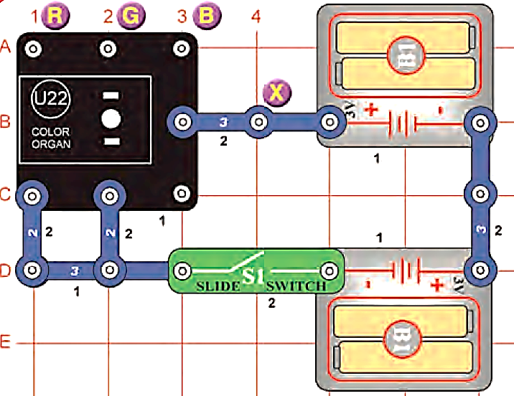
(6)把玩色光控制模組(Play the Color Organ)
以沾濕的手指分別跨觸圖中X和 R, G, B等四個接點，以觀察U22上的LED會發出什麼色光？
(1) X 和 R 紅 →紅
(2) X 和 G 綠 →綠
(3) X 和 B 藍 →藍
(4) X 和 R＋G → 黃光
(5) X 和 G＋B → 青光
(6) X 和 R＋B → 紫光
(7) X 和R＋ G＋B→白光
色光控制模組U22上的LED：由分別僅能發出紅R、藍B、綠G的三只LED組合而成。
此混光LED會產生什麼色光：即端視U22模組的R, G, B控制接點是否有輸入信號
R＋ G → Y 黃光, G + B → Cyan 青光, R＋B → 紫光,
而 R + G + B混合可得出明亮的白光。

Slide 18
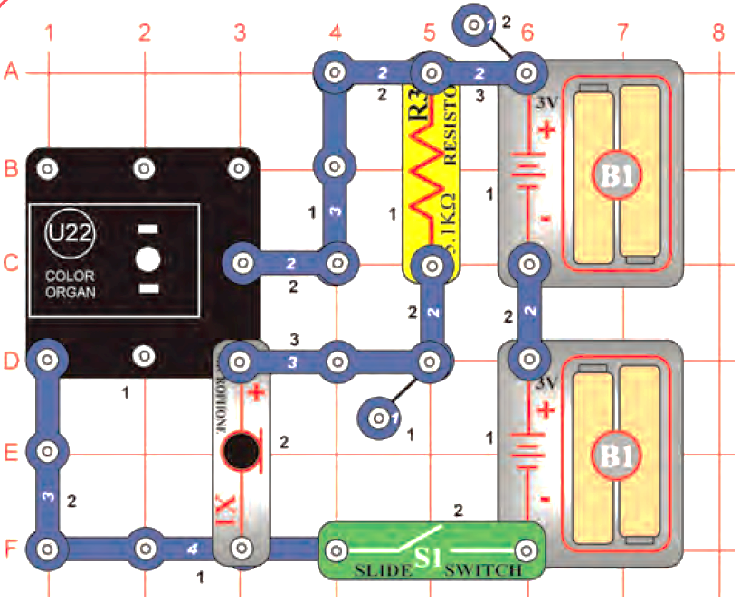
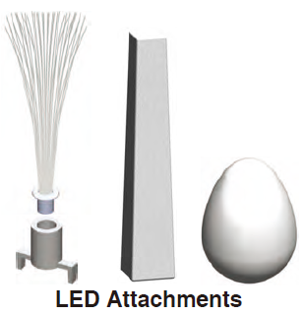
(5) 聲光秀(Voice Light Show)
S1開關啟動整個電路
色光控制器U22上之LED所發色光和亮度隨麥克風所接收的音調和音量而變化。
麥克風
microphone
How does it work?
麥克風將人的聲音轉換成電子訊號，此訊號被送入色光控制IC內，用以控制LED發光的顏色和亮度。
計數器器控制紅-藍-綠LED (The counter controls a red-green-blue LED).

Slide 19
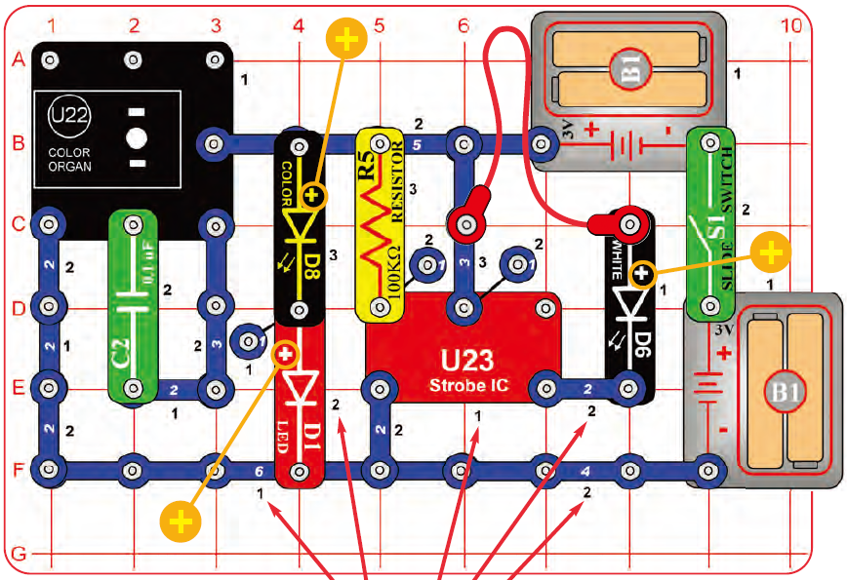
(4)光秀(Light Show)-所有的光源均使用LED
LEDs將電能轉換成光能，依製造所用的材料決定其發光的顏色。
將燈具分別放在發紅光的D1，白光的D6，彩色光的D8，或顏色控制(color organ) IC (U22) 上的LED光源上。

Slide 20
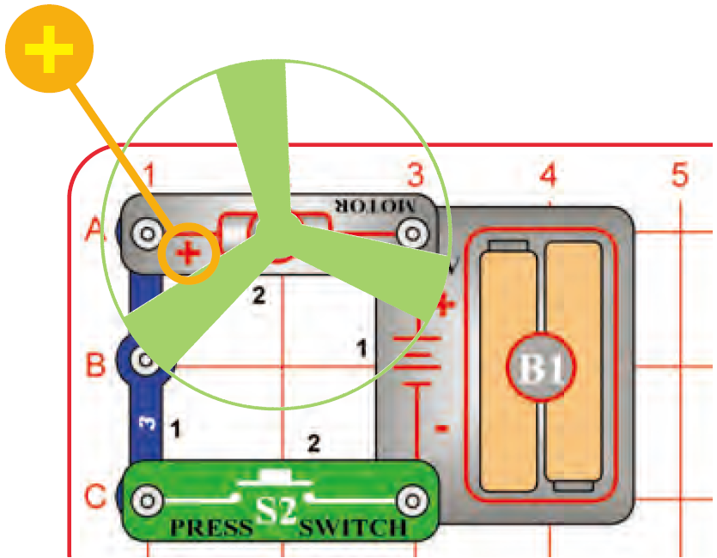
(7) Flying Saucer
如圖連接電路，注意馬達的負極與電池的正極相接。
啟動按鍵開關S2，當馬達達全速轉動數秒後，放開S2按鍵。觀察會有何現象發生。
→風扇應會像飛碟，自動脫離馬達的旋轉軸，騰空飛起。警告：你的頭部千萬不要直接面對即將或正在旋轉的葉片，以免受傷。
Push the press switch (S2) until the motor reaches full speed, then release it.
The fan blade should rise and float through the air like a flying saucer. Be careful not to look directly down on fan blade when it is spinning.
If the fan doesn’t fly off, then press the switch several times rapidly when it is at full speed. The motor spins faster when the batteries are new.
The glow fan will glow in the dark.
It will glow best after absorbing sunlight for a while.
The glow fan is made of plastic, so be careful not to let it get hot enough to melt.
The glow looks best in a dimly lit room.
馬達旋轉，風扇上方的週圍空氣會被吸到風扇下方，形成下壓力，使得風扇被固定在馬達的轉軸上。The air is being blown down through the blade and the motor rotation locks the fan on the shaft.
當關閉馬達，風扇轉速減低，導致風扇無法被鎖牢在馬達轉軸上，因而飛離轉軸，如同螺旋槳飛機自由地平地飛起。When the motor is turned off, the blade unlocks from the shaft and is free to act as a propeller and fly through the air.
若風扇的轉速不夠快，則馬達關閉時，所產生的上升推進力不夠大時，則風扇飛不起來，甚至無法脫離轉軸的卡榫座。If speed of rotation is too slow, the fan will remain on the motor shaft because it does not have enough lift to propel it.

Slide 21
馬達趨動螢光風扇旋轉與螺旋槳效應實驗
如圖連接電路，注意：馬達的負極與電池的正極相接。
啟動按鍵開關S2，當馬達達全速轉動數秒後，放開S2按鍵。觀察會有何現象發生。
→風扇應會像飛碟，自動脫離馬達的旋轉軸，騰空飛起。警告：你的頭部千萬不要直接面對即將或正在旋轉的葉片，以免受傷。
若風扇飛不太起來，問題檢修方式：
(1) 檢查風扇中心底部的卡榫是否剛好卡正馬達上端的塑膠座？
(2) 檢查卡榫和卡榫座之間是否卡得太緊密？若太緊，可用銼刀銼一下，使之彼此之間不要有太大的摩擦力，不必太緊密地卡在一起，
(3) 則當風扇達全速旋轉時，快速連續按壓-釋放S2開關幾次，看看風扇是否能脫離馬達轉軸而飛起。
(4) 若仍飛不起來， 檢查電池是否快沒電了！若電能不足，更換新電池
(5) 再不行，只能送專業或原廠檢修。
4. 風扇葉片具螢光性：故在黑暗環境下，會產生螢光效應。
使用前若能將之先放在陽光中，先多吸收一些陽光中的紫外光能，則昏暗下，能產生的螢光效應越強。
5. 直流馬達應用：
(1) 使用電池裝置時，主要應用在具旋轉機制的裝備，例如電動牙刷或是玩具車。
(2) 電子馬達控制比起以汽油柴油引擎做為旋轉裝置，來得容易簡單控制。

Slide 22
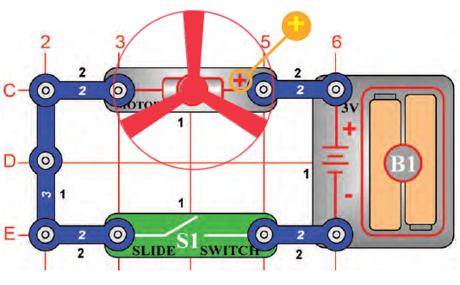
(2) DC Motor & Switch
To show how electricity is used to run a Direct Current (DC) Motor.
如何運轉直流馬達。
馬達：將電能轉換成動能
建議將M1與S1改建置於第二層，方便後續實驗。
→2
→2
當開關閥S1關閉時(切換到ON)，電路導通，直流馬達M1啟動，並推動風扇旋轉。
直流馬達被使用在電池裝置時，主要應用在具旋轉動機的裝備，例如電動牙刷或是玩具車。
電子馬達比起汽油柴油引擎來的簡易控制。

Slide 23
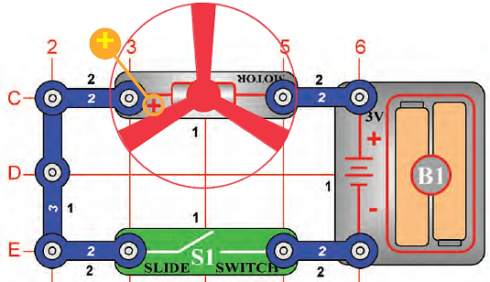
(11) Flying Saucer
延續實驗(2)，但將馬達反向安裝，馬達的(+)極連接電池的(-)極。
S1切換到ON，馬達將慢慢增加轉速。
當馬達達到最高轉速後，關閉電源S1:OFF，風扇將會像飛碟一樣升起浮在空中。
注意不要於直視風扇上頭，避免風扇飛起傷及臉部。
馬達風扇轉動將風往下吹，馬達停止運轉時，因為風扇葉片未被鎖住於馬達軸上，因此風扇葉片將會被空氣風壓反向推起而飛離馬達軸。
但假如馬達運轉過慢，則此飛碟現象將不會出現。可換新電池，或是等馬達轉速達到最大值時，再實驗。
To make a circuit that launches the fan blade to simulate a flying saucer.
像飛碟一樣飛起的風扇

Slide 24
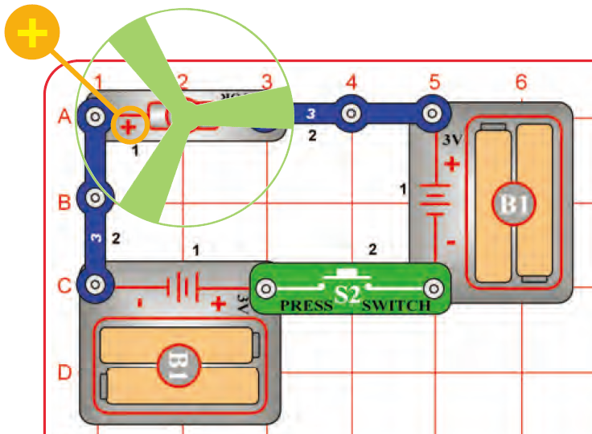
(8) 超快速飛碟(Super Flying Saucer)
多加一組3V電池組
⇨風扇轉速更快；
⇨馬達減速後，
⇨風扇有沒有飛得更高？
This circuit will make the fan spin faster and fly higher than the preceding circuit, making it easy to lose your fan.
Push the press switch (S2) until the motor reaches full speed, then release it.
The fan blade should rise and float through the air like a flying saucer. Be careful not to look directly down on fan blade when it is spinning.

Slide 25
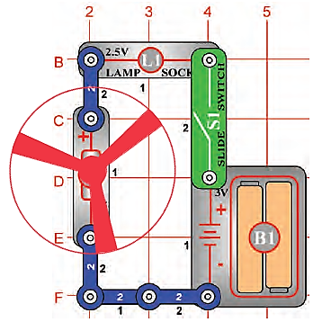
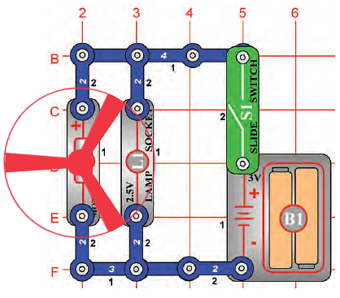
(5) Lamp & Fan
in Series
(6) Lamp & Fan
in Parallel
串聯電燈與風扇
移除風扇葉片後，
留意電燈將熄滅。
並聯電燈與風扇
電燈不會影響流經馬達的電流

Slide 26
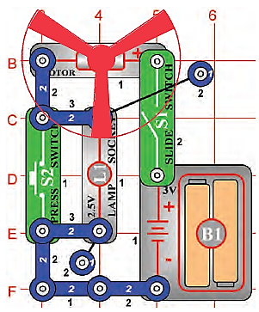
(13) Two-Speed Fan
To show how switches can increase or decrease the speed of an electric fan.
設計如何改變風扇速度
開啟電源S1:ON，電流流經S1、M1、L1再回到電池。此時風扇與電燈都會作動。
當按壓S2時(S2電阻遠小於L1)，電流將改流經S2，此時L1呈現短路不會亮燈，且馬達風扇轉速變快。
商業型風扇不會使用增加電阻方式來調變風量，因為電阻會產生熱。會使用變壓器或其他電子裝置來改變風扇跨壓使風量可調。

Slide 27
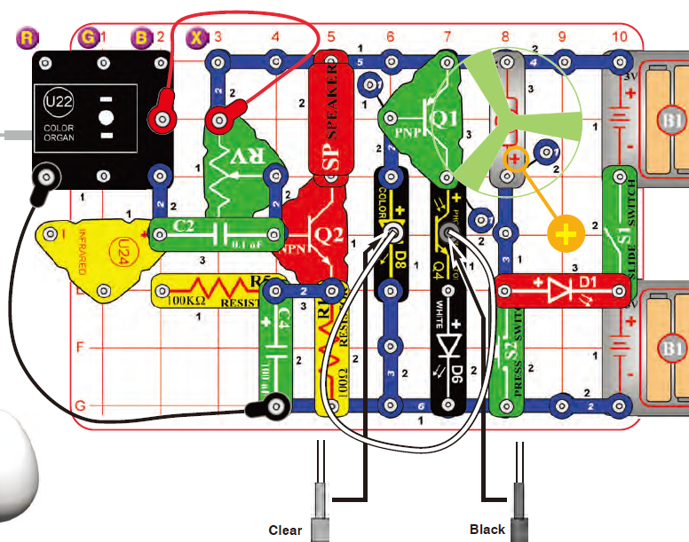
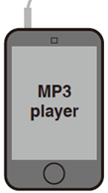
(9) Big Circuit

Slide 28
(9) Big Circuit
Place either the glow fan or the light fan on the motor (M1) shaft, so that it is stable on the little black piece.
Place the clear fiber optic holder on the color LED (D8) and the black fiber optic holder on the phototransistor (Q4), then insert the fiber optic cable between them, but don’t let it lay close to the fan on the motor. For best performance the fiber optic cable should stand straight up in the holders, without bending them.
Connect a music device to the color organ (U22) as shown, and start music on it. For best effects, place one of the LED attachments over the light on the color organ.
Turn on slide switch (S1). Adjust the lever on the adjustable resistor (RV) and the volume control on your music device for best sound and light effects.

Slide 29
(9) Big Circuit
Push the press switch (S2) until the motor reaches full speed, then release it.
The fan will rise into the air like a flying saucer. Be careful not to look down on the fan when it is spinning.
If desired, connect the light fan blade to the charger for a while to charge it, then place it on the motor to spin or launch it.
“Playing the Color Organ”: turn off or disconnect your music device.
Wet your fingers, and touch them between the point marked “X”, and “R”, “G”, or “B” in the drawing.
The infrared detector (U24) and 100kΩ resistor (R5) are only used to support the other components.

Slide 30
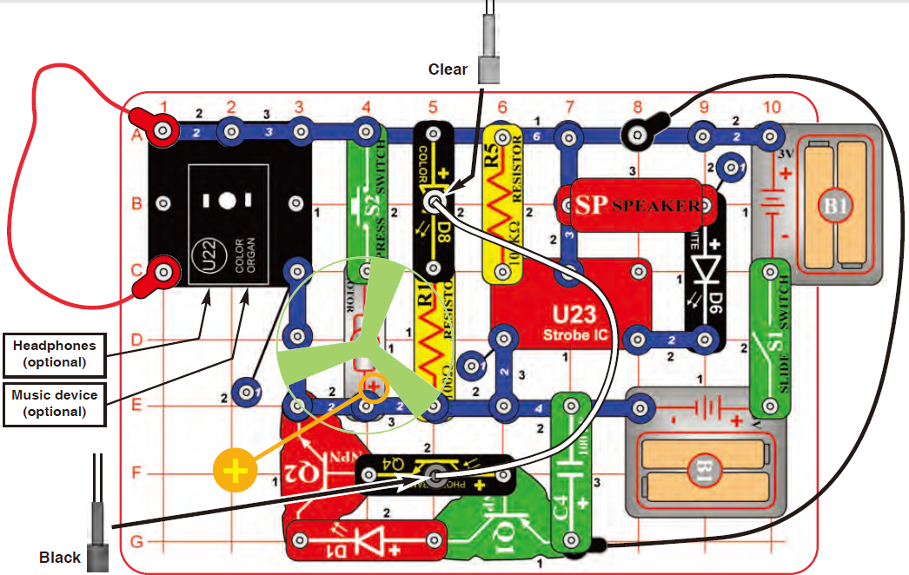
(10) Box Cover Circuit
This circuit is called the Box Cover Circuit because it is pictured on the front of the Snap Circuits® LIGHT box, use that picture to help in building it.

Slide 31
(10) Box Cover Circuit
Build the circuit as shown.
Place the glow fan on the motor (M1) shaft, so that it is stable on the little black piece. Place the clear fiber optic holder on the white LED (D6) and the black fiber optic holder on the phototransistor (Q4), then insert the fiber optic cable between them, but don’t let it lay close to the fan on the motor. For best performance the fiber optic cable should stand straight up in the holders, without bending them. For best effects, place one of the LED attachments over the light on the color organ, and one on the color LED (D8).
Optional: connect a music device to the color organ (U22) as shown, and start music on it (the color organ light will change to the music, but you will not hear it unless you also connect headphones).
Turn on slide switch (S1). A tone is hear from the speaker (SP), and all the lights (D1, D6, D8, and on U22) are on.
Push the press switch (S2) until the motor reaches full speed, then release it. The fan will rise into the air like a flying saucer. Be careful not to look down on the fan when it is spinning.

Slide 32
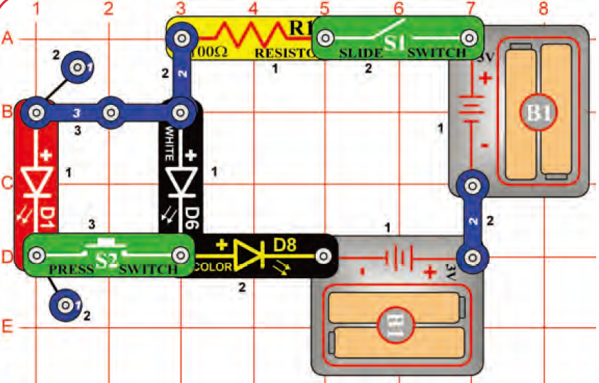
(11)不同色LED之內電阻比較
(Blinking Colors)
如圖在下列各種情況下，觀察D1, D6, 和D8 LEDs光源的發光狀況：
S1 ON, S2 OFF
白光LED D6 & 全彩 LED D8 閃爍，
D1紅光LED不亮。
S1 ON, S2 ON
紅光LED D1 & 全彩 LED D8持續閃爍，
但白光LED D6不會亮
3. 交換D1和D6 的位置，則不論S2 是開或關：
都是紅光LED D1 & 全彩 LED D8 閃爍，
白光LED D6都不會亮。
解釋：對於LED而言，產生紅光比白光容易得多。因紅光LED的順向電壓和內電阻均比白光LED低，故當紅光和白光LED並聯，大部份電流流經紅光LED。
Notes:
Build the circuit as shown and turn on the slide switch (S1). The white and color LEDs (D6 & D8) are blinking.
Push the press switch (S2). Now the red LED (D1) is blinking but the white LED is off.
If you swap the locations of the red and white LEDs, then the red LED will be blinking and the white LED will be off, and pushing the press switch won’t change anything.
Red light is easier for LEDs to produce than white light. When the red and white LEDs are connected in parallel (which happens when S2 is pressed), the red LED will dominate because it turns on more easily.

Slide 33
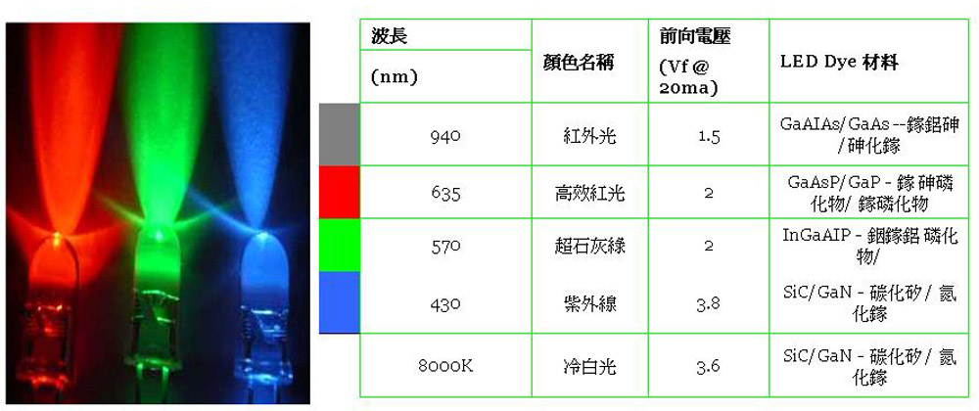
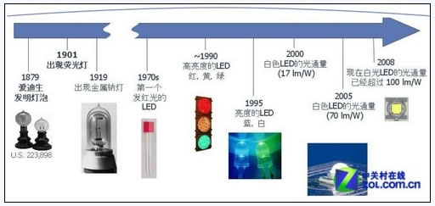
http://www.mem.com.tw/news/images/N081114000320081114143126.jpg
圖片來源：led.zol.com.cn

Slide 34
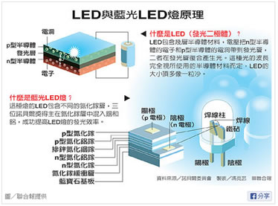
圖片來源：udn.com

Slide 35
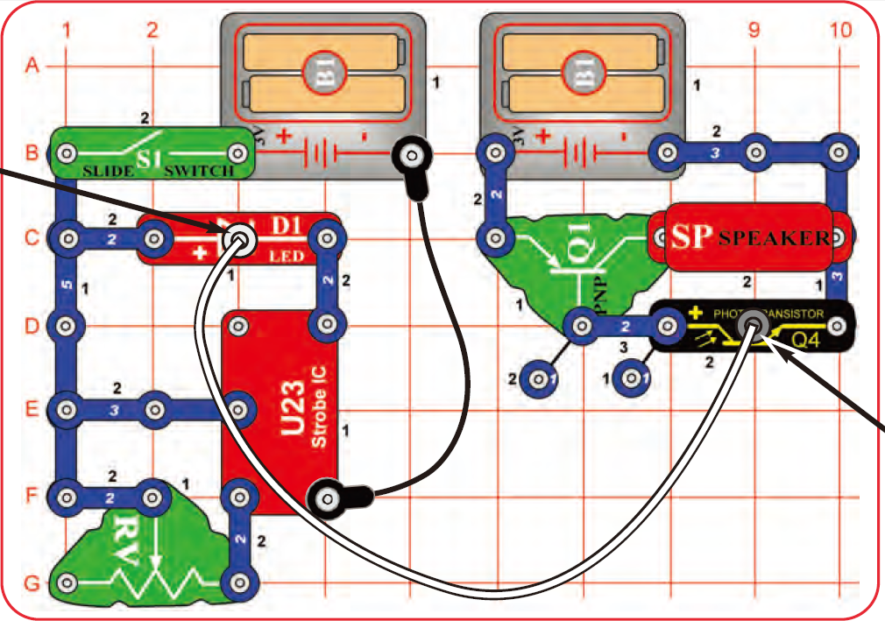
(13)光纖Fiber Optics
⇨光纖通訊
光纖支撐座
fiber optic cable holders
Build the circuit as shown.
Place the clear cable holder on the red LED (D1) and the black cable holder on the phototransistor (Q4), then place the fiber optic cable into the holders as far as it will go.
For best performance the cable should stand straight up in the holders, without bending them.
Turn on slide switch (S1) and move the lever on the adjustable resistor (RV) around.
The sound from the speaker (SP) changes as you move the lever on RV.
可變電阻RV

Slide 36
(13) 光纖 (Fiber Optics) ⇨光纖通訊
在左、右兩電路之間沒有任何導電線連接的狀況下，由位於電路左半部的閃頻 IC (U23)所產生的音調聲，竟能由右半部電路中的揚聲器(喇叭)播放出來。The tone sounds produced by the strobe IC (U23) are played on the speaker (SP), even though there is no electrical connection between them.
左半側電路以紅光LED D1和U23信號結合，製作編碼光信號。The left half the circuit makes a coded light signal, which you see in the red LED (D1).
右半側電路將由光纖傳送過來的編碼光信號做解碼後，傳給揚聲器播放的。The right half of the circuit decodes the light signal and plays it on the speaker.
光纖電纜是用來傳輸兩側電路間的光信號。The fiber optic cable is used to transmit the light signal between the two sides of the circuit.
左、右兩半電路間沒有導電線連接，僅使用光纖做為光線連接！There is no electrical connection between the left and right halves of the circuit, only a light connection using fiber optics!
如果光纖夠長，該電路的發射和接收信號的兩部份電路可以是分開許多英里以上。If your fiber optic cable was longer, the two halves of the circuit could be many miles apart.
光纖通訊：光纖允許在長距離內以很高的傳輸速率，且非常低的失真，藉由光波段的電磁波傳遞信息。This circuit is an example of using fiber optic cables for communication. Fiber optics allows information to be transmitted across great distances at very high speeds with very low distortion, by using light.

Slide 37
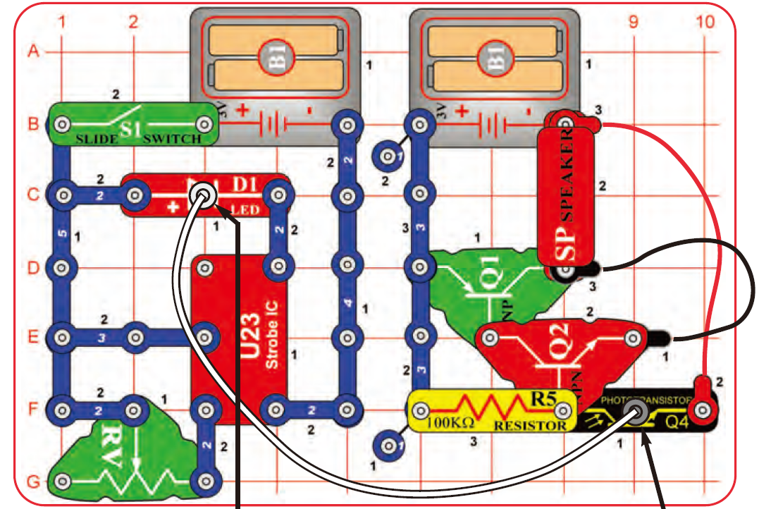
(12)光纖(Fiber Optics)
-更強的光纖通訊
經由串接Q1 & Q2兩個電晶體放大器
⇨使被解碼的光纖信號被放得更大，
⇨進而使揚聲器產生更強的聲音。
滑動可變電阻RV上的槓桿，可控制揚聲器(SP)播出之聲音的音量。因RV滑桿位置可改變電路上的電阻值，進而調整電路中的電流值。
Proj-13: Tones over light電路僅用一個電晶體放大器，但此電路使用了兩個電晶體放大器，故可以發生更響亮的聲音。

Slide 38
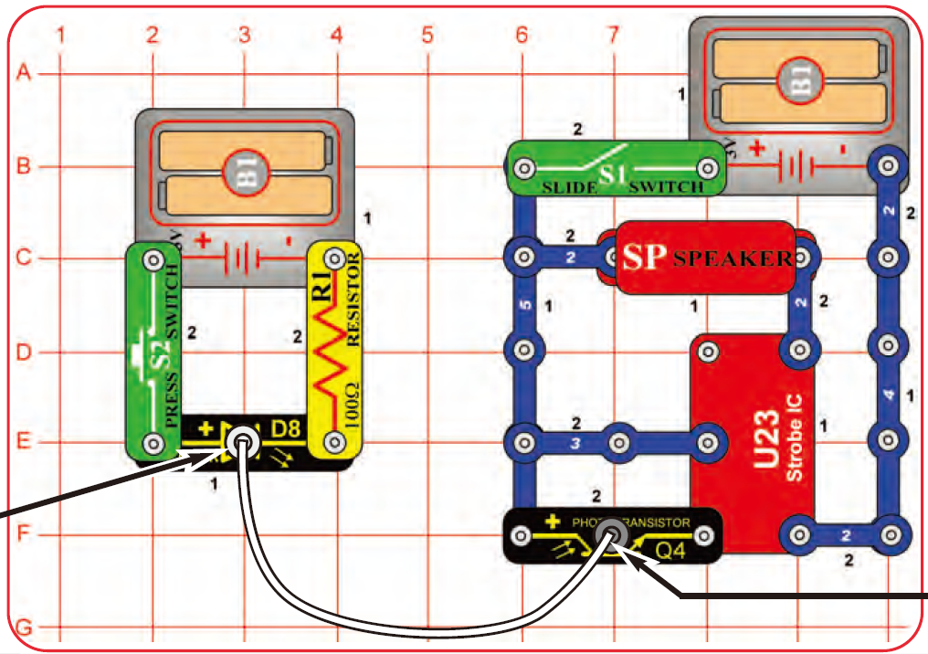
(14)光控聲響(Color Optic Sounds)
將閃頻 IC U23從光通訊電路中的編碼電路移至解碼電路中使用。
從全彩光源 D8發射出的光經光纖，傳送到閃頻IC U23的CTL 控制輸入端，以控制 U23 的輸出，進而控制揚聲器播出的聲音。
U23使用在編碼電路和解碼電路，有何不同？

Slide 39
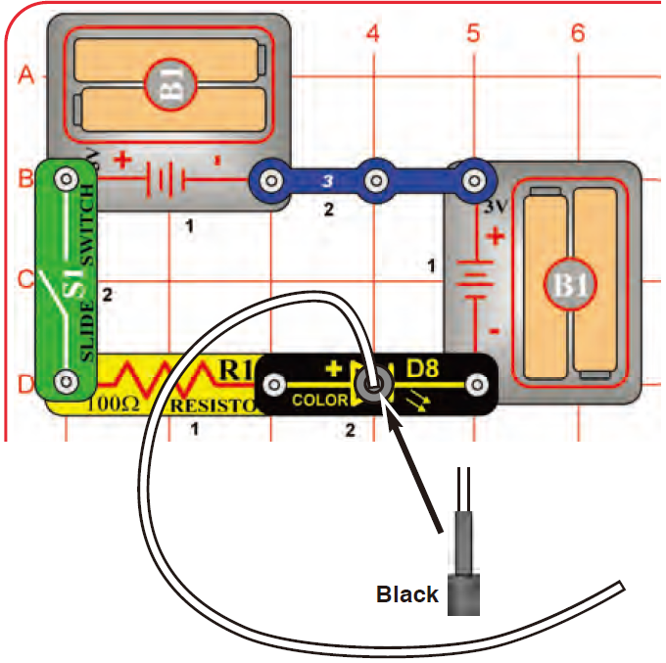
(15)色光的傳輸器(Color Light Transporter)
光線在大氣中以直線方向行進，但因大氣中充滿了水氣、空氣或各種物質，故很容易因與各種物質作用而產生被吸收、漫射、反射、折射等等各種作用，使得光線強度隨傳送距離衰減地很快，致使光線無法傳遞很遠。
但藉由光在光纖中的全反射現象，不僅可使光線以曲線路徑行進，並且可做遠距離的旅行，仍保持足夠的強度。
如圖，光纖的一端接到D8 全彩 LED光源上方，另一端讓之自由開放地留著。
打開開關S1，觀察D8發出的光從光纜自由端傳送出來的光線。
輕柔地將光纖彎成環型，千萬不要損壞光纖表面，切勿使之產生任何凹痕。
在暗房內，觀察光在光纖中傳送的情形。
原用架在D8 LED光源上方黑色不透光的支架改以透明的光纖支架取代後，t重新觀察上列各實驗過程的結果。並與前述互相結果比較。
改用
Leave the other end of the cable free. Turn on the switch S1 and look into the loose end of the fiber optic cable. Flex the cable into loops but don’t dent it. Take the circuit into a dark room and see how the cable looks. You can use the clear cable holder on the color LED instead of the black holder.

Slide 40
(16) Color Optics
打開開關S1，當D8 的光源改變顏色時，D8其實是快速反覆 地啟動、關閉其內部所含的三只R, G, B 單色LED光源，而發射出不同的顏色的光。
此連續開與關的切換動作，形成不同顏色光的變化，經光纖傳送到右側電路中的揚聲器中，產生很有趣「的、的、的、、、」的音效。
產生的音效聲很不大聲，故要很注意聽。

Slide 41
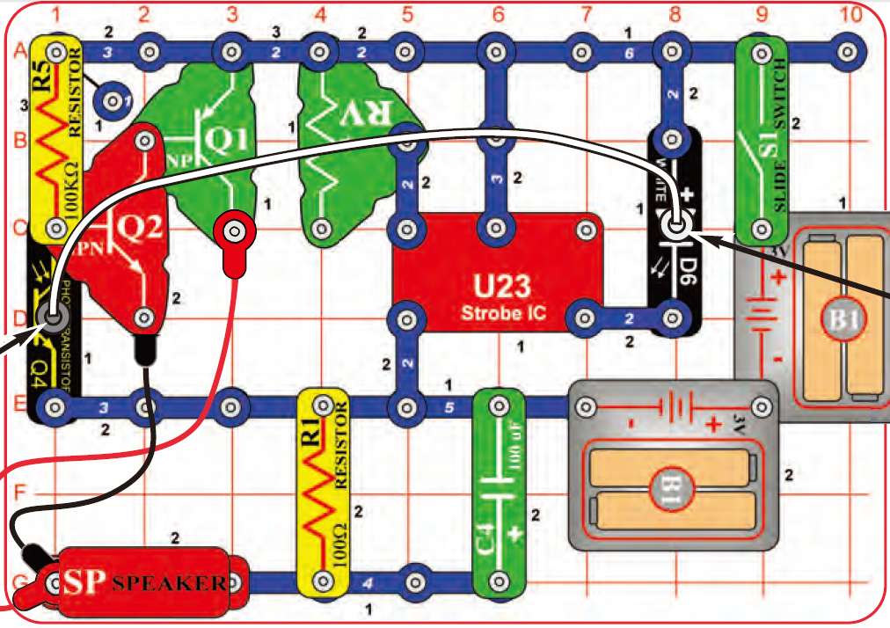
(17)高功率光纖通訊(High Power Fiber Optics)

Slide 42
(17) High Power Fiber Optics
Turn on the slide switch (S1) and move the lever on the adjustable resistor (RV) around.
⇨The sound from the speaker SP changes as one move the lever on RV.
Try removing the black cable holder and just holding the fiber optic cable next to the phototransistor with your fingers.
Hold it at different angles and compare the sound.
⇨You may not hear anything, due to background light in the room.
Take the circuit into a dark room or place your fingers around the phototransistor to block the room light to it.
Now put the black cable holder back on, remove the clear cable holder, and try holding the fiber optic cable at different positions around the white LED.
You can also replace the white LED with the red LED (D1) or the color LED (D8).

Slide 43
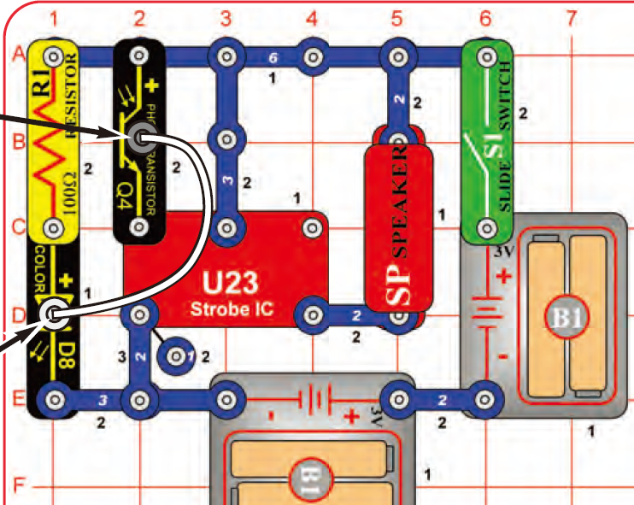
(18) High Color Optics Sounds
啟動滑動開關S1。從 LED D8發出的彩色光源，通過光纖電纜，將光送進閃頻IC U23的控制端點，揚聲器SP為U23輸出訊號端的輸出裝置。
Turn on the slide switch (S1). Light is transmitted from the color LED, through the fiber optic cable, to control the strobe IC (U23) and speaker (SP).
此電路和電路12與電路14很類似，不同之處在於光纖傳輸的光源發射子電路(含LED D8 者)和接收子電路(含有光電晶體者)是使用相同的電壓源。一般來說，因發射和接收電路分別座落在不同地方，故通常分開使用不同的電源。此處，兩電源串連可以增電路的功率。
The circuits on this page are similar to projects 12 and 14, but have the fiber optic transmitting sub-circuit (with the LED) and the receiving sub-circuit (with the phototransistor) using the same voltage sources. Normally the transmitting and receiving circuits will be in different locations with separate voltage sources, but they were combined here to increase the power.

Slide 44
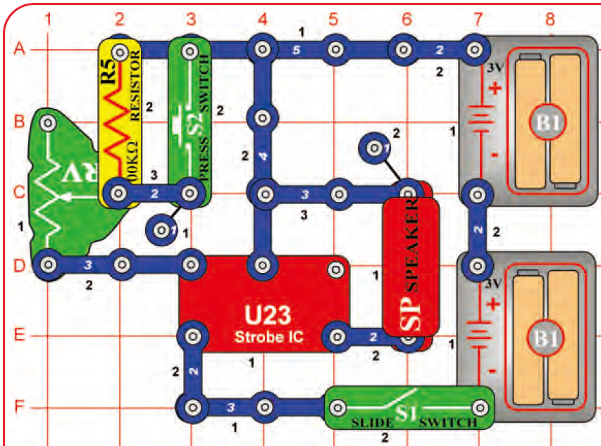
(19)聲音創客(Sound Maker)
電路連接如圖，打開S1開關，可聽到揚聲器的聲音。
透過滑動可變電阻器RV的調整桿位置和控制S2按鍵開關的開啟或關閉，可調整揚聲器輸出的音量。
注意：在極少情況下，有可能不管RV的電阻值為何，電路有可能無反應，或不工作。
如果發生這種情況，將RV桿滑至附近頻閃IC U23的一側， 並關閉滑動開關S1，再啟動S1，使重啟動電路，然後僅讓RV滑動桿在小範圍內調動。
閃頻IC U23可製造電子”音”(electrical “tone”)的訊號；電子音的”音調”(pitch)可由流過R5電阻的電流大小決定，可利用可變電阻調整通過R5的電流量。
U23所產生的電子音信號可用來使揚聲器發出特定的聲響；也可用以控制一個LED發光二體的閃光頻率(flash rate) ，如參見實驗20。
The strobe IC (U23) produces an electrical “tone”. The pitch of the “tone” is adjusted by changing how much electricity flows into its upper-left snap, using a resistor.
The electrical tone it produces can be used to make sound using a speaker, or to control the flash rate of an LED see project 20, the Strobe Light).
Notes:
操作與注意事項：
Build the circuit and turn on the switch (S1). You hear sound from the speaker.
Adjust the sound using the lever on the adjustable resistor (RV), and by pushing the press switch (S2).
Note: In rare cases the circuit may not work at all settings on RV.
If this happens, move the RV lever to the side near the strobe IC, turn the slide switch off and on to reset the circuit, and only move the RV lever over a small range.
電路原理說明：
The strobe IC (U23) produces an electrical “tone”. The pitch of the “tone” is adjusted by changing how much electricity flows into its upper-left snap, using a resistor. The electrical tone it produces can be used to make sound using a speaker, or to control the flash rate of an LED see project 20, the Strobe Light).

Slide 45
(20-22)白光、紅光、會變色的全彩閃光燈White, Red, or Color Strobe Lights
電路19中的揚聲器分別以(1)白色LED D6、(2)紅光LED D1、和(3)全彩的LED D8取代，可得白光、紅光、會變色的全彩閃光燈！
若將RV調製桿滑至最下方,並按壓S2開關,使R5無作用,可得最小有效電阻值。
⇨可使光閃爍的頻率快到讓人以為LED是持續發光，而不是以閃爍式發光。
Notes:
(20) Strobe Light:
Use the preceding circuit, but replace the speaker with the white LED (D6). Now you have a strobe light!
When S2 is pressed, the light may be linking so fast that it appears to be on continuously.
(21) Color Strobe Light-Use the preceding circuit, but replace the white LED with the color LED (D8).
The color LED will not be changing colors like it does in other circuits. When the strobe IC (U23) turns the color LED on and off, it resets the colorcontrol microcircuit in the color LED. Even your slowest strobe speed is too fast for the color LED.
(22) Red Strobe Light: Use the preceding circuit but replace the color LED (D8) with the red LED (D1).

Slide 46
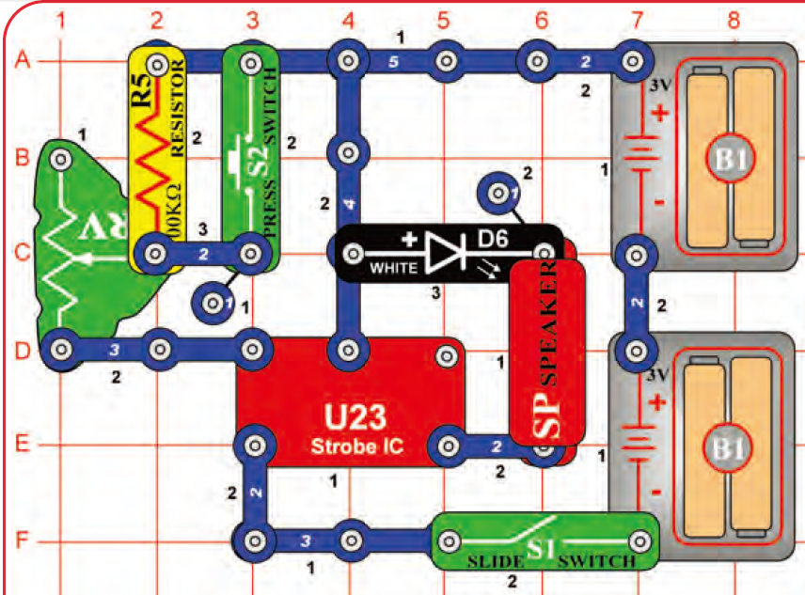
(23-25)嘈雜的閃光(Noisy Strobe Light)
電路19中, 緊鄰揚聲器的 3-snap wire ,以白色LED D6取代。
打開S1開關, 啟動電路; 由調整RV電阻值＋切換S2開關,控制U23輸出的閃爍速率，以控制D6白光閃爍和和SP發聲的速率。
另分別改以D 1或D8取代D6。 ⇨ 再將SP以任意一個LED取代。
建議LED垂直放比較好安接。
注意極性方向
注意：在極少情況下, 有可能不管RV的電阻值為何, 電路有可能無反應或不工作。
如果發生這種情況, 將RV桿滑至附近頻閃IC U23的一側, 並關閉滑動開關S1, 再啟動S1, 使重啟動電路, 然後僅讓RV滑動桿在小範圍內調動。
Notes:
Modify the project 19 circuit to be this one, which has the white LED (D6) next to the speaker (SP).
Build the circuit and turn on the switch (S1).
Adjust the blink rate and sound using the lever on the adjustable resistor (RV), and by pushing the press switch (S2).
Note: In rare cases the circuit may not work at all settings on RV.
If this happens, move the RV lever to the side near the strobe IC, turn the slide switch off and on to reset the circuit, and only move the RV lever over a small range.

Slide 47
(24)嘈雜的紅色閃光(Noisy Red Strobe Light)
-電路19中,緊鄰揚聲器的 3-snap wire,改用紅光LED D1或全彩LED D8.
(25)雙閃爍光(Double Strobe Light)
--將揚聲器SP以任意一個LED取代，即將任意兩個 LED串接，取代圖中 D1+SP的位置。
建議LED垂直放比較好安接。注意極性方向
Notes:
(24) Noisy Red Strobe Light: Use the preceding circuit but replace the white LED (D6) with the red LED (D1) or the color LED (D8).
(25) Double Strobe Light: Use the preceding circuit but replace the speaker and LED with any two LEDs (red, white, or color).

Slide 48
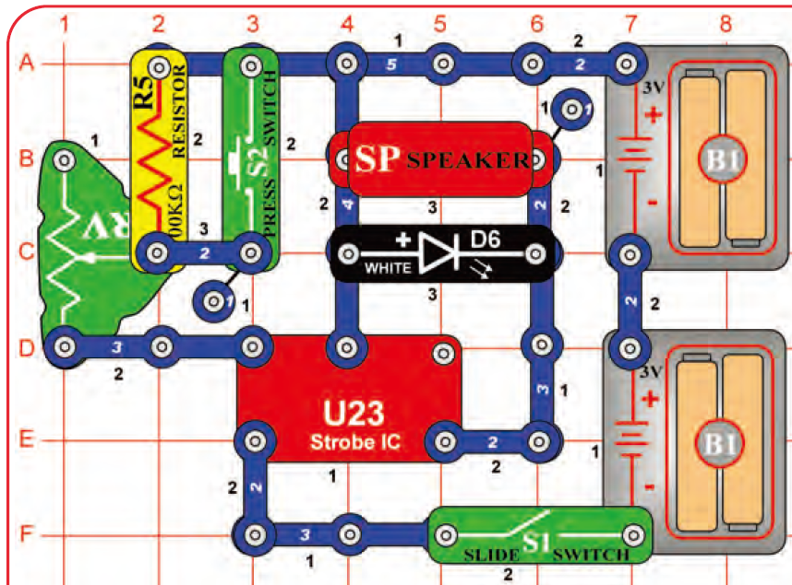
(26 & 27)更響的閃光(Louder Strobe Light)
電路23-25中，原為串聯的SP+LED D6 (或D8) 改為並聯；使SP發出更大的聲響。以 RV + S2 on/off 調控閃頻U23的閃爍頻率。
以RV+S2 on/off 調控閃頻U23的閃爍頻率。
Notes:
(26)更響的閃光(Louder Strobe Light)
Modify the preceding circuit to be this one, which has the white LED (D6) in parallel with the speaker (SP).
Build the circuit and turn on the switch (S1).
Adjust the blink rate and sound using the lever on the adjustable resistor (RV), and by pushing the press switch (S2).
This circuit is louder than the previous circuits because the speaker is in parallel with the LED instead of in series with it. This increases the voltage across the speaker, making it louder.
(27) Louder Color Strobe Light: Use the preceding circuit but replace the white LED (D6) with the red LED (D1) or the color LED (D8).

Slide 49
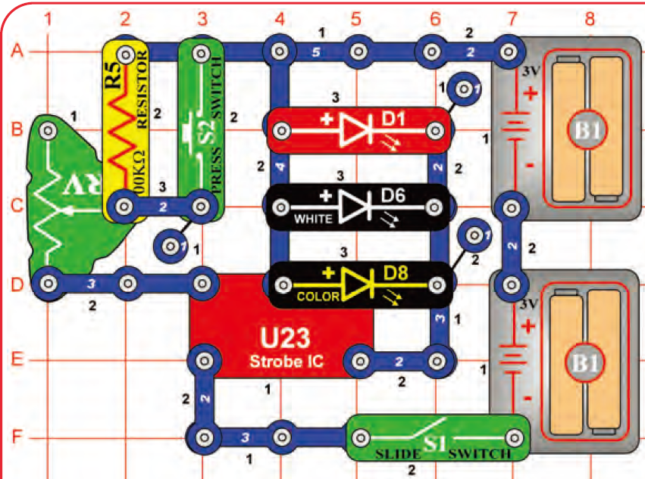
(28) Triple & (29) Noisy Double Strobe Light
三個D1, D6, D8 LED並聯於U23的＋極電源輸入端與輸出端OUT間
其中一個LED 以揚聲器SP替代之。
以RV+S2 on/off 調控閃頻U23的閃爍頻率。
Notes:
(28) Triple Strobe Light
Build this circuit and turn on the slide switch (S1).
Adjust the blink rate using the lever on the adjustable resistor (RV), and by pushing the press switch (S2).
Note: In rare cases the circuit may not work at all settings on RV.
If this happens, move the RV lever to the side near the strobe IC, turn the slide switch off and on to reset the circuit, and only move the RV lever over a small range.

Slide 50
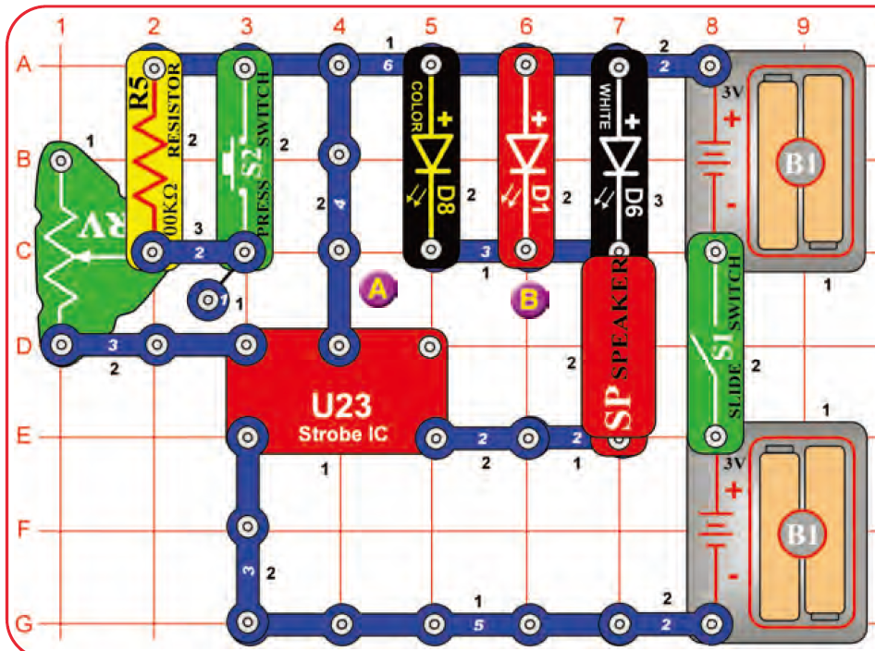
(30)雜響的三道閃光(Noisy Triple Strober)
將「三個D1, D6, D8 LEDs先並聯後，再串聯SP揚聲器」的子電路
連接於U23的＋極電源輸入端與輸出端OUT間，
Notes:
(30) Noisy Triple Strober
Build this circuit and turn on the slide switch (S1).
Adjust the blink rate and sound using the lever on the adjustable resistor (RV), and by pushing the press switch (S2).
Note: In rare cases the circuit may not work at all settings on RV.
If this happens, move the RV lever to the side near the strobe IC, turn the slide switch off and on to reset the circuit, and only move the RV lever over a small range.
(31) Triple Light Noisy Motion Strober:
Use the preceding circuit but replace the speaker (SP) with the motor (M1, “+” toward white LED), then place the speaker across the points marked A & B in the drawing. Do not place any fan on the motor.
The LEDs (D1, D6, & D8) flash, the speaker makes noise, and the motor shaft spins or wiggles.
Adjust the blink rate, sound, and motor spin using the lever on the adjustable resistor (RV), and by pushing the press switch (S2).

Slide 51
(31) Triple Light Noisy Motion Strober
前述電路30中，將SP揚聲器橫向跨接於圖中的A、B兩點上；
原SP揚聲器的位置以馬達取代，且馬達正極與LED 負極連接；馬達上要不要安裝風扇。
三個並聯的LEDs (D1, D6, & D8) 閃爍
SP 揚聲器製造噪音
馬達軸承旋轉或搖幌(wiggles).
以RV+S2 on/off 調控閃頻U23的閃爍頻率。
Notes:
(31) Triple Light Noisy Motion Strober
Use the preceding circuit but replace the speaker (SP) with the motor (M1, “+” toward white LED), then place the speaker across the points marked A & B in the drawing. Do not place any fan on the motor.
The LEDs (D1, D6, & D8) flash, the speaker makes noise, and the motor shaft spins or wiggles.
Adjust the blink rate, sound, and motor spin using the lever on the adjustable resistor (RV), and by pushing the press switch (S2).

Slide 52
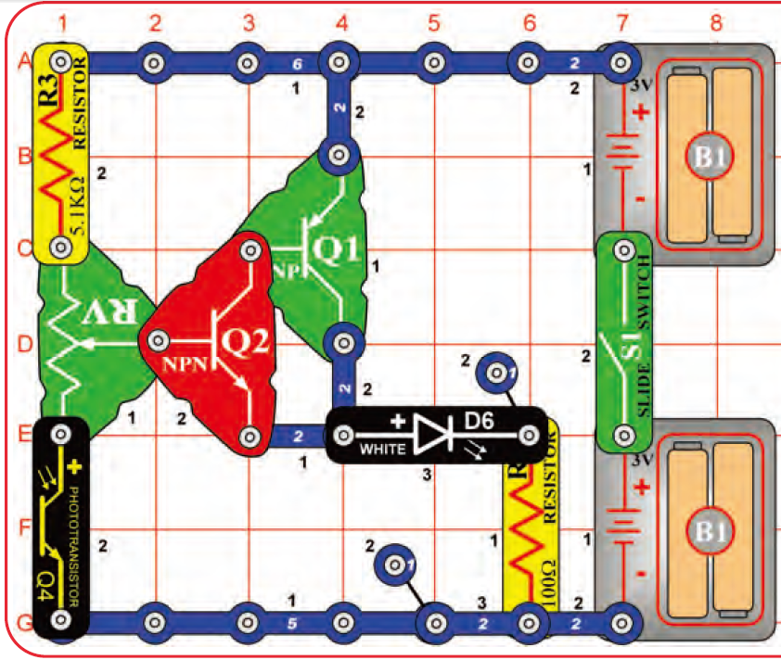
(32)自動點滅路燈(Automatic Light)
接通S1開關, 移動可變電阻RV調整桿, 使白光LED D6 恰好不會亮。
慢慢遮住光電晶體管Q4，可使白光LED變亮。
調整打到光電晶體Q4上的光強度，可控制白光LED的開啟或關閉。
白光LED D6可更換為彩色LED D8或紅光LED D1。
但需要重新調整RV調整桿的位置，因不同的LED，對光強度的靈敏度有所會異動。
此為一自動亮滅的路燈裝置電路，當光線暗到某一個程度時，路燈會自動打開；當光現達到某一亮度時，則路燈會自動關閉。多安裝在戶外的燈座上，以節省電力或因安全考量。
Notes:
(32) Automatic Light
Build the circuit and turn on the slide switch (S1).
Set the lever on the adjustable resistor (RV) so the white LED (D6) just turns off.
Slowly cover the phototransistor (Q4) and the white LED brightens.
Adjust the light to the phototransistor to turn the white LED on or off.
This is an automatic street lamp that you can turn on at a certain darkness and turn off by a certain brightness.
This type of circuit is installed on many outside lights and forces them to turn off and save electricity.
They also come on when needed for safety.
You can replace the white LED with the color LED (D8) or the red LED (D1), but you may need to readjust the sensitivity using the lever on RV.

Slide 53
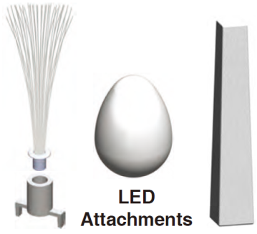
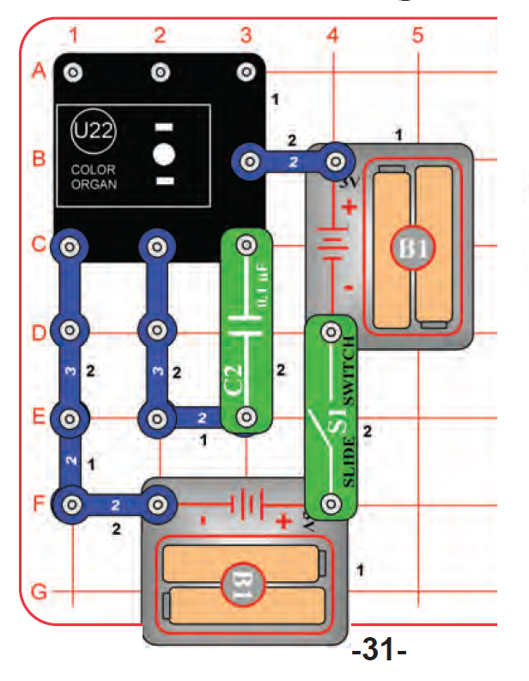
(33)彩光震盪器(Color Oscillator)
電路連接如圖，在彩光控制器U22的LED上安置一個塔型，蛋型，或光纖束的燈具。
啟動開關S1，彩光控制器U22上之LED光的顏色會自己變化。
此為振盪器；控制器U22自己控制振盪。
Notes:
(33)彩光震盪器(Color Oscillator)
Build the circuit as shown, and place one of the LED attachments (tower, egg, or fiber optic tree) over the LED on the Color Organ (U22).
Turn on the switch (S1) and watch. The color organ light will change colors on its own.
This circuit is an oscillator; it uses the color organ to control itself.

Slide 54
積體電路套件 U22、U23各接點用途
Connections:
R - red color control
G - green color control
B - blue color control
(+) - power from batteries
INP - circuit input
FB - feedback connection
(–) - power return to batteries
IN - audio input jack
OUT - audio output jack
Connections:
(+) - power from batteries
(–) - power return to batteries
OUT - output connection
CTL - strobe speed control
NC - not used

Slide 55
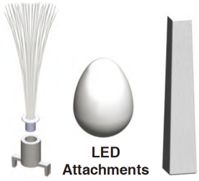
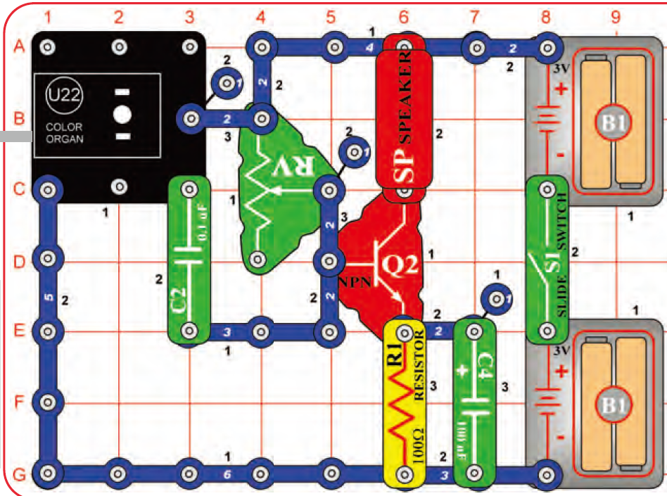
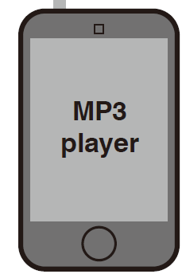
(34)讓光隨音樂起舞(Dance to the Music)
Build the circuit. Connect a music device (not included) to the color organ (U22) as shown, and start music on it.
Place one of the LED attachments over the light on the color organ.
Set the lever on the adjustable resistor (RV), and the volume control on your music device, for best sound quality and light effects.
The color organ light will “dance” in synch with the music.
Compare fast and slow songs, and different loudness levels.
This circuit amplifies the music so it can be heard on the speaker. This is a simple circuit, so sound quality may not be as good as your other music players.
將音樂裝置連接到U22右側標示「in」的輸入口，並開始播放音樂。
調整RV的電阻 &音樂裝置的音量控制器，以獲得最佳的音質和燈光效果。
U22的LED所發之光的顏色和亮度將會與音樂同步變化喔！。
比較快歌、慢歌，和不同的響度級的音樂播放情形。
LED燈具安裝在U22上方的LED上。
此電路將音樂裝置所傳入的信號放大，使可由揚聲器播放出來。
因僅是簡單電路，故所播音樂品質當然不如一般音樂播放器好。
Notes:
(34) Dance to the Music
Build the circuit. Connect a music device (not included) to the color organ (U22) as shown, and start music on it.
Place one of the LED attachments over the light on the color organ.
Set the lever on the adjustable resistor (RV), and the volume control on your music device, for best sound quality and light effects.
The color organ light will “dance” in synch with the music.
Compare fast and slow songs, and different loudness levels.
This circuit amplifies the music so it can be heard on the speaker. This is a simple circuit, so sound quality may not be as good as your other music players.

Slide 56
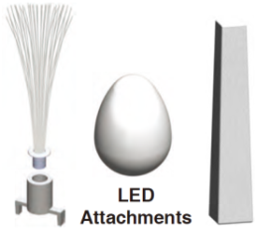
(35)讓光隨音樂勁舞(Super Dance to the Music)
相較前一個電路，此電路能使揚聲器播放出更響亮、更靈敏的音樂。
開啟S1開關，慢慢地調動RV的電阻，使能得到最好且清晰的聲音；僅在很窄的電阻範圍內能獲得清晰的音樂聲。
然後，再調整音樂裝置的音量，以得到最佳的音樂品質。
(36)除去 C4電容器( 電容值C = 100μF)，揚聲器播出的聲音將比較不響亮，但音樂的失真度卻比較低了。
Notes:
(35) Super Dance to the Music
This circuit is similar to the preceding one, but louder and more sensitive.
Build the circuit as shown.
Connect a music device (not included) to the color organ (U22) as shown, and start music on it, set the volume to mid-range.
Place one of the LED attachments over the light on the color organ.
Turn on the switch (S1) and SLOWLY ADJUST the lever on the adjustable resistor (RV) for best sound; there will only be a narrow range where the sound is clear.
Adjust the volume on your music device for best sound quality.

Slide 57
(36)讓光隨音樂勁舞Super Dance to the Music (II)
如前一個電路連接，但除去 C4電容器( 電容值C = 100μF)，此時揚聲器所播放的聲音不再那麼響亮，但音樂的失真度卻比較低了。
調整RV的電阻值和控制音樂裝置的音量，使能得到最佳的音樂聲響。

Slide 58
(37) 隨著音樂(Follow the Music)
Build the circuit. Set the volume control on your music device
for best sound quality and light effects.
The color organ light will “dance” in synch with the music.
Compare fast and slow songs, and different loudness levels.
Notes:
(37) 隨著音樂(Follow the Music)
Build the circuit. Connect a music device (not included) to the color organ (U22) as shown, and start music on it.
For best effects, place one of the LED attachments over the light on the color organ.
Set the volume control on your music device for best sound quality and light effects.
The color organ light will “dance” in synch with the music.
Compare fast and slow songs, and different loudness levels.

Slide 59
(38) 彩光控制器U22的耳機輸出聲音
(Color Organ – Headphones)
連接如圖的電路。自備的音樂裝置和耳機如圖所示，分別連接到U22右側的IN和OUT插入口，啟動音樂。
為達到最佳效果，將LED燈具安裝於LED上。
調整音樂裝置的音量控制，以得到最佳音質和燈光效果。
Build the circuit. Connect a music device (not included) and your own headphones (not included) to the color organ (U22) as shown, and start music on it.
For best effects, place one of the LED attachments over the light on the color organ.
Set the volume control on your music device for best sound quality and light effects.
The color organ light will “dance” in synch with the music.
Output signal to headphones is mono, so you will not hear stereo effects.
U22上之LED的光變化將隨音樂「同步」起“舞”。
因輸送到耳機的信號是單聲道信號，所以不會聽到立體聲的效果。
比較此電路中，用耳機聽到的音樂和前幾個電路使用揚聲器所聽到的聲音質量。
Notes:
(38) 彩光控制器U22的耳機輸出孔(Color Organ – Headphones)
Build the circuit. Connect a music device (not included) and your own headphones (not included) to the color organ (U22) as shown, and start music on it.
For best effects, place one of the LED attachments over the light on the color organ.
Set the volume control on your music device for best sound quality and light effects.
The color organ light will “dance” in synch with the music.
Output signal to headphones is mono, so you will not hear stereo effects.
Compare the sound quality of using headphones in this circuit, to using the speaker in the preceding circuit.

Slide 60
(39)可調度的光舞秀(Adjustable Light Dance)
啟動電路，調變可變電阻RV的電阻值，以改變
聲音的音調(tone of sound)和光的「速度」(Speed of Light)。
Notes:
(39)可調度的光舞秀(Adjustable Light Dance)
Build the circuit as shown. For best effects, place one of the LED attachments over the light on the color organ.
Turn on the switch (S1) and move the lever on the adjustable resistor (RV) to change the tone of the sound and “speed” of the light.

Slide 61
(40)懸浮的水滴(Suspended Raindrops)
Build the circuit as shown. Connect the white LED (D6) to the red & black jumper wires. Turn on the slide switch (S1).
Go to a water faucet and adjust the faucet so water is dripping at a steady rate.
Dim the room lights and hold the white LED so it shines on the dripping water.
Try to set the lever on the adjustable resistor (RV) so that the dipping water drops appear suspended in mid-air.
You may need to adjust the drip rate on the faucet to make this work.
You may get better results if you replace the 100kΩ resistor (R5) with the 5.1kΩ resistor (R3).
Also, try setting the strobe rate to minimum and adjusting the drip rate.
如圖，以紅和黑跳線連接白光LED D6 到電路中，開啟滑動開關S1。
將電路拿到水龍頭附近，調整水龍頭的水流量，使水以穩定流速滴落。
調暗室內燈光，並手持白光LED，以使LED可打光在滴水束上。
試著調變可變電阻RV的電阻值，使下落的水滴看來像是懸浮在半空中，不會往下落的錯覺。
可能需調整水龍頭的水流速，以順利觀察到懸浮現象。
若以 5.1 kΩ 的R3電阻取代 100 kΩ 的 R5電阻，可能會有比較好的效果。
也可嘗試將閃頻 IC U22的閃頻速率調到最低值，並調整水滴的速率。
Notes:
(40) Suspended Raindrops
Build the circuit as shown. Connect the white LED (D6) to the red & black jumper wires. Turn on the slide switch (S1).
Go to a water faucet and adjust the faucet so water is dripping at a steady rate.
Dim the room lights and hold the white LED so it shines on the dripping water.
Try to set the lever on the adjustable resistor (RV) so that the dipping water drops appear suspended in mid-air.
You may need to adjust the drip rate on the faucet to make this work.
You may get better results if you replace the 100kΩ resistor (R5) with the 5.1kΩ resistor (R3).
Also, try setting the strobe rate to minimum and adjusting the drip rate.

Slide 62
(41)紅外線偵測器(Infrared Detector)
連接如圖電路，並取一個家用的電視/音響/DVD遙控器。
將遙控器的紅外線發光源對著電路中U24紅外探測器，然後按下遙控器上的任一鍵，即可觸使電路中的紅光LED D1發光。
有時即使沒有遙控器，在陽光下或房間內的某些光也可能觸動紅光LED D1發光。若此，可將實驗移到較黑暗的房間內進行。
電視遙控器會發送一系列紅外光頻段的脈衝序列，以表示電視機型號和所按下之按鈕所代表要傳遞的信息。
U24紅外光探測器隨時偵測其周圍環境的紅外光源
紅外線遙控器
Notes:
(41)紅外線偵測器(Infrared Detector)
You need an infrared remote control for this project, such as any TV/stereo/DVD remote control in your home.
Build the circuit and turn on the switch (S1). Point your remote control toward the infrared module (U24) and press any button to activate the red LED (D1).
Sometimes this circuit may activate without a remote control, due to infrared in sunlight or some room lights.
If this happens, try moving to a dark room.
TV remote controls transmit a sequence of pulses representing the TV model and the button that was pressed. The U24 infrared detector is just looking any infrared signal.

Slide 63
(42)音頻紅外線偵測器(Audio Infrared Detector)
電路連接如圖，RV取最低電阻值(即滑桿滑到至U24一側),啟動電路。
將家用紅外光遙控器的紅外線發光源對著電路中U24紅外探測器，按下遙控器上任一鍵，即會觸發電路中的SP發生警報聲響。
調變RV的電阻值(僅能小範圍內變化)，看看警報聲可以響多久。
若以 R3電阻(5.1kΩ) 取代R1電阻(100 kΩ )，警報聲響會略為不同,但RV電阻的變化範圍可比較大些。
陽光或某些光也會發射一些紅外光，且可能激發紅光LED發光。看看在沒有遙控器的情形下，是否會有此結果發生。
Sunlight and other light sources emit some infrared light, and may activate the infrared detector. See if you can activate it without a remote control.
有時雖沒有遙控器，但陽光或某些室內燈光會有紅外線存在。如果會發生此情況，建議可移動到一個較黑暗的房間，再進行實驗。
Notes:
(42) Audio Infrared Detector
You need an infrared remote control for this project, such as any TV/stereo/DVD remote control in your home.
Build the circuit, set the lever on the adjustable resistor (RV) all the way towards the infrared module (U24), and turn on the switch (S1).
Point your remote control toward the infrared module and press any button to activate an alarm sound.
The lever on the adjustable resistor sets how long the alarm plays for, but it only works over a narrow range.
Next, replace the 100Ω resistor (R1) with the 5.1kΩ resistor (R3). The alarm sound is a little different, but the control range on RV is wider.
Sometimes this circuit may activate without a remote control, due to infrared in sunlight or some room lights. If this happens, try moving to a dark room.
Sunlight and other light sources emit some infrared light, and may activate the infrared detector. See if you can activate it without a remote control.

Slide 64
(43)光子紅外偵測器(Photo Infrared Detector)
如圖，將前述固定光纖束用的基座置放於感光電晶體Q4上方。
調整RV的電阻值，使紅光LED D1剛好不會亮。如果無法使D1不亮，請關閉或移去室內的光源。
將家用紅外線遙控器直接對著插在Q4的基座後，然後按下遙控器上的任一按鈕，應立即可見到紅光色LED D1被激活發光。
Q4 感光電晶體(phototransistor)
則可用以檢測可見光和紅外光。
U24 紅外感測器(infrared detector module)被設計成只能偵測紅外光。
Notes:
(43)光子紅外偵測器(Photo Infrared Detector)
You need an infrared remote control for this project, such as any TV/stereo/DVD remote control in your home.
Build the circuit and turn on the switch (S1).
Place the mounting base (normally used with the fiber optic tree) on the phototransistor (Q4).
Set the lever on the adjustable resistor (RV) so the red LED (D1) just turns off; if it never turns off, move away from room lights.
Point your remote control directly into the mounting base on Q4, and press any button to activate the red LED (D1).
The phototransistor can detect light, and infrared light is light. The infrared module (U24) is designed to focus only on infrared light.

Slide 65
(44)光控音波感測器(Photo Audio Infrared Detector)
如圖連接電路，並啟動電路。調整RV的電阻值，使揚聲器SP剛好不會發出聲響。如果無論如何調動RV電阻值，都無法使SP不發聲響的話，請關閉或移去室內的光源。
將家用紅外線遙控器直接對著插在Q4上的基座後，然後按下遙控器上的任一按鈕，隨之應立即可聽到SP被激發出聲響。
(45) Photo Audio Infrared Detector II
若以電容器C4 (100μF) 取代電容器C2 (0.1μF)
⇨揚聲器SP發出更長且更悅耳的聲響喔！
Notes:
(44) Photo Audio Infrared Detector
You need an infrared remote control for this project, such as any TV/stereo/DVD remote control in your home.
Build the circuit and turn on the switch (S1).
Place the mounting base (normally used with the fiber optic tree) on the phototransistor (Q4).
Set the lever on the adjustable resistor (RV) so the sound just turns off (if it never turns off, move away from room lights.
Point your remote control directly into the mounting base on Q4, and press any button to activate the sound.

Slide 66
(45) Photo Audio Infrared Detector (II)
若以100μF的電容器C4 取代 0.1μF的電容器C2，可使揚聲器SP發出更長且比較悅耳的聲響喔！
Use the preceding circuit, but replace the 0.1μF capacitor (C2) with the 100μF capacitor (C4). The circuit works the same way, but the sound stays on longer and is more pleasant.
Notes:
(45) Photo Audio Infrared Detector (II)
Use the preceding circuit, but replace the 0.1μF capacitor (C2) with the 100μF capacitor (C4).
The circuit works the same way, but the sound stays on longer and is more pleasant.

Slide 67
(46-54)閃頻效應實驗前的準備
如圖所示，將彩色圓形紙片(Colored disc)安裝到灰色塑質的圓型托盤座(Disk holder，簡稱圓盤)上。
並將彩色紙片圓邊緣的三片突出的小Tab片，經由圓托盤邊的三個小洞內由內往外插出。如此不需要任何膠帶或黏貼劑，就能讓紙片固定在托盤上。
如此，實驗時馬達快速旋轉，紙片也不致飛離托盤；實驗後，也易於更換其他的圓紙片。
並將之小心地安裝到馬達M1的旋轉軸承上。
Tab
Tab
Tab
Notes:
Build the circuit as shown. Take the colored disc shown and install it into the disc holder, then place the disc holder on the motor (M1).
Connect the white LED (D6) to the red & black jumper wires.
For best effects, do this in a dimly lit room.
Turn on the slide switch (S1) and push the press switch (S2) until the motor spins continuously (if it stops after you release the press switch, replace your batteries).
Hold the white LED upside down over the disc holder so it shines on the spinning disc, and move the lever on the adjustable resistor (RV) slowly while watching the pattern on the spinning disc.
The motor spins the disc so fast that it looks like a blur.
However, as you slowly adjust RV the pattern on the disc appears to slow down, stop, and reverse direction.
Patterns close to the disc center may be moving at different speeds, or in different directions, from patterns farther from the center!
Some patterns may become clear while others are still blurred.
If the motor does not continue spinning after you release S2, then replace your batteries.
If it still won’t keep spinning then replace the 5.1kΩ resistor (R3) with

Slide 68
附加：碟形盤黏固於馬達軸承頂部的流程(需成人陪同處理)
碟形托盤若鬆鬆地安放在馬達旋轉軸承的上方時，則當馬達旋轉，會因托盤鬆動或搖擺震動，導致實驗觀察所得的圖案搖晃，致使圖案看來混亂變化、模糊不清。即使是當實驗時，RV的電阻值調整到應該是要得到圖案看來是靜止不動的狀態時。The disc holder rests on the motor top loosely and vibrates, making the disc pattern blurry even when the RV setting makes the pattern “stop”.
如果圓盤能緊固在軸承頂上(motor top)的話，圖案會顯示得明顯清晰。The disc patterns will appear clearer if you permanently mount the disc holder to the motor top.
Notes:
OPTIONAL (Adult supervision required)
The disc holder rests on the motor top loosely and vibrates, making the disc pattern blurry even when the RV setting makes the pattern “stop”.
The disc patterns will appear clearer if you permanently mount the disc holder to the motor top. This set contains a spare motor top, which can be used for this. This requires removing the motor top from the motor whenever you want to switch from using the disc holder to using the glow fan, so is optional, and requires adult supervision. If you want to do this, pry the motor top off the motor shaft using a screwdriver.
Lay the spare motor top in the disc holder upside down, and bond together with glue (glue not included).
After the glue dries, push the modified disc holder on the motor shaft and install a disc cutout.
When you want to return to using the glow fan, replace the motor top disc holder with the normal motor top.

Slide 69
碟形盤黏固於馬達軸承頂部流程
(a)
材料包中有一備用的馬達頂部(motor top)，取出備用。
先從馬達軸承上方拆除用以安裝風扇用的三軸卡榫配件，如圖(a)所示。This requires removing the motor top from the motor whenever you want to switch from using the disc holder to using the glow fan, so is optional, and requires adult supervision.
使用平頭螺絲起子小心地撬出馬達頂部配件。To pry the motor top off the motor shaft using a screwdriver.
如圖(b)所示，將馬達頂套配件平放在圓形托盤底部的中心凹洞內，用膠水將兩者黏勞在一起。Lay the spare motor top in the disc holder upside down, and bond together with glue (glue not included).
等膠水乾了後，以手的力量將處理好的托盤固定在馬達的軸承上。After the glue dries, push the modified disc holder on the motor shaft and install a disc cutout.
當想改用發光風扇，則除離此碟形托盤，更換成普通用以安裝風扇用的三軸卡榫配件即可。When you want to return to using the glow fan, replace the motor top disc holder with the normal motor top.
(b)
(c)
Notes:
OPTIONAL (Adult supervision required)
The disc holder rests on the motor top loosely and vibrates, making the disc pattern blurry even when the RV setting makes the pattern “stop”.
The disc patterns will appear clearer if you permanently mount the disc holder to the motor top. This set contains a spare motor top, which can be used for this. This requires removing the motor top from the motor whenever you want to switch from using the disc holder to using the glow fan, so is optional, and requires adult supervision. If you want to do this, pry the motor top off the motor shaft using a screwdriver.
Lay the spare motor top in the disc holder upside down, and bond together with glue (glue not included).
After the glue dries, push the modified disc holder on the motor shaft and install a disc cutout.
When you want to return to using the glow fan, replace the motor top disc holder with the normal motor top.

Slide 70
(46-54)閃頻效應(Strobe Effects)
Projects 46-54使用的電路圖

Slide 71
(46-54)閃頻效應實驗前的準備
如圖所示，將彩色圓形紙片(Colored disc)安裝到灰色塑質的圓型托盤座(Disk holder，簡稱圓盤)上。
並將彩色紙片圓邊緣的三片突出的小Tab片，經由圓托盤邊的三個小洞內由內往外插出。如此可不需任何膠帶或黏貼劑，就能讓紙片固定在托盤上。
如此，實驗時馬達快速旋轉，紙片也不致飛離托盤；實驗後，也易於更換其他的圓紙片。
並將之小心地安裝到馬達M1的旋轉軸承上。
Tab
Tab
Tab
Notes:
Build the circuit as shown. Take the colored disc shown and install it into the disc holder, then place the disc holder on the motor (M1).
Connect the white LED (D6) to the red & black jumper wires.
For best effects, do this in a dimly lit room.
Turn on the slide switch (S1) and push the press switch (S2) until the motor spins continuously (if it stops after you release the press switch, replace your batteries).
Hold the white LED upside down over the disc holder so it shines on the spinning disc, and move the lever on the adjustable resistor (RV) slowly while watching the pattern on the spinning disc.
The motor spins the disc so fast that it looks like a blur.
However, as you slowly adjust RV the pattern on the disc appears to slow down, stop, and reverse direction.
Patterns close to the disc center may be moving at different speeds, or in different directions, from patterns farther from the center!
Some patterns may become clear while others are still blurred.
If the motor does not continue spinning after you release S2, then replace your batteries.
If it still won’t keep spinning then replace the 5.1kΩ resistor (R3) with

Slide 72
(46-54)閃頻效應(Strobe Effects)
白光LED D6的正、負極分別以紅和黑色兩跳線連接到圖中所示位置。
為能觀察到最佳的實驗效果，建議在燈光比較昏暗的房間內進行此系列的實驗為宜。
開啟滑動開關S1，持續按著按鍵開關S2，直至馬達可以持續旋轉。
注意：如果一放開S2的按鍵開關，馬達很快就停止不轉動的話，表示馬達無法啟動達到足夠高的全速運轉的能力，意即所使用之電池的內部電能可能已經不夠了。建議應更換新的電池。
手持白光LED D6 如右圖所示，使D6所發的白光光源照射到圓盤上的彩色圖片上；
然後在將RV的電阻值從最小電阻值，慢慢地調高其電阻的過程中，仔細觀察轉盤上的圖案如何隨RV電阻和轉盤轉速改調變而變化。
轉盤轉速實際是順著固定方逐漸變變快，但彩色圓紙片上圖案的轉動，有時看來卻好像是變慢旋轉、有時又好像要停止不轉，有時卻又像正在做反向旋轉的運動。
Notes:
Build the circuit as shown. Take the colored disc shown and install it into the disc holder, then place the disc holder on the motor (M1).
Connect the white LED (D6) to the red & black jumper wires.
For best effects, do this in a dimly lit room.
Turn on the slide switch (S1) and push the press switch (S2) until the motor spins continuously (if it stops after you release the press switch, replace your batteries).
Hold the white LED upside down over the disc holder so it shines on the spinning disc, and move the lever on the adjustable resistor (RV) slowly while watching the pattern on the spinning disc.
The motor spins the disc so fast that it looks like a blur.
However, as you slowly adjust RV the pattern on the disc appears to slow down, stop, and reverse direction.
Patterns close to the disc center may be moving at different speeds, or in different directions, from patterns farther from the center!
Some patterns may become clear while others are still blurred.
If the motor does not continue spinning after you release S2, then replace your batteries.
If it still won’t keep spinning then replace the 5.1kΩ resistor (R3) with

Slide 73
(46) 閃頻效應解說(Explanation of Strobe Effects)
閃頻IC U22使LED的白光閃爍得非常快，以致人眼觀測以為LED是持續不間斷地發光。The strobe IC is making the white LED flash so fast that your eyes think it is on continuously.
經由調整RV的電阻值調控了閃頻IC U22的閃光速率：
當LED的閃光頻率與轉盤的轉速同步的話，則可清楚地看到紙片上的圖案，甚至以為圖案沒有在旋轉，而被誤以為是靜止不動的狀態。
若光的閃光速率和圖片的轉速沒有同步的話，則看到的便是圖片模糊混成一片的混色結果。RV sets the flash rate, and at some settings the LED flashes are synchronized with speed of the patterns spinning on the disc, making them appear visible instead of blurred.
當圖片形成完全模糊，會呈顯紫色，橙色和淺綠色等顏色。When the disc pattern is totally blurred, it will appear as purple, orange, and light green
當結合等量的紅色與藍色混合，可呈顯紫色；等量的紅色和黃色，則呈橙色；等量的黃色和藍色混合，得綠色。Combining equal amounts of red & blue makes purple, red & yellow makes orange, and yellow & blue makes green.
Notes:
(46) 閃頻效應解說 (Explanation of Strobe Effects)
How does this work?
The strobe IC is making the white LED flash so fast that your eyes think it is on continuously.
RV sets the flash rate, and at some settings the LED flashes are synchronized with speed of the patterns spinning on the disc, making them appear visible instead of blurred.
When the disc pattern is totally blurred, it will appear as purple, orange, and light green.
Combining equal amounts of red & blue makes purple, red & yellow makes orange, and yellow & blue makes green.

Slide 74
(47)低速閃頻效應(Slow Strobe Effects)
圖中虛線紅框內 RV調變端連接的3端接線(3-snap circuit)分別更換成
(1) 100kΩ 電阻R5 或 (2)兩個並聯的R5 (借用它盒內的R5) 。
開啟S1啟動電路，慢慢調變RV的電阻值，仔細觀察轉盤上旋轉的圖案如何隨RV調變的電阻值變化，並和實驗(46)的結果做比較。
三項電路觀察結果，旋轉所得圖案均不一樣：
U23輸出端所決定的閃頻率由Ｕ23的控制端CTL所的有效電阻所決定。
有效電阻值越高，閃頻率越低。
未接電阻的 3 snap circuit ⇨ 閃頻速率最快
僅接一個R5電阻值 ⇨有效電阻最高 ⇨ 閃頻速率最慢
並聯兩個R5電阻值 ⇨有效電阻居中 ⇨閃頻速率居中
Notes:
(47)低速閃頻效應(Slow Strobe Effects)
Use the preceding circuit, but replace the 3-snap on the adjustable resistor (RV) with the 100kΩ resistor (R5).
The circuit works the same, but the strobe rate is much slower (now you can see the LED flashing), so the strobe effects are different.
Slowly adjust the setting on RV as before, and watch the patterns on the spinning disc.
Note: In rare cases the LED may not flash at all settings on RV.
If this happens, move the RV lever to the side near the strobe IC, turn the slide switch off and on to reset the circuit, and only move the RV lever over a small range.
Bonus for owners of other Snap Circuits® sets: If you have a second 100kΩ resistor (from model SC-100 / 300 / 500 / 750 or other sets), place it directly over the R5 that replaced the 3-snap in the above circuit (and place a 1-snap under one side of the additional R5).
Stacking the two 100kΩ resistors together creates a “medium” range of strobe speeds, in between the speeds created with the 3-snap and single 100kΩ.
Adjust the RV setting and watch the strobe effects as before.

Slide 75
(48)穩頻/定的閃頻效果
(Stable Strobe Effects)
仍採用電路46和47，但如圖所示，加一個 0.1μF電容器C2與馬達串聯成一個小的減震穩定迴路，可使馬達的轉動更為穩定。
經由調整RV的電阻值，找出與馬達轉速同步的特定閃頻速度，以使快速旋轉中的圖案能夠更清晰可見，圖案拖尾的模糊現象比之前好多了。
此0.1μF的電容器並沒有提供電力或電能的功效，但有助於使馬達的定位更為穩固，進而使在轉動時，能減少振動。較低的馬達振動，可使盤形托盤器更穩定，並因此使圖案可以看得更清晰一點。
你能否發現這些不同之處嗎？
Notes:
(48)穩頻/定的閃頻效果(Stable Strobe Effects)
Use the circuits from projects 46 and 47, but add the 0.1μF capacitor (C2) next to the motor, as shown here.
Set the strobe speed so the patterns are visible, and see if they look less blurred than before.
Result: The 0.1μF capacitor has no electrical effect, but it helps to hold the motor in place better and reduce vibrations. Less motor vibration makes the disc holder more stable, and so makes the patterns a little clearer. See if you can notice a difference.

Slide 76
(49)閃頻效應-2 (Strobe Effects II)
轉盤上的圖片更換為如左圖所示的三原色圖片，重複電路46-48的實驗，得下列結果：
當旋轉紙片內的圖案完全模糊看不清楚時時，紙片則呈顯近似白色的混光效果。
因等量的紅，綠和藍色三原光組合，可得白光。
在彩光IC U23中的LED內即是由紅，綠，藍等三色光所組合成的。
(50)閃頻效應-3 (Strobe Effects III)
更換左圖所示圖片，重複電路46-48的實驗，觀察頻閃效果。
在某些RV設置，彩虹顏色會映入眼簾。
Notes:
(49) Strobe Effects (II)
Replace the disc in the disc holder with the one shown here, and repeat projects 46-48. Observe the strobe effects.
To remove a disc from the holder, use your fingernail, or use a pencil to push it up from beneath one of the tabs.
Ｒesult:
When the disc pattern is totally blurred, it appears to be white.
Combining equal amounts of red, green, and blue makes white.
The LED in the color organ IC combines red, green, and blue lights to make white.
(50) Strobe Effects (III)

Slide 77
(51-53)閃頻效應4-6 (Strobe Effects 4-6)
轉盤上的圖片分別更換為下列所示的三張圖片，重複電路46-48的閃頻效應實驗。
左圖：有時會看到圖片上所有的顏色，但有時只看藍色(藍色在此圖片中所佔據的比例最少喔)，其他顏色好像都被隱藏起來的。
中間：此不尋常的特別圖案，在不同的RV電阻值設定下，會有一些令人驚奇的圖案呈現喔！
左圖：當圖案被完全模糊混色時，會呈顯紫色、青色和黃色的。因等量紅色與藍色混合得紫色，等量綠色和藍色混合得青色，紅色和綠色，則呈現黃色。
Notes:
(51-53)閃頻效應4-6 (Strobe Effects 4-6)
Replace the disc in the disc holder with the one shown here, and repeat projects 46-48.
Observe the strobe effects. With this pattern, some areas may appear to be moving at different speeds or directions.
Sometimes you can see all the colors on the disc, but sometimes you can see all the colors except blue, which is hidden.
This unusual pattern produces several amazing displays at different RV settings.
When the disc pattern is totally blurred, it will appear as purple, cyan, and yellow.
Combining equal amounts of red & blue makes purple, green & blue makes cyan, and red & green makes yellow.

Slide 78
(54)製作自己的閃頻圖片
(Make Your Own Strobe Effects)
在紙上繪製自己的圖案，也可上網搜索有趣的圖案和視覺錯覺圖案。圖片內容有沒有限制，可盡情地發揮自己的創意，做任何什麼都可！然後，將之切成相同大小的光盤片，用以做為轉盤上的圖片。
重複電路46-48的閃頻效應實驗。
請與同學和朋友比賽，看看誰做出最有趣的頻閃效果！
Notes:
(54) Make Your Own Strobe Effects
Draw your own patterns on paper or cardboard, then cut them to the same size as our discs.
You can also draw patterns on the backs of our discs.
Put them on the disc holder and repeat projects 46-48.
Have a contest with your friends to see who can make the most interesting strobe effects!
You can also find lots of fun patterns and visual illusions by doing a search on the internet.
There is no limit to what you can do!

Slide 79
(55)
Another Strobe Light
另一頻閃光

Slide 80
(55) Another Strobe Light
以下實驗流程與電路46-54的步驟大致相同
This circuit is similar to project 46, and works the same way.
Build the circuit as shown. Take one of the colored discs and install it into the disc holder, then place the disc holder on the motor (M1).
Connect the white LED (D6) to the red & black jumper wires.
For best effects, do this in a dimly lit room. Turn on the slide switch (S1).
Push the press switch (S2) until the motor spins continuously (if it stops after you release the press switch, replace your batteries).
Hold the white LED upside down over the disc holder so it shines on the spinning disc, and move the lever on the adjustable resistor (RV) slowly while watching the pattern on the spinning disc.
The motor spins the disc so fast that it looks like a blur.
However, as you slowly adjust RV the pattern on the disc appears to slow down, stop, and reverse direction. Patterns close to the disc center may be moving at different speeds, or in different directions, from patterns farther from the center!
If the motor does not continue spinning after you release S2, then replace your batteries.
If it still won’t keep spinning then replace the 5.1kΩ resistor (R3) with the 100Ω resistor (R1).
You can reduce the strobe speed by replacing the 3-snap on the adjustable resistor (RV) with the 100kΩ resistor (R5), just as is done in project 48.

Slide 81
比較電路46 & 電路56
電路46-54:用RV控制LED的閃光率，
電路56:以RV來調控制馬達的轉速,以與LED閃光率作用觀測閃頻效果。
結果調整馬達速度，以期得到最好的頻閃效果通常比較困難，因馬達反應時間較長，需要時間來穩定反應所調整的速度；而LED反應時間很短，閃爍速率容易立即反應調整的結果。

Slide 82
(56) 馬達頻閃效應(Motor Strobe Effects)
電路46-54：用RV控制LED的閃光率，
電路56:以RV來調控制馬達的轉速,以與LED閃光率作用觀測閃頻效果。
結果調整馬達速度，以期得到最好的頻閃效果通常比較困難，因
馬達的反應時間較長，需要時間來穩定反應所調整的速度；
而LED反應時間很短，閃爍速率很容易立即反應調整的結果。

Slide 83
(56) Motor Strobe Effects
Patterns close to the disc center may be moving at different speeds, or in different directions, from patterns farther from the center!
Compare this circuit to the one in project 46.
This project changes the strobe effects by using RV to control the motor speed, while project 46 does it by using RV to control the LED flash rate.
Getting the best strobe effects by adjusting the motor speed is more difficult, because the motor takes time to adjust its speed, while the LED flash rate adjusts instantly.
Notes:
(56) Motor Strobe Effects
Patterns close to the disc center may be moving at different speeds, or in different directions, from patterns farther from the center!
Compare this circuit to the one in project 46.
This project changes the strobe effects by using RV to control the motor speed, while project 46 does it by using RV to control the LED flash rate.
Getting the best strobe effects by adjusting the motor speed is more difficult, because the motor takes time to adjust its speed, while the LED flash rate adjusts instantly.

Slide 84
(57 & 58) Motor Strobe Effects (II & III)
分別以(1) 5.1kΩ電阻R3 & (2)100kΩ電阻R5 更換電路56中的100Ω電阻R1。
電路工作原理相同，但LED閃光速率較慢，故閃頻效果也不太一樣。
調整RV電阻值，以改變馬達轉速，並觀看旋轉盤上圖案如何變化。
Notes:
(57) Motor Strobe Effects (II)
Use the preceding circuit, but replace the 100Ω resistor (R1) with the 5.1kΩ resistor (R3).
The circuit works the same, but the LED flash rate is slower, so the strobe effects are different.
Adjust the setting on RV as before, and watch the patterns on the spinning discs.
(58) Motor Strobe Effects (III)
Use the preceding circuit, but replace the 5.1kΩ resistor (R3) with the 100kΩ resistor (R5).
The circuit works the same, but the LED flash rate is slower (now you can see the LED flashing), so the strobe effects are different.
Adjust the setting on RV as before, and watch the patterns on the spinning discs.

Slide 85
(58) Motor Strobe Effects (III)
以100kΩ電阻器R5更換前述馬達閃頻電路中5.1kΩ電阻R3。
該電路工作原理相同，但LED閃光燈速度更慢(現在應該可以看到LED閃爍)，所以頻閃效果會不同的。
調整RV電阻值，以改變馬達轉速，並觀看旋轉盤上圖案如何變化。
Notes:
(58) Motor Strobe Effects (III)
Use the preceding circuit, but replace the 5.1kΩ resistor (R3) with the 100kΩ resistor (R5).
The circuit works the same, but the LED flash rate is slower (now you can see the LED flashing), so the strobe effects are different.
Adjust the setting on RV as before, and watch the patterns on the spinning discs.

Slide 86
(59)發光二極體比較(LEDs Together)
比較三顆LED間的亮度差異。
移除其中任一顆 (或最亮、最暗的) LED後，再比較留下的兩顆LED間的亮度差異。
結果討論：
LED發光所需的最低順向電壓(forward voltage)：取決於光的顏色；電壓不夠，即使有再高的電流流通，也不會亮。
亮度強弱：則取決於發光後，流經LED電流的大小
一般紅光LED所需電壓最低，其次綠光，藍光和白光所需電壓最高。
全彩LED D8中同時包含紅、綠和藍光LED，故為使之發出全彩色光，則所需電壓也最高。
R1電阻可縮減提供給發光二極體的有效電壓。
LED的亮度變化，會因有些LED需要比較高電壓。
紅光看起來比其他色光亮，是因紅色LED D1較容易啟動發亮，故主導其他顏色。
結果討論：
LED發光所需的最低順向電壓(forward voltage)：取決於光的顏色；電壓不夠，即使有再高的電流流通，也不會亮。
亮度強弱：則取決於發光後，流經LED電流的大小
一般紅光LED所需電壓最低，其次綠光，藍光和白光所需電壓最高。
Notes:
(59) LEDs Together
Turn on the slide switch (S1), and compare the brightness of the three LEDs.
Next, remove any of the LEDs and see how the brightness of the others changes.
結果討論
The voltage needed for an LED to turn on depends on the light color.
Red light needs the least, green needs more, but blue and white need the most.
The color LED (D8) contains red, green, and blue LEDs.
The R1 resistor reduces the voltage available to the LEDs.
The LED brightness varies because some of the LEDs need more voltage than is available.
The red LED (D1) will dominate the other colors because it turns on more easily.

Slide 87
發光二極體的IV特性曲線和規格
IV characteristic curves of Light Emitting Diode
Typicl LED Characteristics http://www.electronics-tutorials.ws/diode/diode_8.html
Semiconductor Material半導體材料 | Wavelength 波長 | Colour 顏色 | V_{F} @20mA 順向電壓
GaAs | 850-940 nm | Infra-Red 紅外光 | 1.2 V
GaAsP | 630-660 nm | Red 紅光 | 1.8 V
GaAsP | 605-620 nm | Amber 琥播光 | 2.0 V
GaAsP:N | 585-595 nm | Yellow 黃光 | 2.2 V
AlGaP | 550-570 nm | Green 綠光 | 3.5 V
SiC | 430-505 nm | Blue 藍光 | 3.6 V
GaInN | 450 nm | White 白光 | 4.0 V
非發光用途的
其他類型二極體
主要以矽Si或鍺Ge元素為製作材料
http://www.electronics-tutorials.ws/diode/diode_8.html
https://learn.sparkfun.com/tutorials/diodes

Slide 88
(60) LED併聯組合 (LEDs Together) (II)
將電路59中的滑動開關S1往下移，使僅用到下方一組3V電源組。
比較三顆 LED 發光強度的差異，有些LED可能不會亮。
移除其中任何一顆LED，比較留下的兩顆LED的亮度差異。
僅3V的定電壓源，經電阻R1和發光二極體分壓後，橫跨於LED並聯組的剩餘電壓僅夠使紅光LED發亮，但不足以激活其他色光的LED。
⇨調降電壓使
紅光LED強度在LED並聯組更明顯地主導總亮度。
Notes:
(60) LEDs Together (II)
Modify the preceding circuit by moving the slide switch (S1) to the location shown here. Compare the brightness of the LEDs. Some LEDs may not turn on.
Next, remove any of the LEDs and see how the brightness of the others changes.
This circuit reduces the voltage to the circuit, because only one set of batteries is connected.
The limited battery voltage is split between the R1 resistor and the LEDs.
The remaining voltage across the LEDs is enough to activate the red LEDs, but may not be enough to activate the other colors.
With the reduced voltage, the red LED will dominate even more than in the preceding circuit.

Slide 89
(61) LED亮度控制(Brightness Control)
調整RV電阻值可改變白光D6的發光亮度。如需要可安裝一燈具於LED上，以利亮度變化的觀察。
電阻可控制電路中流通之電流的大小，電阻越大，電流越小。
本電路以調整電阻的方式，控制LED的發光強度，並限制電流的流通量，以使電池可以有較長久的使用壽命，並保護LED避免於被高功率之電源所損害。
什麼是電阻？
相當於電子和材料之間所產生的電性摩擦阻力。
可變電阻RV的電阻可調範圍為
200Ω- 50,000Ω (50kΩ).
Notes:
(61) Brightness Control
Build the circuit and turn on the slide switch (S1).
Move the lever on the adjustable resistor (RV) to vary the brightness of the light from the white LED (D6).
If desired, you may place any of the LED attachments (tower, egg, or fiber optic tree) on the LED.
Resistors are used to control or limit the flow of electricity in a circuit. Higher resistor values reduce the flow of electricity in a circuit. In this circuit, the adjustable resistor is used to adjust the LED brightness, to limit the current so the batteries last longer, and to protect the LED from being damaged by the batteries.
What is Resistance? Take your hands and rub them together very fast. Your hands should feel warm. The friction between your hands converts your effort into heat. Resistance is the electrical friction between an electric current and the material it is flowing through. The adjustable resistor can be set for as low as 200Ω, or as high as 50,000Ω (50kΩ).

Slide 90
(62 & 63)電阻與光源(Resistors & LEDs)
1. 分別以 R1，R3 和R5 取代電路61中LED 極端所接的3端接線(3 snap wire)；並調整RV電阻值(0.2-50kΩ)，比較串聯這些定電阻後，LED 的亮度變化。
低阻R1 = 100 Ω串聯 ⇨亮度主要由RV電阻值決定，R1的影響不大。
高阻R5 = 100 kΩ串聯 ⇨總電阻最高⇨ 電流過低(I <6x10⁻⁵A)
⇨RV電阻影響有限⇨亮度很弱，且變化不明顯。
R3 = 5.1 k Ω串聯結果，則介於前兩者之間。
2. 分別以紅光D1和全彩D8 LED 取代白光D6 LED；
並以不同的定電阻R1, R3, R5分別串聯可變電阻RV。
調變RV電阻值，觀察各種組合情況下，不同LED之亮度變化，並比較結果。
RV電阻值
(0.2-50kΩ)
Notes:
(62)電阻(Resistors)
Use the circuit built in project 61, but replace the 3-snap with one of the yellow resistors in this set (R1, R3, or R5).
Observe how each changes the LED brightness at different settings for the adjustable resistor.
The R1 resistor (100Ω) will have little effect, since it will be dominated by the adjustable resistor.
Resistor R5 (100kΩ) is a high resistance, which greatly restricts the flow of electricity, so the LED will be very dim or off.
Resistor R3 (5.1kΩ) will be in between those.
(63) Resistors & LEDs
Use the circuits from projects 61 and 62, but replace the white LED (D6) with the red LED (D1) or color LED (D8).
Vary the adjustable resistor lever and change the yellow esistors to see how the light varies with each LED.

Slide 91
(64 & 65)低功率亮度控制
(Low Power Brightness Control & LEDs)
僅使用一組3V的電池源
建議在昏暗的室內方便觀察。
調整RV電阻值(0.2-50kΩ)，觀察全彩LED D8的亮度變化。
在較高的RV電阻值時，電流變小，故LED的亮度變得很微弱。
且可因過多分壓落在RV上，導致跨過D8的電壓過低，致使D8內無法產生藍光、甚至綠光。
(65) Low Power Resistors & LEDs
分別改以紅光D1和白光D6 LED 取代全彩D8 LED.
調整RV電阻值，觀察LED 的亮度變化。
白光LED可能根本都不會亮喔！
Notes:
(64)低功率亮度控制(Low Power Brightness Control)
Build the circuit and turn on the slide switch (S1).
Move the lever on the adjustable resistor (RV) to vary the brightness of the light from the color LED (D8).
For best effects, do this in a dimly lit room.
At some RV settings the LED will be very dim, and some of its colors may be totally off.
(65) Low Power Resistors & LEDs
Use the circuit from project 64, but replace the color LED (D8) with the red LED (D1) or white LED (D6).
Vary the adjustable resistor lever to see how the light varies with each LED.
The white LED may not be on at all.

Slide 92
(66)光的視覺暫留(Persistence of Vision)
電路、光纖與光纖束連接如圖，關閉室內光源；如圖手握光纖與光纖束連接處，然後輕輕搖晃光纖束，仔細觀察光纖束鬆散端的光點變化。
先調變可變電阻RV的電阻值，使能清楚看到光纖束尾端的光點。
因人眼視覺暫留效應，可見光纖束末端光點形成連續的光徑變化，且隨不同的搖晃速度，光徑會隨意地搖晃出一段美麗的光線路徑。
視覺暫留是因為光線變化的速度快過人眼可調變的速度
人的眼睛會連續看到剛剛已看到的影像。
電影院中，電影幀是以很快的速度(通常為每秒24)閃現在屏幕上。
時序結構，使光源閃爍，就像該幀的中心通過在它的前面。
你的眼睛看到這個快速連續閃光作為一個連續的電影。
Notes:
(66) Persistence of Vision
Build the circuit as shown.
Place the black fiber optic cable holder on the white LED (D6) and insert the fiber cable into the black holder as far as it will go.
Turn on the slide switch (S1).
Take the circuit into a dark room and wave the cable around while watching the loose end.
Try it with the lever on the adjustable resistor (RV) at different settings.
The light coming out the loose end of the fiber optic cable will separate into short segments or dashes of light.
“Persistence of Vision” works because the light is changing faster than your eyes can adjust.
Your eyes continue seeing what they have just seen.
In a movie theater, film frames are flashed on the screen at a fast rate (usually 24 per second).
A timing mechanism makes a light bulb flash just as the center of the frame is passing in front of it.
Your eyes see this fast series of flashes as a continuous movie.

Slide 93
(67-68)稜鏡光柵膜(Prismatic Film)
電路連接如圖，並取一片稜鏡光柵膜(Prismatic Film, 6SC FILM)，或用物理光學實驗室中常用的高密度1D或2D光柵膜眼鏡。
啟開電路，全彩LED D8將連續不停地切換不同顏色的色光。請透過稜鏡光柵膜，仔細觀察D8所發出的各色光源是單色光？還是混色光？
3.另分別以白光和紅光LED取代電路中的全彩D8 LED，再重複上述實驗，以稜鏡光柵膜觀察白光和紅光是單色光？還是混色光？
4.並以此膜觀察室內、室外光源。
稜鏡光柵膜(Prismatic Film)：此膜可用以分析光源是單色光源?還是混光光源？若光柵密度夠高，還可分析光源是由哪些單色光組合而成的。
白光是可見光顏色所組合的光。
稜鏡光柵膜
Prismatic Film 6SC FILM
Notes:
(67)稜鏡光柵膜(Prismatic Film)
This is the same circuit as project 1, but you will view it differently.
Turn on the switch (S1), and view the LED through the prismatic film (the clear slide).
Prismatic film makes interesting light effects.
Replace the color LED (D8) with the white LED (D6) and red LED (D1); view them through the prismatic film.
Prismatic film separates light into different colors. White light is a combination of all colors.

Slide 94
(69)散射光(Scattering Light)
透過各種半透明液體、玻璃、塑膠等材料觀看電路67中全彩LED D8所發射出的光源。
以果汁、膠質體、霧玻璃或塑料觀看也可以。
另分別以白光D6和紅光D1 LED取代電路中的全彩D8 LED，再重複上述實驗。白光LED雖然比較亮，但不會變色。
半透光材料的光暈開或霧化效果：不會完全阻隔光線，可散射光源，故可將光源散射到液體或材料所分佈的範圍
如同本套件中蛋型和塔型燈具附件使用的塑質材料對光源有點光源霧化暈開的效果。
各種半透光材質(Semi-transparent materials)
Notes:
(69)散射光(Scattering Light)
Use the project 67 circuit, but view the color LED through various semitransparent liquids, glassware, and plastics.
Juices, jello, and cloudy glass or plastic work well.
Replace the color LED with the white LED (D6). The white LED is brighter, but does not change color.
Semi-transparent materials scatter the light without completely blocking it, so a wide area of the liquid or material is lit up by the light.
This happens in the egg and tower LED attachments.

Slide 95
(70)彩色光纖光線(Color Fiber Light)
如圖，以透明的光纖架固定光纖束的其中一端，並將之置放於電路67的彩光LED D8上方。
在光線微弱的昏暗室內，啟動電路，觀察光源從光纖纜線的另一開口端射出的情形。
即使光纖被彎折，仍可見光通過光纖纜線傳播。
光線在真空或空氣中通常僅能直線行進或傳送；但可透過在光纖內的全反射現象，在強度不衰減的情況，改變傳送方向。
Notes:
(70) Color Fiber Light
Use the circuit from project 67, but place the clear cable holder on the color LED (D8), then place the fiber optic cable into the holder as far as it will go.
Turn on the switch, then take the circuit into a dimly lit room and see the light coming out the open end of the cable.
The light travels through the cable even as you bend it around.

Slide 96
光纖纜線中全反射的應用 (Application of total reflection in an Optic Fiber)
當光如圖以足夠大的入射角度入射到光纖內的玻璃表面，會因光學的全反射效應，使所有入射光都被反射，且理想下光的強度幾乎不會衰減。
通常光纖纜線是由介電值比空氣高，具柔性的玻璃纖維或透明塑質材料製作而得的。
只要入射到光纖內的光線的入射角度大於某一臨界角度，就可以使光線以高廣角度的入射、反射作用，而沿著光纖內壁彈跳傳送，並光線在強度幾乎不衰減的情況下，仍能被傳遞得很遠。
可通過電纜光移動，即使它被彎曲了一點，但如果有一個緊彎曲然後大部分的光將被吸收，而不是反射向前。
半透明材料，如塔和雞蛋LED附件在此設置，讓一些光線通過，但周圍撒。
When light hits a glass surface at a wide enough angle, all the light is reflected.
Fiber optic cables have arrays of flexible glass fibers.
In these cables, light rays move through by bouncing along the inside walls at wide angles, and can travel great distances.
Light moves through the cable even if it is bent a little, but if there is a tight bend then most of the light will be absorbed instead of reflected forward.
Translucent materials, such as the tower and egg LED attachments in this set, allow some light to pass through but scatter it around.
Notes:
光纖導/纜線(Optic Fiber)
When light hits a glass surface at a wide enough angle, all the light is reflected. Fiber optic cables have arrays of flexible glass fibers.
In these cables, light rays move through by bouncing along the inside walls at wide angles, and can travel great distances.
Light moves through the cable even if it is bent a little, but if there is a tight bend then most of the light will be absorbed instead of reflected forward.
Translucent materials, such as the tower and egg LED attachments in this set, allow some light to pass through but scatter it around.

Slide 97
(71)單向塑料(One Way Plastic)
如圖連接電路，但此電路不固定在基座網格(base grid)板上。
開通電路後，透過基座網格觀看全彩LED D8光源。
然後再試著透過基座網格的側面(如圖)觀看D8光源；卻看不見光。
也試試以透過其他透光材料查看另兩棵顆LED D1 和 D6的光源。
基座網格板正面平整、光滑，故可讓光線很容易穿透此正面。
貼近觀察(可藉放大鏡輔助) 網格板的側邊，可見格板其實是輕微彎曲的。
因著這些彎曲，和LED光源從格板的側邊入射的高入射角度，使得相較於光線直接從格板正面入射的情形而言，可得更多的光線被散射或被反射光。
某些具特殊異向結構的材料，會使光在材料不同方向會呈現的不同程度的穿透率，這是由於它們物理結構的特性所造成的。
側邊導光板
Notes:
(71) One Way Plastic
Build the circuit shown, but build it without using the base grid.
Turn on the switch (S1) and view the color LED (D8) light through the base grid.
Then turn the base grid on its side and try to see through it; you can’t.
Try viewing other lights through other clear materials.
The main surface of the base grid is flat and smooth, giving a nice transition for light rays to pass through. If you look closely at the side edges (using a magnifying glass helps), you will see they are slightly curved. These curves, and the angle of the light hitting them, cause more light to be scattered or reflected than light hitting the main surface. Some materials can also pass light better in some directions than in other directions, due to their physical structure.

Slide 98
(72-73)白光/紅光閃爍信號燈(White/Red Blinker)
1. 此電路將使白光 LED D6 &全彩 LED D8一起閃爍 。
因全彩LED D8內有一個微電路，會切換其發光的顏色。故當微電路驅動D8改變顏色時，同時也會改變流經電路的電流量，以致影響白光D6 LED的亮度變化。故而造成兩顆LED一起閃爍，可做信號燈用。
2. 若以紅光LED D1取代白光 LED D6 ，則紅光LED D1 也會隨全彩 LED D8一起閃爍
(74)紅光&白光(Red & White)
以白光D6取代全彩D8，使與紅光D6及電阻形成串聯迴路。
啟動電路，因已無全彩D8和其微電路變光控制存在了，故白光和紅光兩顆LED都不會閃爍了！
Notes:
(72-73)白光/紅光閃爍信號燈(White/Red Blinker)
The color LED (D8) has a microcircuit that changes the light colors.
As it does this, it changes the current through the circuit – which also affects the brightness of the white LED (D6).
Use the preceding circuit, but replace the white LED (D6) with the red LED (D1).
Use the preceding circuit, but replace the color LED (D8) with the white LED (D6).
Both LEDs light, but neither in blinking.

Slide 99
(75-81)色光選擇器(Color Selector)
電路連接如圖，並另依下列情形連接A-B, C-D, E-F各組後，啟動電路，觀察光纖束/樹發出之光的顏色；
移去光纖束，另以稜鏡(prismatic)光柵膜觀察光是單色光?還是混光?
僅接A-B ⇨紅光
僅接C-D ⇨綠光
僅接E-F ⇨藍光
接E-F & C-D⇨青色
接A-B & C-D⇨黃色
接A-B & E-F⇨紫色
接A-B , C-D & E-F
⇨白色
稜鏡光柵膜
Notes:
(75-81)色光選擇器(Color Selector)
Build the circuit as shown. Place the fiber optic tree and mounting base on the color organ (U22). Turn on the switch (S1). The color organ makes a red light. Remove the fiber optic tree and mounting base, and look at the light through the prismatic film.
Remove the 2-snap between points A & B, and add one between points C & D. Now the color is green. Look at it using the fiber optic tree, and then the prismatic film.
Remove the 2-snap between points C & D, and add one between points E & F. Now the color is blue. Look at it using the fiber optic tree, and then the prismatic film.
Remove the 2-snap between points E & F, and add one between points A & B. Now the color is yellow, which is a combination of red and green. Look at it using the fiber optic tree, and then the prismatic film.
Remove the 2-snap between points C & D, and add one between points E & F. Now the color is purple, which is a combination of red and blue. Look at it using the fiber optic tree, and then the prismatic film.
Add a 2-snap between points C & D. Now the color is cyan, which is a combination of green and blue. Look at it using the fiber optic tree, and then the prismatic film.

Slide 100
(82)彩光LED的發光光譜(Color Spectra)
啟動電路，使D6發白光，以稜鏡光柵膜觀測此白光的發光光譜為何？
得彩虹般的連續全光譜(all the colors of a rainbow)。宜在較暗的室內進行觀測。
拆除W-W連線,改連接C-C，使全彩D8發光。並分別使R-R, G-G, B-B間組合連接，以控制U22上的彩色LED發光的顏色。
以稜鏡光柵膜仔細觀測由全彩D8 LED和Ｕ22的LED所發出之不同色光的光譜，兩者間有何差異。
當兩者都發白光時，比較兩組白光LEDs的光譜差異。
Notes:
(82) LED Color Spectrum
Build the circuit as shown, and turn on the switch (S1).
The white LED (D6) will be on.
Look at the white LED through the prismatic film to see the color spectrum of white light, which is all the colors of a rainbow.
For best effects, do this in a dimly lit room.
Now remove the 2-snap across points W-W, and place it across points C-C (the color LED), then points R-R, G-G, and B-B (for the color organ).
Using the prismatic film, look at the color spectrum produced by the color LED, and the different colors from the color organ.
Compare them to the white LED spectrum.

Slide 101
(83-84)彩光LED的發光光譜 [Color Spectra)]
除去W-W連線, 分別在下列三種連接組合下：
R-R & G-G；
R-R & B-B；
G-G & B-B；
R-R & G-G & B-B。
使用稜鏡光柵膜從
❶不同方向，❷不同角度,
觀察U22 LED的發光光譜。
⇨上述不論哪一種連接組合,使U22 LED所發出的光譜最多也只會呈現紅R，綠G，藍B的三色光譜。
⇨ 不會有彩虹般的連續光譜。
Notes:
(83)彩光LED的發光光譜-2 [Color Spectra (II)]
Use the preceding circuit, but remove the 2-snap across points W-W and place 2-snaps across R-R and G-G.
Use the prismatic film to look at the color spectrum.
View from different directions and different angles.
Next, move the 2-snaps to R-R and B-B, and look at the spectrum.
Then move the 2-snaps to G-G and B-B and look at the spectrum.
View from different directions and different angles.
For each combination, the color spectrum should be mostly light of the 2 individual colors you are combining.

Slide 102
(84)彩光LED的發光光譜-3 [Color Spectra (III)]
除去W-W連線, 連接 R-R & G-G & B-B，使U22 LED 發出白光，如圖所示。使用稜鏡光柵膜從❶不同方向，❷不同角度,觀察U22 LED的發光光譜。
⇨ 因LED所產生的白光是由僅能分別產生紅光，綠光和藍光的LED，彼此緊鄰在一起組合而成的。故實際的光譜會隨觀察視線的方向和角度而有變化。
2. 拆除R-R, G-G, 和B-B的接線，連接W-W，使D6發出白光，如電路82。再次使用稜鏡光柵膜，查看白光LED D6的光譜；並與U22的白光光譜比較。
⇨ 因D6的白光是由單個LED產生的，故光頻不僅不會隨觀察的視角和方向而變化；且亮度比較亮。
Notes:
(83)彩光LED的發光光譜-3 [Color Spectra (III)]
With the above connections, the color organ (U22) produces white light.
The actual color spectrum you see will vary with your viewing angle, because the light is produced using separate red, green, and blue LEDs next to each other.
Now remove the 2-snaps from R-R, G-G, and B-B, and place one across W-W, so the circuit is like the project 82 drawing.
Use the prismatic film to view the color spectrum from the white LED (D6) again, and compare it to the white light spectrum from U22.
The D6 spectrum does not vary as much with the viewing angle because the light is produced by a single LED, and it is brighter.

Slide 103
(85) LED Color Spectrum (IV)
分別以紅、藍、綠色三原色的濾光紙取代稜鏡光柵膜，重複電路82-84中所有實驗觀察。
特定顏色的濾紙，表示允許該顏色的光可穿透濾紙，但阻隔其他兩原色的光無法通過。
若三原色的濾紙疊在一起，則理論上應該會阻隔所光線。
但實際上，一般濾紙的濾光效果通常不是很完全。
p11有更多有關光譜的參考資訊。
Notes:
(85) LED Color Spectrum (IV)
Use the circuit combinations from projects 82-84, but look at the different lights through the red, green, or blue filters instead of the prismatic film.
Each filter only allows you to see light of that color, and blocks the other colors.
If you put all three filters together then all light is blocked.
Actually, the red filter will pass a little of the green light, the blue filter will pass a little of the green light, and the green filter will pass a little of the green and blue light.
This is because green light is between red and blue light in the color spectrum, and the filters are not perfect.
See page 11 for more information about the color spectrum.

Slide 104
(86) LED Color Spectrum (V)
重複電路82-86的實驗，但先將光纖的一端插入黑色不透光的光纖端點固定配件內，並將之安放在擬觀測的LED上。
當LED的光源沿著光纖從另一尾端射出時，以稜鏡光柵膜觀測此光源的光譜。昏暗的房間。
經光纖傳送出來的色光雖然不亮，但因光束變得較細窄，故反而使得彩色光譜能更清晰呈現。
建議在光線昏暗的環境下進行觀測
Notes:
(86) LED Color Spectrum (V)
Repeat project 82, but place the black fiber optic cable holder with the fiber optic cable on the LED you want to view.
Look at the light coming out the other end of the cable using the prismatic film, and view in a dimly lit room.
The light is not as bright but the beam is narrower, so the color spectrum may be clearer.

Slide 105
(87-88)閃爍與嘟嘟聲光效應(Blinking Beeping)
啟動電路，全彩D8 LED連續閃爍著切換光源的顏色，喇叭SP (或改接紅光D1 LED)也會隨著D8光源閃爍切換，而產生嘟嘟聲(或紅光D1可隨之閃樂)。
--不過此嘟嘟生實在太微弱，故很不容易聽到。
全彩D8 LED 內含微電路，可控制光的顏色。當改變光顏色時，因LED內部電阻會改變，
⇨隨之改變流入Q2電晶體基極(Base Electrode) 的I_{B}電流量
⇨進而使Q2的放大率和被放大的I_{C}與I_{E}電流量也隨光色切換而發生改變。
⇨故造成閃樂光和嘟嘟的聲響(D1也閃爍)。
Notes:
(87) Blinking Beeping
Build the circuit as shown and turn on the switch (S1).
The color LED (D8) will be blinking and you hear beeping from the speaker.
The sound will not be very loud.
The color LED (D8) has a microcircuit that changes the light colors. As it does this, it changes the current through the circuit.
The transistor (Q2) amplifies the changing current and uses it to control the speaker (SP).
(88) Blinking Blinking

Slide 106
(89) LEDs光閃控制(Blinking Control)
(90)光閃爍控制嘟嘟聲效應(Blinking Control Beeping)
此電路中的白光D6 LED會隨著全彩D8變色也跟著使白光閃爍。
以喇叭SP取代D6後，仔細聽喇叭SP是否有微弱的嘟嘟聲產生?!
因白光D6的閃爍和亮度是由D8和Q2同時控制。
-- 此電路中的全彩D8的亮度比電路87-88亮。
喇叭SP取代D6，仔細聽喇叭SP會有微弱的嘟嘟聲產生。但音量實在很小，故恐怕會聽不太到。
但若移去全彩D8，則白光D6就不會閃爍喔！
喇叭SP應也不嘟嘟了！
Notes:
(89) Blinking Control
Build the circuit as shown and turn on the switch (S1).
The color LED (D8) and white LED (D6) will both be blinking.
The color LED will be brighter than in the preceding circuit.
The white LED is controlled by the color LED using the transistor (Q2).
If you remove the color LED from the circuit then the white LED will not blink.
(90) Blinking Control Beeping
Use the preceding circuit, but replace the white LED (D6) with the speaker (SP).
Now the blinking LED controls a beeping sound, but the sound will not be very loud.
(91) Triple Blinker
Build the circuit as shown and turn on the switch (S1).
Three LEDs (D1, D6, and D8) will be blinking.
The red and white LEDs are controlled by the color LED using the transistor (Q2).
If you remove the color LED from the circuit then the other LEDs will not blink.

Slide 107
(91) 三重閃爍器(Triple Blinker)
將D1, D6 和 D8三只 LEDs都接到如圖的電路上，啟動電路。
⇨可見三顆LEDs會同時閃爍喔！
但若除去全彩D8
⇨紅光D1和白光D6還是會亮，
⇨但卻都不閃了！
Notes:
(91) Triple Blinker
Build the circuit as shown and turn on the switch (S1).
Three LEDs (D1, D6, and D8) will be blinking.
The red and white LEDs are controlled by the color LED using the transistor (Q2).
If you remove the color LED from the circuit then the other LEDs will not blink.

Slide 108
~ THE END ~

