Slide 1
光學電路工程-趣味營
戴明鳳教授 2016.08.15 修
國立清華大學物理系教授兼教務處跨領域科教中心主任
檔案連結網址https://drive.google.com/open?id=0B4bNyMQ3x7awMjJabmdUMEFTd1E

Slide 2
電學動手篇：生活中實用之聲、光、力學式控制電路實驗DIY與其探究
運用美商開發的鈕扣式電路(snap circuit)元件套件組探究基本且有趣的基本電子電路。
此套件內所有的零件經過精心設計，不需要任何焊接或額外工具輔助，只要像扣鈕扣一樣將各種零件扣組在一起，即可完成電路組裝。
可組接達180多組以上於生活中實用、有趣、簡單易學且具親和力的電子電路，使能深入淺出地理解生活中實用的基本電子及電路知識。
經由講員精彩的演講和彩色的電路圖示，就可以自己組裝完成各式實用且有趣的應用電路，並熟悉電子電路的工作原理和效用，如各種不同控制方式的音樂播放、防盜和滿水警報器、門鈴等多種生活中實用的電路裝置。甚至還可以跟朋友一起設計並進行一些有趣的電子遊戲。
善用此研習與電子積木套件組，可讓原對電子電路完全沒有概念的K12師生或甚至成年人都可以透過自己動手做組裝的過程，學習各種基本電子零件和簡單電路的特性與功能。
⇨您也可以成為電子電路的科學與技術達人喔！

Slide 3
SC-175 英文實驗教材
http://www.elenco.com

Slide 4
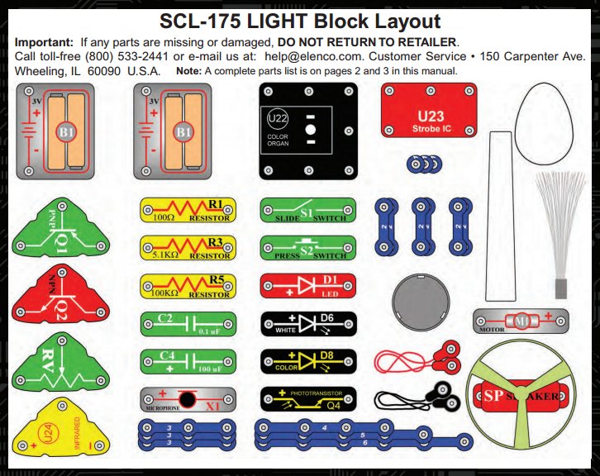
零件收存配置圖 SC-175 Snap Circuits® Block Layout

Slide 5
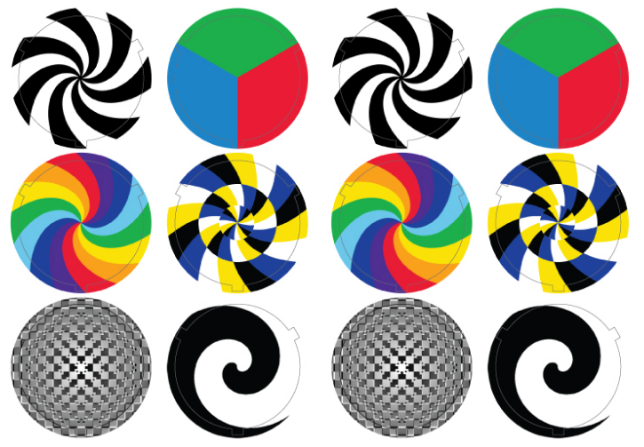
配件圖 SC-175 Snap Circuits® Color Discs

Slide 6
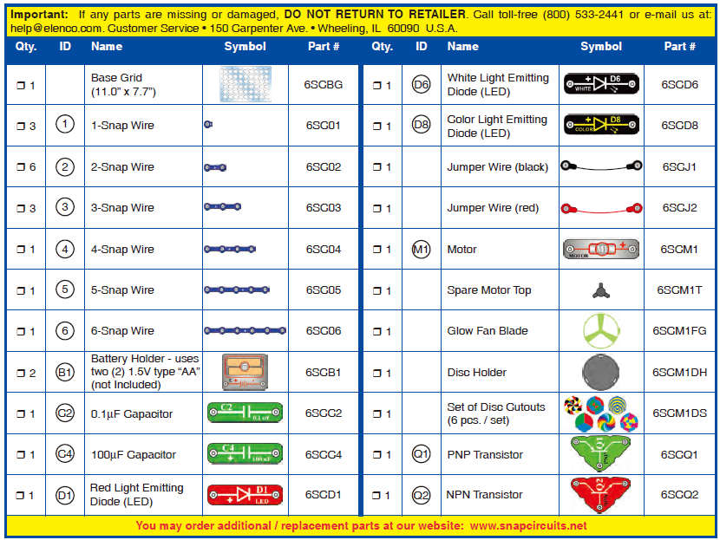
SC-175 電子元件清單：元件符號＆零件編號

Slide 7
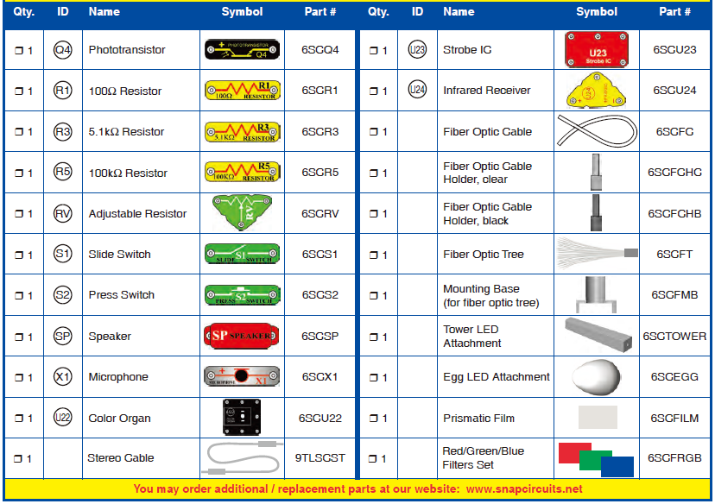
SC-175 電子元件清單：元件符號＆零件編號

Slide 8
警告事項 Warning
WARNING for all projects with a symbol- Moving parts.
(1) Do not touch the motor or fan during operation! (2) Do not lean over the motor. (3) Do not launch the fan at people, animals, or objects. (4) Eye protection is recommended.
警告：對於任何會移動或轉動之馬達和風扇元件(器件)的警告
當在操作過程中，請切勿觸摸！
請勿俯身於這些會轉動的元件上方。
不要對著人，動物或物體發射風扇。
強烈建議注意對眼睛的保護。
2. WARNING: SHOCK HAZARD - Never connect Snap Circuits® to the electrical outlets in your home in any way!
警告：電擊危險 –無論如何切勿將Snap Circuits®
連接到市電的電源插座上。
3. WARNING: CHOKING HAZARD - Small parts. Not for children under 3 years. 警告：窒息危險 –留心小於3歲以下的兒童吞食元件。

Slide 9
基本故障排除(Basic Troubleshooting)-1
1. 大多數出現問題的電路都是由於不正確的電路組裝，在啟動主要的電源開關之前，一定要先仔細檢查你的電路是否完全符合講義中所示的電路圖。
2. 確保標有正/負電極符號的元件如電路圖所示方向正確連接。
3. 確保所有元件和線路均已牢固地組裝於格子基板上。
在確定電路組裝完全正確的情況下，電路仍未能正常工作的話，請先嘗試更換電池。因有可能是電池電能(電力)不足了。
1. Most circuit problems are due to incorrect assembly, always double-check that your circuit exactly matches the drawing for it.
2. Be sure that parts with positive/negative markings are positioned as per the drawing.
3. Be sure that all connections are securely snapped.
4. Try replacing the batteries.

Slide 10
基本故障排除(Basic Troubleshooting)-2
5. 當馬達帶動風扇旋轉不順或不均衡時，請檢查風扇中心底部的卡榫槽是否準確地扣在馬達軸承上黑色小塑料軸的三個插腳間。如果黑色塑料軸已毀損，請更換之；套件中附有一個備品。可用螺絲起子撬破其中一腳，然後將之推出馬達的軸承，再更換一個新品。
若光纖電路無法正常工作，請先確認LED和光電晶體是否分別正確地插入透明與黑色的光纜固定夾(clear & black cable holders)內。並盡可能地將光纜推入固定夾內，且接近固定夾處的光纜最好能自然地直立於夾座的上方。
ELENCO®原廠不負責任何因不正確連接所導致之元件損壞的賠償或更換。
注意：若懷疑有元件損壞，可以按照使用手冊第15頁「進一步故障排除」步驟，以檢測哪些元件需要更換。
5. If the motor spins but does not balance the fan, check the black plastic piece with three prongs on the motor shaft, and replace it if it is damaged (this kit includes a spare). To replace, pry the broken one off the motor shaft using a screwdriver, then push the new one on.
6. If a fiber optics circuit isn’t working, make sure the clear & black cable holders are pushed all the way onto the LED/phototransistor, and the fiber optic cable is pushed into the holders as far as it will go. The cable should be standing straight up in the holders.
.Note: ELENCO® is not responsible for parts damaged due to incorrect wiring. If you suspect you have damaged parts, you can follow the Advanced Troubleshooting procedure on page 15 to determine which ones need replacing.

Slide 11
其他注意事項
警告WARNING：
啟動電路之前，務必檢查電路的接線正確無誤。已安裝了電池的電路，切勿將之置於無人看管的狀態況。
Always check your wiring before turning on a circuit. Never leave a circuit unattended while the batteries are installed.
2. 切勿連接額外的電池或其他電源到電路上中。Never connect additional batteries or any other power sources to your circuits.
3. 放棄任何破裂或損壞的元件。Discard any cracked or broken parts.
成人指導監護：因兒童的能力差異度很大，即使同年齡群的孩子，成年人應該協助為兒童選擇合適且安全的實驗(本手冊應使大人監督，建立實驗是否適合孩子)。確保你的孩子閱讀並遵循所有相關的指示和安全程序，並讓該手冊隨時置於手邊供參考。
Adult Supervision: Because children’s abilities vary so much, even with age groups, adults should exercise discretion as to which experiments are suitable and safe (the instructions should enable supervising adults to establish the experiment’s suitability for the child). Make sure your child reads and follows all of the relevant instructions and safety procedures, and keeps them at hand for reference.

Slide 12
This product is intended for use by adults and children who have attained sufficient maturity to read and follow directions and warnings.
Never modify your parts, as doing so may disable important safety features in them, and could put your child at risk of injury.
小心：對閃光或會快速變色或變化圖案之光源很敏感的人在使用此教具時要特別小心。
CAUTION: Persons who are extremely sensitive to flashing lights and rapidly changing colors or patterns should exercise caution when playing with this toy.
小心：不要直視產生白光的LED (D6)
CAUTION: High intensity light. Do not look directly at white LED (D6).

Slide 13
電池 Batteries注意事項
Use only 1.5V AAA type, alkaline batteries . 使用1.5V的3號鹼性電池
Insert batteries with correct polarity. 正確地連接電池的極性
Non-rechargeable batteries should not be recharged. 非可充電性電池不可充電
Rechargeable batteries should only be charged under adult supervision, and should not be recharged while in the product. 充電電池充電時需在成人的指導下進行，使用電路時不可進行充電。
Do not mix old and new batteries.新舊電池不宜混搭使用
Do not connect batteries or battery holders in parallel. 不要並聯電池和電池盒。
Do not mix alkaline, standard (carbon-zinc), or rechargeable (nickel-cadmium) batteries. 不能將鹼性電池、碳鋅電池和鎘鎳充電電池混用
Remove batteries when they are used up. 電池能量用盡後，務必將之從電池盒中取出。
Do not short circuit the battery terminals. 電池的兩電極不可短路連接。
Never throw batteries in a fire or attempt to open its outer casing. 切勿將電池置於火中或試著打開電池的外層殼裝。
Batteries are harmful if swallowed, so keep away from small children.吞食電池會受傷，故需使之遠離幼童。

Slide 24
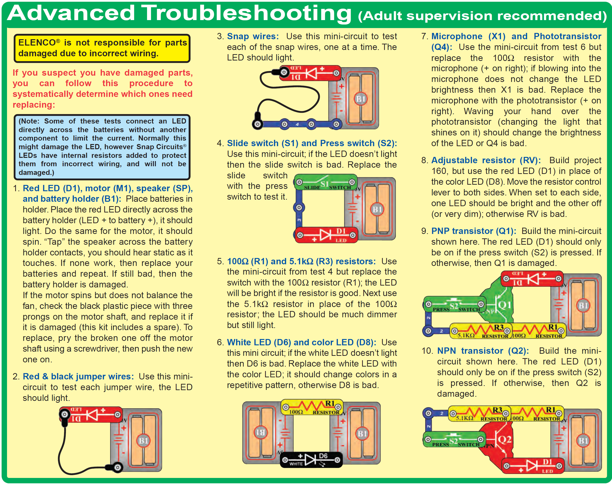

Slide 26
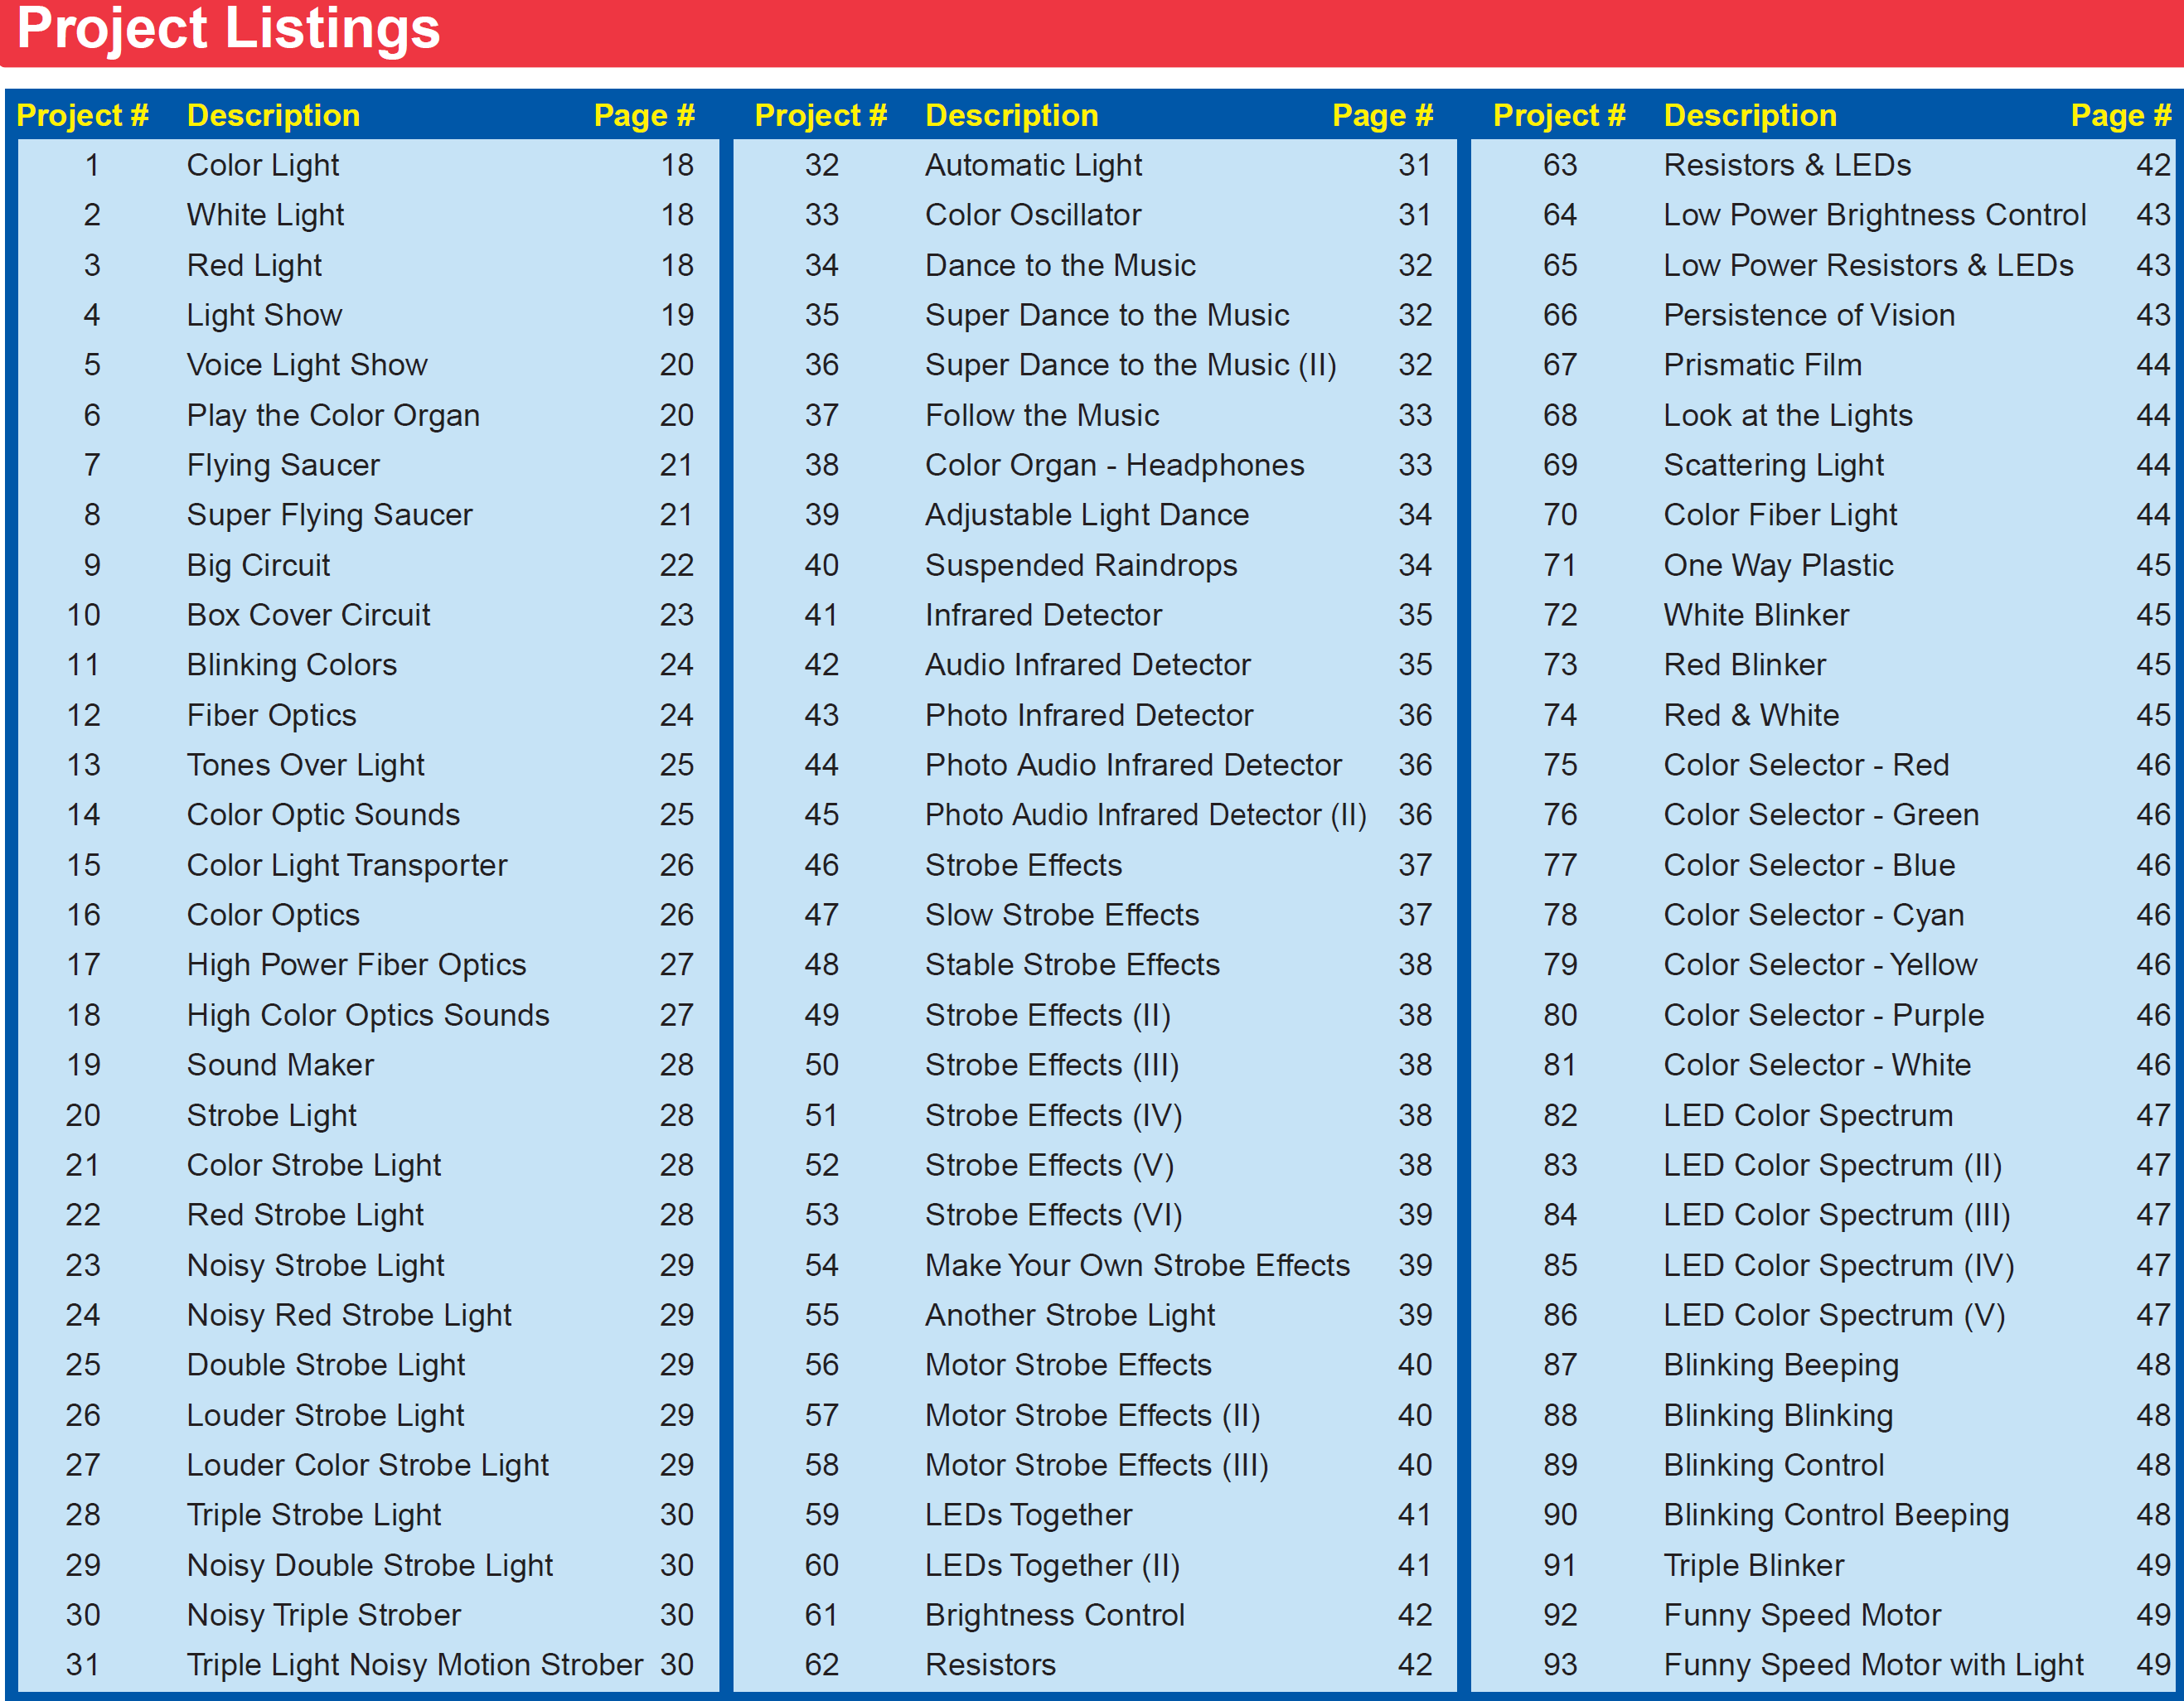

Slide 27
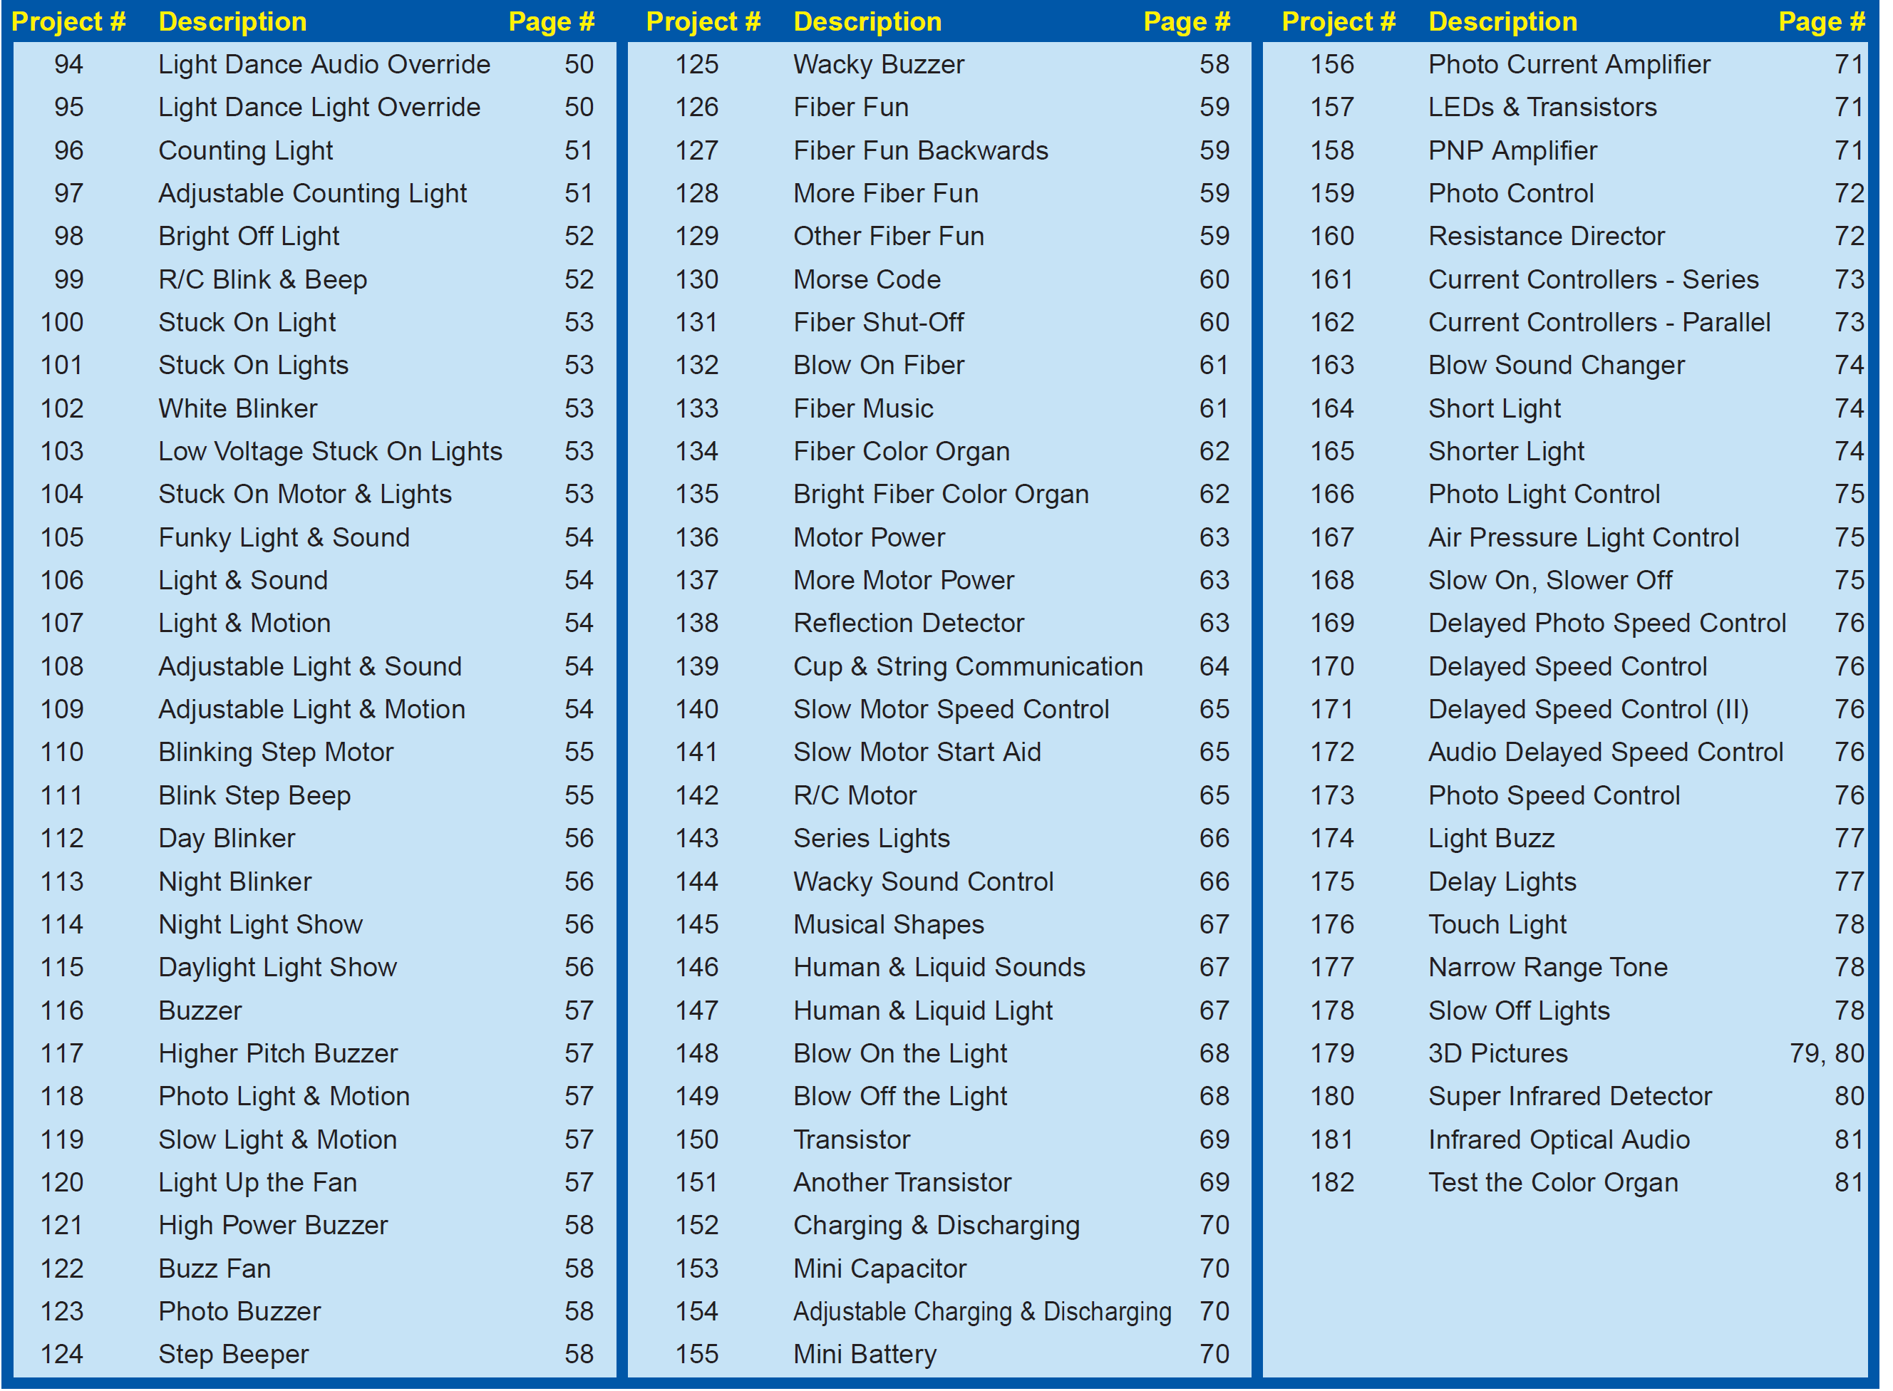

Slide 28
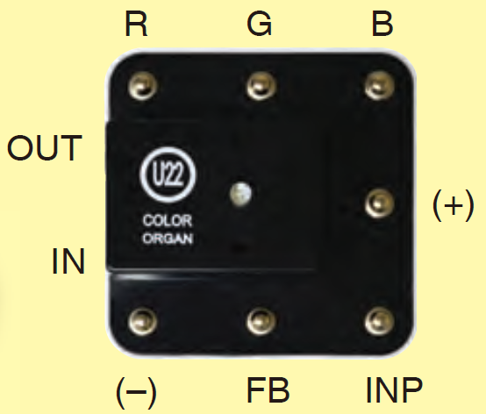
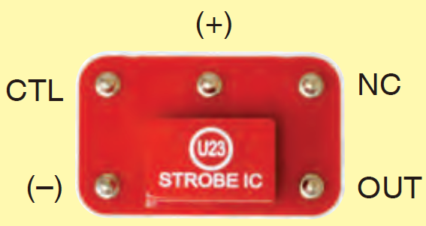
積體電路套件 U22、U23各接點用途
Connections:
R - red color control
G - green color control
B - blue color control
(+) - power from batteries
INP - circuit input
FB - feedback connection
(–) - power return to batteries
IN - audio input jack
OUT - audio output jack
Connections:
(+) - power from batteries
(–) - power return to batteries
OUT - output connection
CTL - strobe speed control
NC - not used

Slide 29
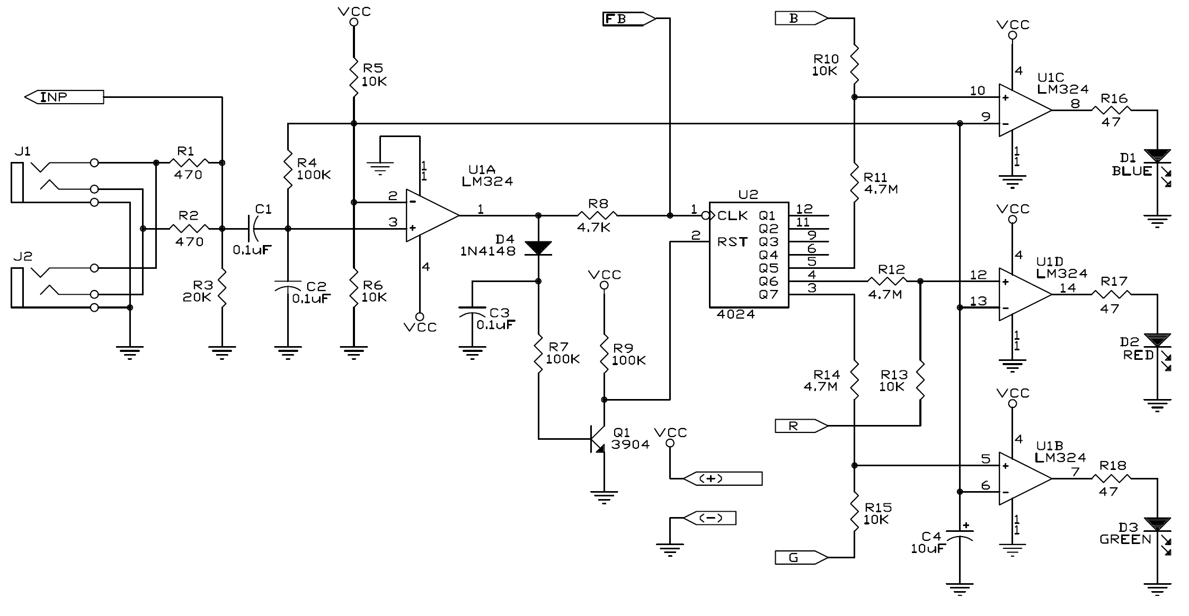
色光控制器(Color Organ) U22
此控制模組實際的電路如圖所示，外盒中心含一顆全彩LED和IC積體電路。
可直接控制 R, G, B或經由輸入外來的音頻信號控制 LED的光源顏色。
各接點功用 Connections:
R - red color control
G - green color control
B - blue color control
(+) - power from batteries
INP - circuit input
FB - feedback connection
(–) - power return to batteries
IN - audio input jack
OUT - audio output jack
U22 模組內部電路圖
僅SCL-175套件內含有此組件
Notes:
色光控制器(Color Organ) U22
The color organ module (only in SCL-175) contains resistors, capacitors, transistors, a tri-color LED, and integrated circuits.
The LED in it can change colors by direct control, or in synch with an audio input signal. Its actual schematic is complex and looks like this:

Slide 30
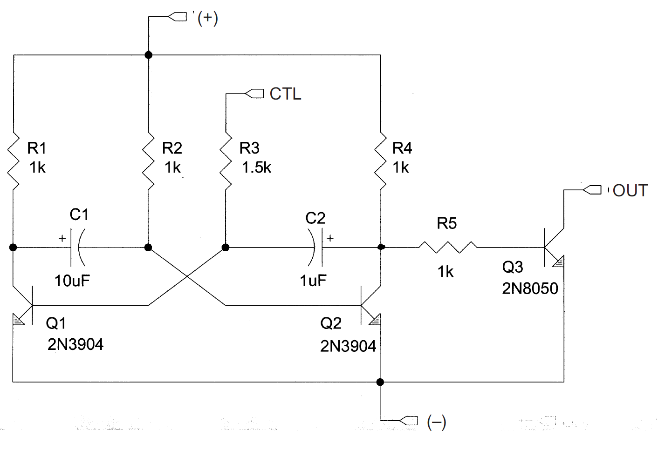
閃頻IC (Strobe IC)
僅Snap circuit SLC-175 套件內含有此組件，主要用以製造LED光源閃爍所需的閃頻電路。
Connections:
(+) - power from batteries
(–) - power return to batteries
OUT - output connection
CTL - strobe speed control
NC - not used
Notes:
閃頻IC (Strobe IC):
The strobe IC module (only in SCL-175) contains
resistors, capacitors, and transistors that
are needed to make a strobe light circuit. Its
schematic looks like this:

Slide 31
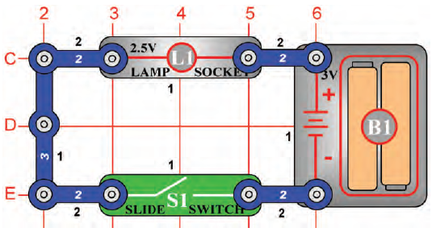
操作 說明
A. 白色數字 1, 2, 3
- 表snap wire 上的鈕釦數
2 為有 2 鈕釦點的藍色連接導線
3 為有3個鈕釦點的連接導線
B. 黑色數字1, 2, 3：代表層別.
1 為平面結構第一層
2 為平面結構第二層
(建議先將第一層結構的元件安裝於板子上後，再進行第二層結構的建置。)

Slide 32
~ THE END ~

